Slide 1
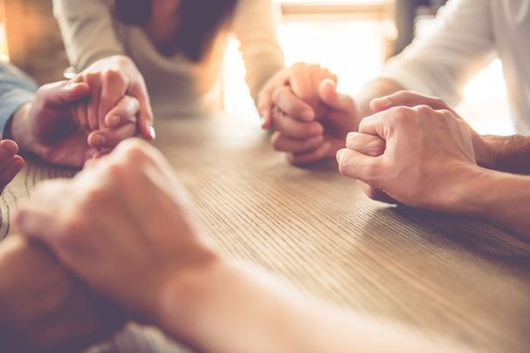
Friendship
Seven Ways to Grow
Authentic Relationships

Slide 2
1. Friends pray for each other.

Slide 3
3 John 1-2
The elder to the beloved Gaius, whom I love in truth. Beloved, I pray that all may go well with you and that you may be in good health, as it goes well with your soul.

Slide 4
2. Friends rejoice in truth.

Slide 5
3 John 3-4
For I rejoiced greatly when the brothers came and testified to your truth, as indeed you are walking in the truth. I have no greater joy than to hear that my children are walking in the truth.

Slide 6
3. Friends serve each other.

Slide 7
3 John 5-6
Beloved, it is a faithful thing you do in all your efforts for these brothers, strangers as they are, who testified to your love before the church. You will do well to send them on their journey in a manner worthy of God.

Slide 8
4. Friends accept second place.

Slide 9
3 John 9-10
I have written the church, but Diotrephes, who likes to put himself first, does not acknowledge our authority… And not content with that, he refuses to welcome the brothers, and also stops those who want to and puts them out of the church.

Slide 10
5. Friends are obedient to God.

Slide 11
3 John 11-12
Beloved, do not imitate evil but imitate good. Whoever does good is from God; whoever does evil has not seen God. Demetrius has received a good testimony from everyone and from the truth itself. We also add our testimony, and you know that our testimony is true.

Slide 12
6. Friends prefer to see each other face to face.

Slide 13
3 John 13-14
I had much to write to you, but I would rather not write with pen and ink. I hope to see you soon, and we will talk face to face.

Slide 14
7. Friends greet each other.

Slide 15
3 John 15
Peace be to you. The friends greet you. Greet the friends, every one of them.

