Slide 1
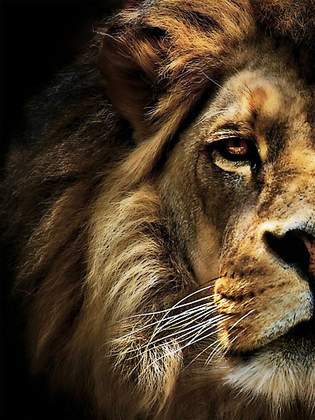
The Book of Daniel

Slide 2
“And your house and your kingdom shall be made sure forever before me. Your throne shall be established forever.” 2 Samuel 7:16
931 BC
722 BC
Northern Kingdom:
ISRAEL
586 BC
597 BC
Saul
David
Solomon
605 BC
Southern Kingdom:
JUDAH

Slide 3
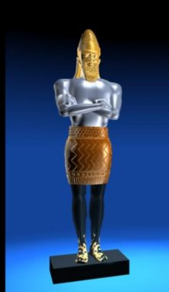
1 2 3 4 5 6 7 8 9 10 11 12
The Book of Daniel
Four empires will rise & fall before the everlasting kingdom.
2
3
4
5
6
7
God rescues & exalts those who are faithful.
Babylonian
Medo-Persian
Grecian
Roman
Aramaic
God humbles the proud.
Fiery Furnace
Lion’s Den
Nebuchad-nezzar
Belshazzar
2
3
4
5
6
7

Slide 4
Outline of Daniel
1 – Intro
2 – Four Empires
3 – Fiery Furnace
4 – Beast
5 – Fall of Bbln
6 – Lions’ Den
7 – Four Empires
8 – Medo-Persia & Greek Empires
9 – 70 Yrs & Weeks
10-12 – Jewish Destiny in Latter Days

Slide 5
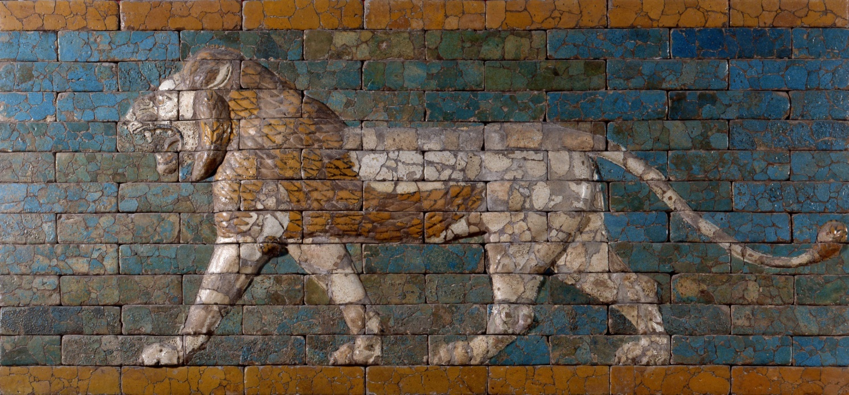
Daniel’s Confession

Slide 6
Daniel 9:5
“…we have sinned and done wrong and acted wickedly and rebelled, turning aside from your commandments and rules.”

Slide 7
Daniel 9:6
“We have not listened to your servants the prophets, who spoke in your name…”

Slide 8
Daniel 9:7
“To you, O Lord, belongs righteousness, but to us open shame… because of the treachery they have committed against you.”

Slide 9
Daniel 9:8
“To us, O LORD, belongs open shame… because we have sinned against you.”

Slide 10
Daniel 9:9-10
“…we have rebelled against him and have not obeyed the voice of the LORD our God by walking in his laws, which he set before us by his servants the prophets.”

Slide 11
Daniel 9:11
“All Israel has transgressed your law and turned aside, refusing to obey your voice.”

Slide 12
Daniel 9:11
“And the curse and oath… have been poured out upon us, because we have sinned against him.”

Slide 13
Daniel 9:13
“…we have not entreated the favor of the LORD our God, turning from our iniquities and gaining insight by your truth.”

Slide 14
Daniel 9:14, 15, 16
“…we have not obeyed his voice.”
“…we have sinned, we have done wickedly.”
“…because of our sins, and for the iniquities of our fathers…”

Slide 15
Daniel Justifies God

Slide 16
Daniel 9:4, 5
“O Lord, the great and awesome God, who keeps covenant and steadfast love with those who love him and keep his commandments…”
“We have not listened to your servants the prophets…”

Slide 17
Daniel 9:7, 9
“To you, O Lord, belongs righteousness”
“To the Lord our God belong mercy and forgiveness”

Slide 18
Daniel 9:12, 14
“He has confirmed his words, which he spoke against us…”
“…for the LORD our God is righteous in all the works he has done…”

Slide 19
Daniel’s Plea

Slide 20
Daniel 9:16
“O Lord, according to all your righteous acts, let your anger and your wrath turn away…”

Slide 21
Daniel 9:17
“Now therefore, O our God, listen to the prayer of your servant and to his pleas for mercy, and for your own sake, O Lord, make your face to shine upon your sanctuary…”

Slide 22
Daniel 9:18
“For we do not present our pleas before you because of our righteousness, but because of your great mercy.”

