Slide 2
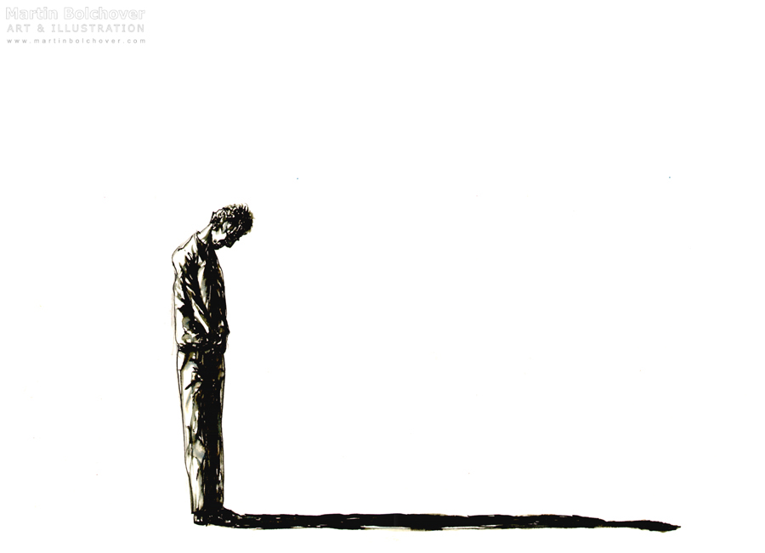
The human condition.

Slide 3
Romans 2:14-15
For when Gentiles, who do not have the law, by nature do what the law requires, they are a law to themselves, even though they do not have the law. They show that the work of the law is written on their hearts, while their conscience also bears witness, and their conflicting thoughts accuse or even excuse them…

Slide 4
God’s remedy.

Slide 5
Hebrews 9:22
…without the shedding of blood there is no forgiveness of sins.

Slide 6
John 1:29
“Behold, the Lamb of God, who takes away the sin of the world!”

Slide 7
Hebrews 9:14
…how much more will the blood of Christ, who through the eternal Spirit offered himself without blemish to God, purify our conscience from dead works to serve the living God.

Slide 8
Luke 19:8
And Zacchaeus stood and said to the Lord, “Behold, Lord, the half of my goods I give to the poor. And if I have defrauded anyone of anything, I restore it fourfold.”

Slide 9
Isaiah 38:17
…in love you have delivered my life
from the pit of destruction,
for you have cast all my sins
behind your back.

Slide 10
Jeremiah 31:34
“For I will forgive their iniquity, and I will remember their sin no more.”

Slide 11
Micah 7:19
He will again have compassion on us;
he will tread our iniquities underfoot.
You will cast all our sins
into the depths of the sea.

Slide 12
Isaiah 43:25
“I, I am he
who blots out your transgressions for my own sake,
and I will not remember your sins.”

Slide 13
Psalm 103:12
…as far as the east is from the west,
so far does he remove our transgressions from us.

Slide 14
The necessity of confession.

Slide 15
1 John 1:8-9
If we say we have no sin, we deceive ourselves, and the truth is not in us. If we confess our sins, he is faithful and just to forgive us our sins and to cleanse us from all unrighteousness.

Slide 16
Psalm 32:3-4
For when I kept silent, my bones wasted away through my groaning all day long. For day and night your hand was heavy upon me; my strength was dried up as by the heat of summer.

Slide 17
Psalm 32:5
I acknowledged my sin to you, and I did not cover my inquiry; I said, “I will confess my transgressions to the LORD,” and you forgave the iniquity of my sin.”

Slide 18
“I can’t forgive myself.”

Slide 19
Hebrews 9:14
…how much more will the blood of Christ, who through the eternal Spirit offered himself without blemish to God, purify our conscience from dead works to serve the living God.

Slide 20
1 John 1:9
If we confess our sins, he is faithful and just to forgive us our sins and to cleanse us from all unrighteousness.

