Slide 1
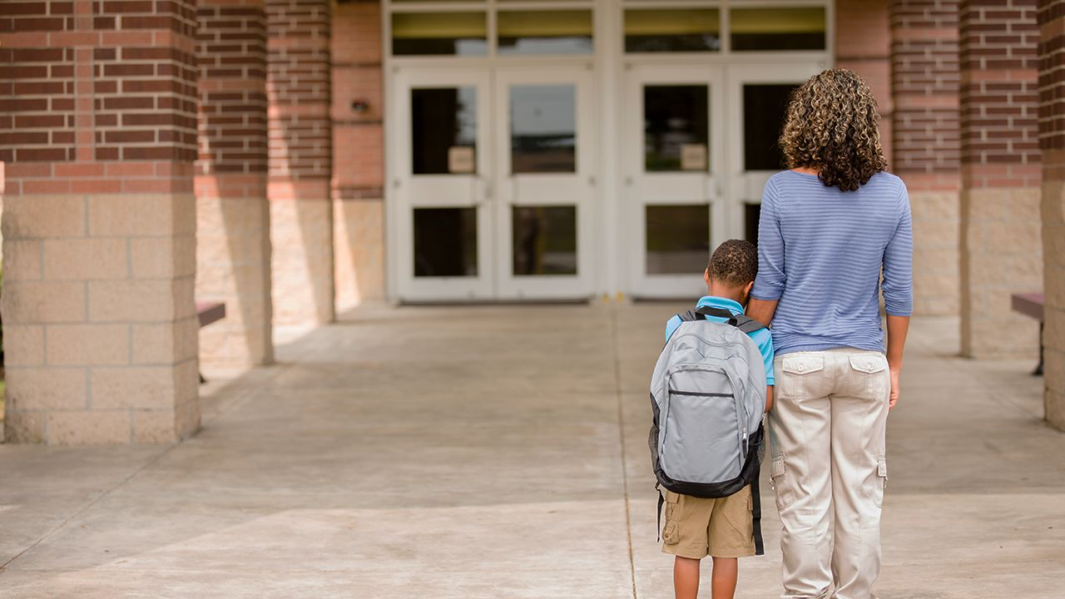
Fear Not

Slide 2
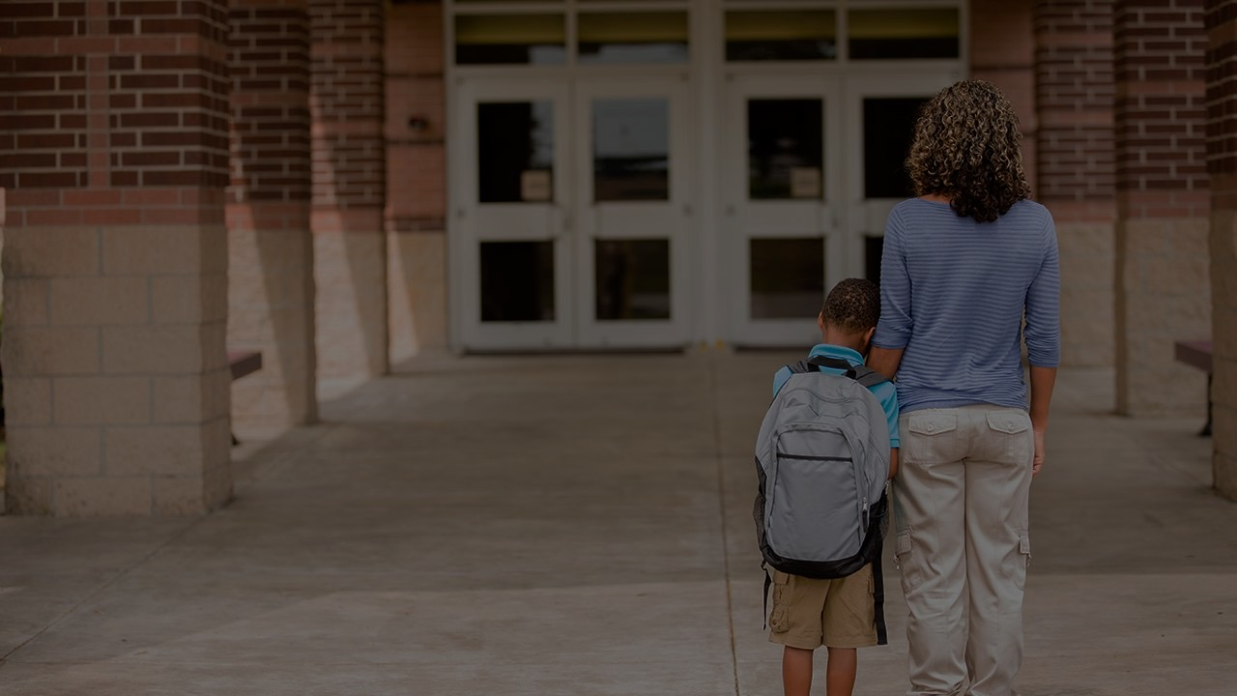
Model complete surrender.

Slide 3
Joshua 14:8
“But my brothers who went up with me made the heart of the people melt; yet I wholly followed the LORD my God.”

Slide 4
Point out the fruit.

Slide 5
Numbers 13:23
And they came to the Valley of Eschol and cut down from there a branch with a single cluster of grapes, and they carried it on a pole between two of them; they also brought some pomegranates and figs.

Slide 6
Be decisive about obedience.

Slide 7
Numbers 13:30
But Caleb quieted the people before Moses and said, “Let us go up at once and occupy it, for we are well able to overcome it.”

Slide 8
Forget the past.

Slide 9
Numbers 14:2
The whole congregation said to them, “Would that we had died in the land of Egypt! Or would that we had died in this wilderness!”

Slide 10
Be honest about the difficulties.

Slide 11
Numbers 14:7-8
“The land, which we passed through to spy it out, is an exceedingly good land. If the LORD delights in us, he will bring us into this land and give it to us, a land that flows with milk and honey.”

Slide 12
Do not tolerate grumbling.

Slide 13
Numbers 14:9
“Only do not rebel against the LORD.”

Slide 14
Call attention to the Lord.

Slide 15
Numbers 14:9
“And do not fear the people of the land, for they are bread for us. Their protection is removed from them, and the LORD is with us; do not fear them.”

Slide 16
Schedule one on one time.
Daily verses (Isa 41:13; Jas 4:7).
Keep a prayer journal.
Plan weekly devotions.
Sing.
Bring your kids to everything.
Text God’s promises.
Pray.

Slide 17
