Slide 1
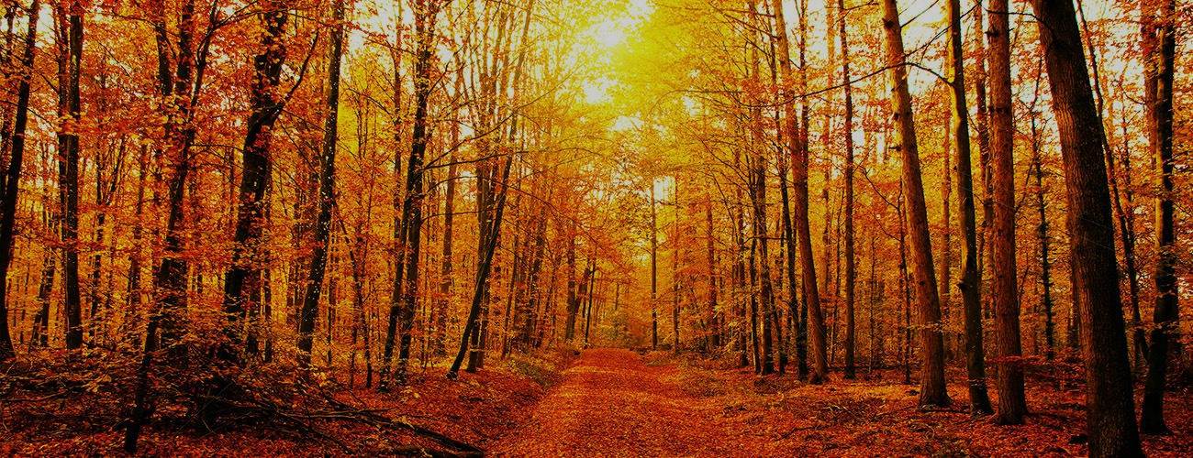
Welcome to Northwood!

Slide 2
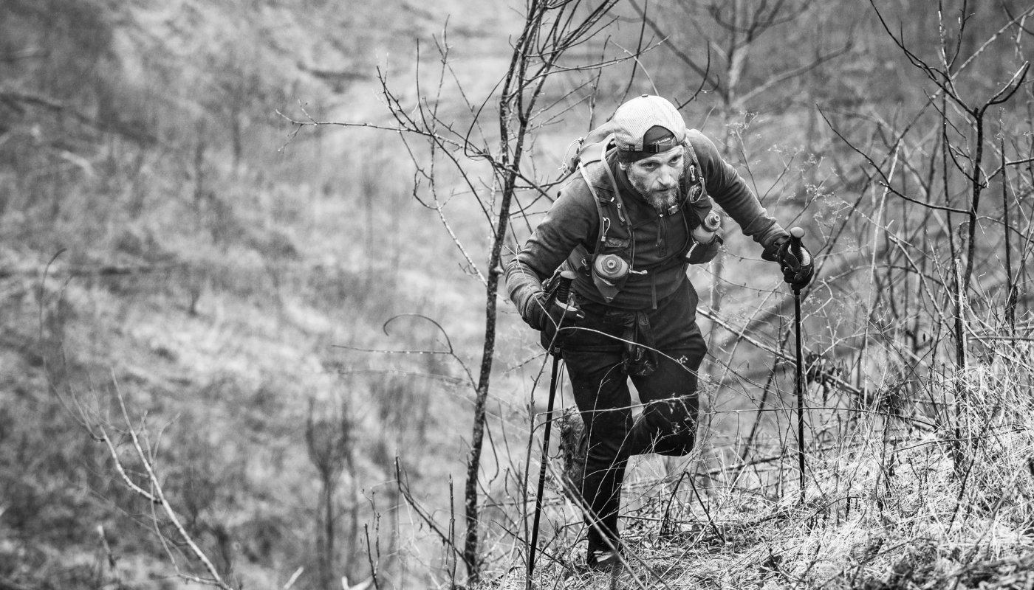

Slide 3
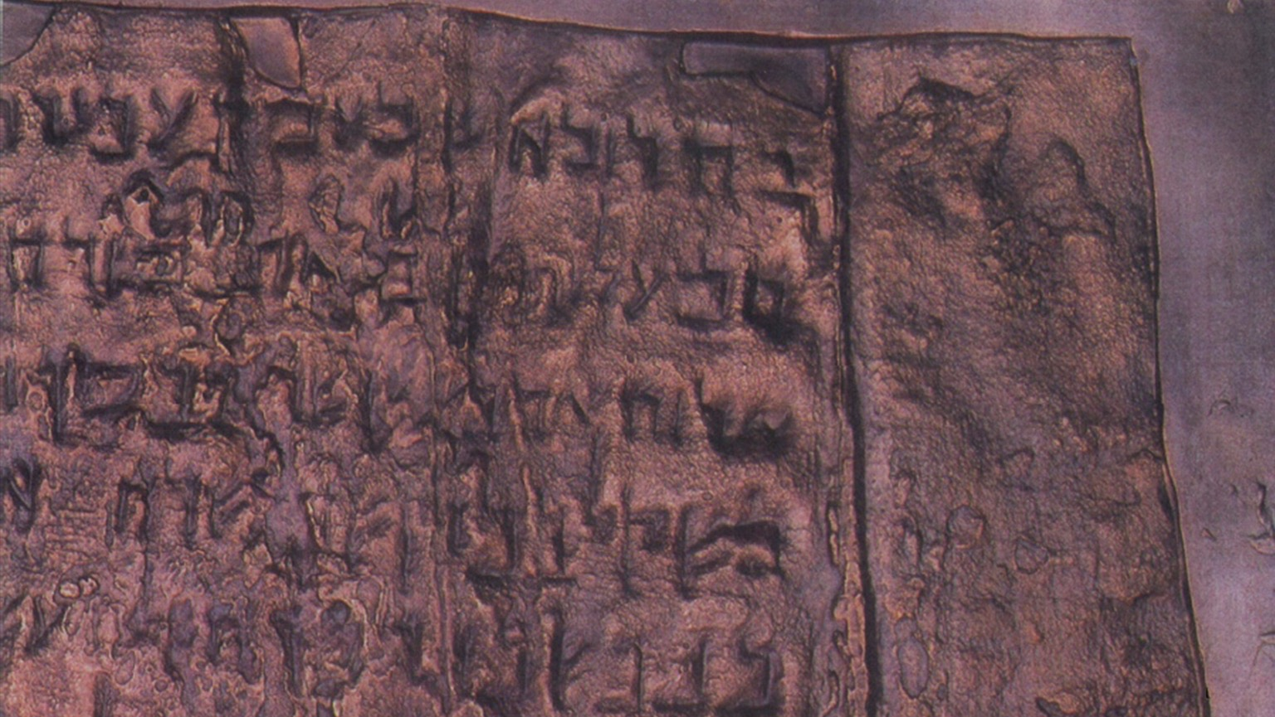
TREASURE
HIDDEN

Slide 4
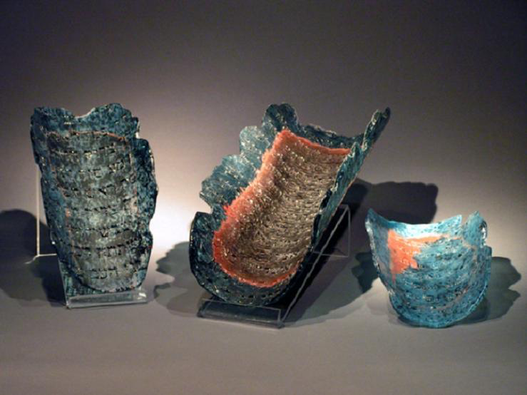

Slide 5
“The kingdom of heaven is like treasure hidden in a field, which a man found and covered up. Then in his joy he goes and sells all that he has and buys that field.”
Matthew 13:44

Slide 6
“Beware of men, for they will deliver you over to courts and flog you in their synagogues, and you will be dragged before governors and kings for my sake…”
Matthew 10:17-18

Slide 7
“Brother will deliver brother over to death, and the father his child, and children will rise against parents and have them put to death, and you will be hated by all for my name’s sake.”
Matthew 10:21-22

Slide 8
“Do not think that I have come to bring peace to the earth. I have not come to bring peace, but a sword. For I have come to set a man against his father, and a daughter against her mother, and a daughter-in-law against her mother-in-law.”
Matthew 13:34-35

Slide 9
“Enter by the narrow gate. For the gate is wide and the way is easy that leads to destruction, and those who enter it are many. For the gate is narrow and the way is hard that leads to life, and those who find it are few.”
Matthew 7:13-14

Slide 10
“The kingdom of heaven is like treasure hidden in a field, which a man found and covered up. Then in his joy he goes and sells all that he has and buys that field.”
Matthew 13:44

Slide 11
“Do not lay up for yourselves treasures on earth, where moth and rust destroy and where thieves break in and steal, but lay up for yourselves treasures in heaven, where neither moth nor rust destroys and where thieves do not break in and steal.”
Matthew 6:19-20

Slide 12
“And your Father who sees in secret will reward you.”
Matthew 6:4, 6, 18

Slide 13
“they shall be comforted”
“they shall inherit the earth”
“they shall be satisfied”
“they shall receive mercy”
“they shall see God”
“they shall be called sons of God”
Matthew 5:4-9

Slide 14
“As for what was sown on good soil, this is the one who hears the word and understands it. He indeed bears fruit and yields, in one case a hundredfold, in another sixty, and in another thirty.”
Matthew 13:23

Slide 15
“It is the smallest of all seeds, but when it has grown it is larger than all the garden plants and becomes a tree, so that the birds of the air come and make nests in its branches.”
Matthew 13:32

Slide 16
“So everyone who acknowledges me before men, I also will acknowledge before my Father who is in heaven…”
Matthew 10:32

Slide 17
“Well done, good and faithful servant. You have been faithful over a little; I will set you over much. Enter into the joy of your master.”
Matthew 25:21

Slide 18
“Then the righteous will shine like the sun in the kingdom of their Father.”
Matthew 13:43

