Slide 1
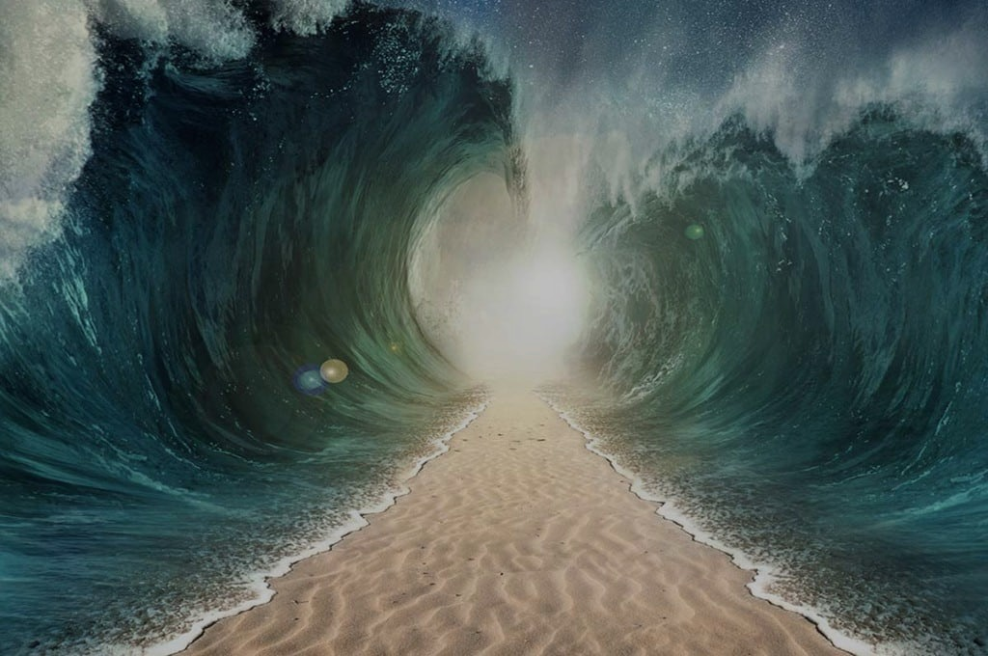
HEROES
OF THE FAITH

Slide 2
Feb 2 – Abel
Feb 9 – Enoch
Feb 16 – Noah
Feb 23 – Abraham
Mar 1 – Sarah
Mar 8 – Isaac
Mar 15 – Jacob
Mar 22 – Joseph
Apr 5 – Moses
Apr 12 – Rahab
Apr 19 – The Others

Slide 3
Noah
Saving Faith

Slide 4
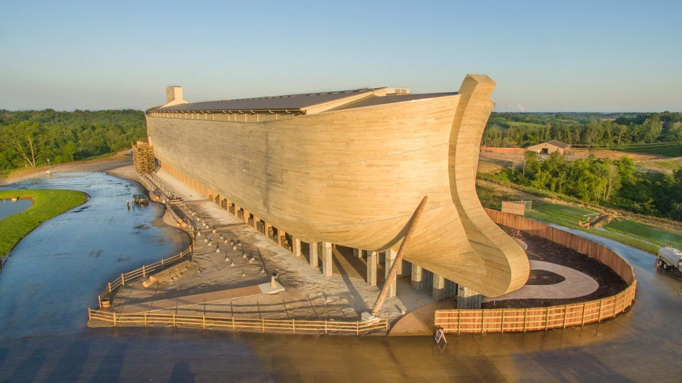

Slide 5
Hebrews 11:7
By faith Noah, being warned by God concerning events as yet unseen, in reverent fear constructed an ark for the saving of his household.

Slide 6
Now faith is the assurance of things hoped for, the conviction of things not seen.
Hebrews 11:1

Slide 7
By faith we understand that the universe was created by the word of God, so that what is seen was not made out of things that are visible.
Hebrews 11:3

Slide 8
Just as it was in the days of Noah, so will it be in the days of the Son of Man. They were eating and drinking and marrying and being given in marriage, until the day Noah entered the ark, and the flood came and destroyed them all.
Luke 17:26-27

Slide 9
Hebrews 11:7
By faith Noah, being warned by God concerning events as yet unseen, in reverent fear constructed an ark for the saving of his household.

Slide 10
The LORD saw that the wickedness of man was great in the earth, and that every intention of the thoughts of his heart was only evil continually.
Romans 10:17

Slide 11
Noah was a righteous man, blameless in his generation. Noah walked with God. And Noah had three sons, Shem, Ham, and Japheth.
Genesis 6:9-10

Slide 12
Noah did this; he did all that God commanded him.
Genesis 6:22

Slide 13
Then the LORD said to Noah, “Go into the ark, you and all your household, for I have seen that you are righteous before me in this generation.”
Genesis 7:1

Slide 14
On the very same day Noah and his sons, Shem and Ham and Japheth, and Noah’s wife and the three wives of his sons with them entered the ark…
Genesis 7:13

Slide 15
Hebrews 11:7
By this he condemned the world and became an heir of the righteousness that comes by faith.

Slide 16
Noah found favor in the eyes of the LORD.
Genesis 6:8

Slide 17
…for all have sinned and fall short of the glory of God, and are justified by his grace as a gift, through the redemption that is in Christ Jesus, whom God put forward as a propitiation by his blood, to be received by faith.
Romans 3:23-25

Slide 18
David also speaks of the blessing of the one to whom God counts righteousness apart from works: “Blessed are those whose lawless deeds are forgiven, and whose sins are covered; blessed is the man against whom the Lord will not count sin.”
Romans 4:6-8

Slide 19
By faith Abel offered to God a more acceptable sacrifice than Cain, through which he was commended as righteous.
Hebrews 11:4

Slide 20
Therefore let us be grateful for receiving a kingdom that cannot be shaken, and thus let us offer to God acceptable worship, with reverence and awe, for our God is a consuming fire.
Hebrews 12:28-29

Slide 21
Therefore let us be grateful for receiving a kingdom that cannot be shaken, and thus let us offer to God acceptable worship, with reverence and awe, for our God is a consuming fire.
Hebrews 12:28-29

Slide 22
Therefore, since we are surrounded by so great a cloud of witnesses, let us also lay aside every weight, and sin which clings so closely, and let us run with endurance the race that is set before us...
Hebrews 12:1

Slide 23
...looking to Jesus, the founder and perfecter of our faith, who for the joy that was set before him endured the cross, despising the shame, and is seated at the right hand of the throne of God.
Hebrews 12:2

Slide 24
Consider him who endured from sinners such hostility against himself, so that you may not grow weary or fainthearted. In your struggle against sin you have not yet resisted to the point of shedding your blood.
Hebrews 12:3-4

Slide 25
Are you offering acceptable worship?

Slide 26
Are you getting tired of doing the right thing?

