Slide 1
Welcome to Northwood!

Slide 2
SYNERGISM
“working together,” or cooperation between God’s grace and human willing and activity
MONERGISM
“one working,” or God’s grace as the effectual source of election, redemption, faith, and perseverance

Slide 3
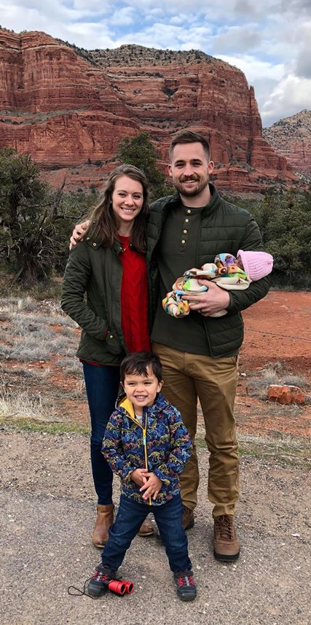
“Young children are fools,
not sinners.”
Joshua Carter

Slide 4
Parenting Books
“Your child is born sinful.”
“Sin is bound in the heart of your child.”
“Remember, it’s the sin inside them that messes everything up.”

Slide 5
Total Inherited Depravity
Behold, I was brought forth in iniquity, and in sin did my mother conceive me. Psalm 51:5
For I knew that you would surely deal treacherously, and that from before birth you were called a rebel. Isaiah 48:8
The wicked are estranged from the womb; they go astray from birth, speaking lies. Psalm 58:3

Slide 6
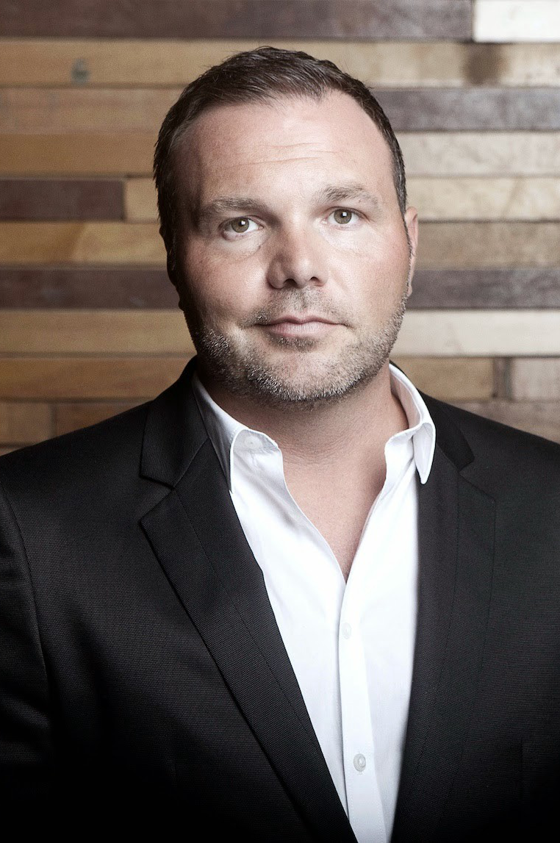
“…completely disobeying her dad. She’s exercising her free will. She’s unregenerate at that point… and her unregenerate will was disobedience…

Slide 7
“And as she ran I preached to her repentance…
‘Ashley, stop!’
‘Ashley, stop!’
‘Come back to your daddy!’

Slide 8
“And I looked and she was approaching the intersection.
And I’m preaching to her and I’m pursuing her.

Slide 9
“And parked right in front of our house is a parked car. And she’s so little she’s running in front of the parked car... And so any oncoming car will not see her coming.

Slide 10
“She will be in the line of traffic before they see her. My little girl is going to die.

Slide 11
“Now I have revealed my heart… I love her… I’ve presented this free invitation to repent… I’ve called her back to myself… And she is exercising her unregenerate will.

Slide 12
“And so I exercise my loving father desire and I pursue her… I call to her and I’m pursuing her…

Slide 13
“And I grabbed her, literally, by the back of her little coat… And I yanked her, literally, right out of the way of the oncoming truck… It, seriously, was inches that she was missed by a truck going 40 mph…

Slide 14
“My daughter barely lived…
THAT is election…

Slide 15
“Where the Father in love pursues obstinate, disobedient children who have chosen death. And He decrees that more important than their will is His love.”
(Mark Driscoll)

Slide 16
What Happens to Infants
Who Die?
“…according to Paul, the fact that all die physically (even those who, like infants, did not have the opportunity to knowingly transgress a law of God-Romans 5:13-14) is a demonstration that we are connected with the guilt of Adam’s sin.

Slide 17
What Happens to Infants
Who Die?
“These verses make it very unlikely that all infants who
die are lost.

Slide 18
What Happens to Infants
Who Die?
“If we are all born under sin, and salvation is by faith in Christ (which infants do not seem to have the mental capacity to exercise), then it might at first seem that no infants can be saved. We are not, however, aware of anyone who actually takes this position.

Slide 19
What Happens to Infants
Who Die?
“…some have held that God saves some infants who die and not others. They point that this seems most consistent with the doctrines of election and original sin.”
(Matt Perman, desiringgod.org)

Slide 20
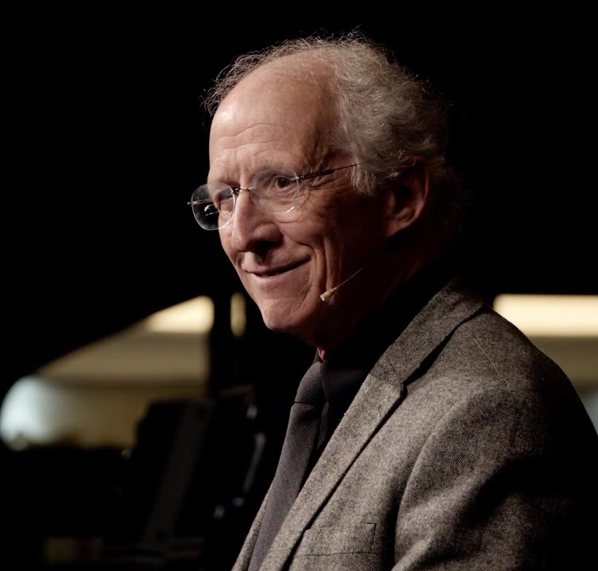
“Jesus says in John 9:41 to those who were offended at his teaching and asked if he thought they were blind—he said, “If you were blind, you would not have had sin; but since you say, ‘We see,’ your sin remains.”

Slide 21
“In other words, if a person lacks the natural capacity to see the revelation of God’s will or God’s glory then that person’s sin would not remain—God would not bring the person into final judgment for not believing what he had no natural capacity to see.

Slide 22
“The point for us is that even though we human beings are under the penalty of everlasting judgment and death because of the fall of our race into sin and the sinful nature that we all have, nevertheless God only executes judgment on those who have the natural capacity to see his glory and understand his will…

Slide 23
“Infants, I believe, do not yet have that capacity; and therefore, in God’s inscrutable way, he brings them under the forgiving blood of his Son.”
(John Piper)

Slide 24
SAVED or DEPRAVED from Birth?
Behold, I was brought forth in iniquity, and in sin did my mother conceive me.
Psalm 51:5
Yet you are he who took me from the womb;
you made me trust you at my mother’s breasts.
On you was I cast from
my birth, and from
my mother’s womb you have been my God.
Psalm 22:9-10

Slide 25
“Brothers, do not be children in your thinking. Be infants in evil, but in your thinking be mature.”
1 Corinthians 14:20

Slide 26
“Unless you turn and become like children, you will never enter the kingdom of heaven. Whoever humbles himself like this child is the greatest in the kingdom of heaven.”
Matthew 18:3-4

Slide 27
For apart from the law, sin lies dead. I was once alive apart from the law, but when the commandment came, sin came alive and I died.
Romans 7:8-9

Slide 28
Therefore, just as sin came into the world through one man, and death through sin, and so death spread to all men because all sinned…
Romans 7:12

Slide 29
Foolishness is bound up in the heart of a child, but the rod of discipline drives it far from him.
Proverbs 22:15

Slide 30
“Foolishness is a very different problem than sinfulness! The reason why your little bundle of joy has become a raging hurricane of terror sometimes is not because he is consciously rebelling against God and his righteousness. It’s because he is acting impulsively in ways that seem reasonable to him, but he doesn’t yet understand the foolishness of his actions.”

Slide 31
“And so, while we have young children, our job as parents is to impart wisdom through training and discipline.”
(Joshua Carter, via facebook)

Slide 32
Driving Out Foolishness
The rod and reproof give wisdom, but a child left to himself brings shame to his mother. Proverbs 29:15
Whoever spares the rod hates his son, but he who loves him is diligent to discipline him. Proverbs 13:24
For the moment all discipline seems painful rather than pleasant, but later it yields the peaceful fruit of righteousness to those who have been trained by it. Hebrews 12:11

