Slide 1
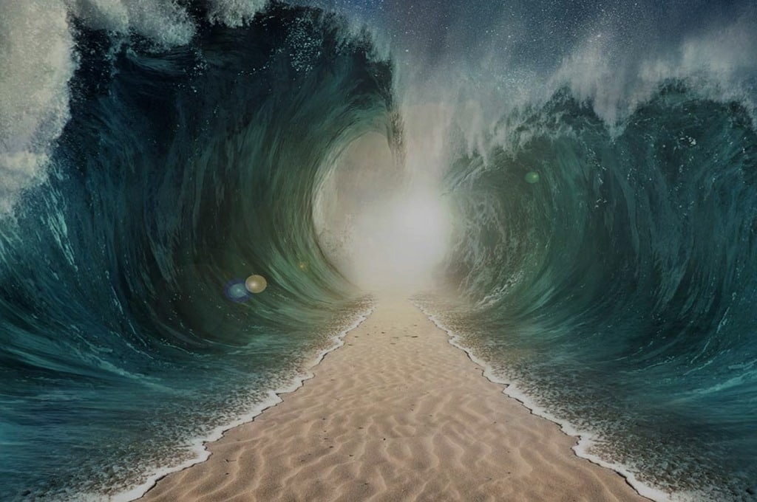
HEROES
OF THE FAITH

Slide 2
Feb 2 – Abel
Feb 9 – Enoch
Feb 16 – Noah
Feb 23 – Abraham
Mar 1 – Sarah
Mar 8 – Isaac
Apr 5 – Jacob
Apr 12 – Joseph
Apr 19 – Moses
Apr 26 – Rahab
May 3 – The Others

Slide 3
Jacob
Faith of the Dying

Slide 4
Hebrews 11:21
By faith Jacob, when dying…

Slide 5
“I am the LORD, the God of Abraham your father and the God of Isaac. The land on which you lie I will give to you and to your offspring.”
Genesis 28:13

Slide 6
“‘I am the God of Bethel, where you anointed a pillar and made a vow to me. Now arise, go out from this land and return to the land of your kindred.’”
Genesis 31:13

Slide 7
“But you said, ‘I will surely do you good, and make your offspring as the sand of the sea, which cannot be numbered for multitude.’”
Genesis 32:12

Slide 8
And he said to him, “What is your name?” And he said, “Jacob.” Then he said, “Your name shall no longer be called Jacob, but Israel, for you have striven with God and with men, and have prevailed.”
Genesis 32:27-28

Slide 9
Hebrews 11:21
By faith Jacob, when dying, blessed each of the sons of Joseph, bowing in worship over the head of his staff.

Slide 10
“It is my son’s robe. A fierce animal has devoured him. Joseph is without doubt torn to pieces.” Then Jacob tore his garments and put sackcloth on his loins and mourned for his son many days. All his sons and all his daughter rose up to comfort him, but he refused to be comforted and said, “No, I shall go down to Sheol to my son, mourning.” Thus his father wept for him.
Genesis 37:33-35

Slide 11
So ten of Joseph’s brothers went down to buy grain in Egypt. But Jacob did not send Benjamin, Joseph’s brother, with his brothers, for he feared that harm might happen to him.
Genesis 42:3-4

Slide 12
“You have bereaved me of my children: Joseph is no more, and Simeon is no more, and now you would take Benjamin. All this has come against me.”
Genesis 42:36

Slide 13
“Take also your brother, and arise, go again to the man. May God Almighty grant you mercy before the man, and may he send back your other brother and Benjamin. And as for me, if I am bereaved of my children, I am bereaved.”
Genesis 43:13-14

Slide 14
“The days of the years of my sojourning are 130 years. Few and evil have been the days of the years of my life, and they have not attained to the days of the years of the life of my fathers in the days of their sojourning.”
Genesis 47:9

Slide 15
After this, Joseph was told, “Behold, your father is ill.” so he took with him his two sons, Manasseh and Ephraim. And it was told to Jacob, “Your son Joseph has come to you.” Then Israel summoned his strength and sat up in bed.”
Genesis 48:1-2

Slide 16
And Jacob said to Joseph, “God Almighty appeared to me at Luz in the land of Canaan and blessed me, and said to me, ‘Behold, I will make you fruitful and multiply you, and I will make of you a company of peoples and will give this land to your offspring after you for an everlasting possession.’

Slide 17
And now your two sons, who were born to you in the land of Egypt before I came to you in Egypt, are mine; Ephraim and Manasseh shall be mine, as Reuben and Simeon are. And the children that you fathered after them shall be yours. They shall be called by the name of their brothers in their inheritance.”
Genesis 48:3-6

Slide 18
Now the eyes of Israel were dim with age, so that he could not see. So Joseph brought them near him, and he kissed them and embraced them. And Israel said to Joseph, “I never expected to see your face; and behold, God has let me see your offspring also.”
Genesis 48:10-11

Slide 19
And he blessed Joseph and said, “The God before whom my fathers Abraham and Isaac walked, the God who has been my shepherd all my life long to this day, the angel, who has redeemed me from all evil, bless the boys; and in them let my name be carried on, and the name of my fathers Abraham and Isaac; and let them grow into a multitude in the midst of the earth.”
Genesis 48:15-16

Slide 20
Never gave up.

Slide 21
Didn’t hold bitterness in his heart.

Slide 22
Willing to learn and grow late in life.

Slide 23
Looked forward and not backward.

