Slide 1
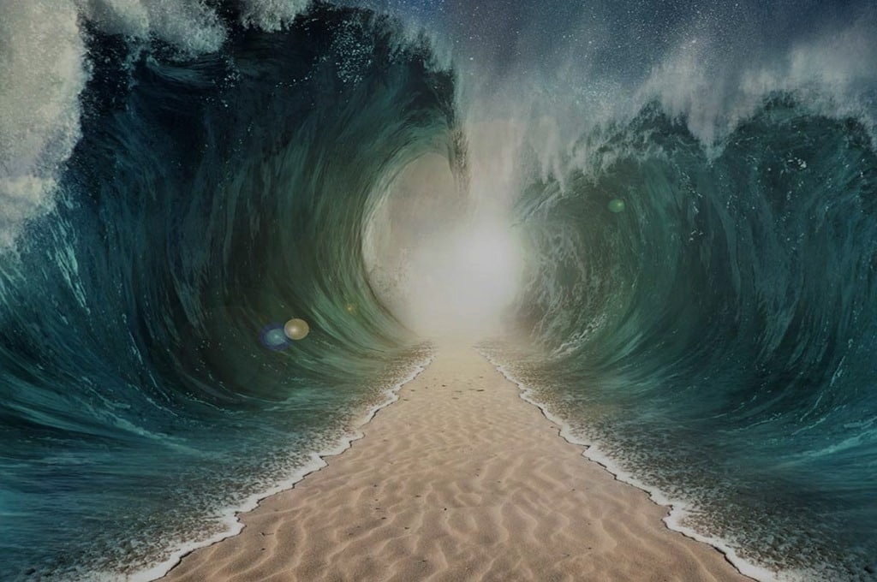
HEROES
OF THE FAITH

Slide 2
The Others
Faith to Finish

Slide 3
Hebrews 11:33-34
…who through faith conquered kingdoms, enforced justice, obtained promises, stopped the mouths of lions, quenched the power of fire, escaped the edge of the sword, were made strong out of weakness, became mighty in war, put foreign armies to flight.

Slide 4
“Go in this might of yours and save Israel from the hand of Midian; do not I send you?” And he said to him, “Please, Lord, how can I save Israel? Behold, my clan is the weakest in Manasseh, and I am the least in my father’s house.”
Judges 6:14-15

Slide 5
And the LORD said to him, “But I will be with you, and you shall strike the Midianites as one man.”
Judges 6:16

Slide 6
Hebrews 11:35-36
Some were tortured… Others suffered mocking and flogging, and even chains and imprisonment. They were stoned, they were sawn in two, they were killed with the sword.

Slide 7
But recall the former days when, after you were enlightened, you endured a hard struggle with sufferings, sometimes being publicly exposed to reproach and affliction, and sometimes being partners with those so treated.
Hebrews 10:32-33

Slide 8
Consider him who endured from sinners such hostility against himself, so that you may not grow weary or fainthearted. In your struggle against sin you have not yet resisted to the point of shedding your blood.
Hebrews 12:3-4

Slide 9
Hebrews 11:37-38
They went about in skins of sheep and goats, destitute, afflicted, mistreated—-of whom the world was not worthy—wandering about in deserts and mountains, and in dens and caves of the earth.

Slide 10
For God is not unjust so as to overlook your work and the love that you have shown for his name in serving the saints, as you still do.
Hebrews 6:10

Slide 11
Do not neglect to do good and to share what you have, for such sacrifices are pleasing to God.
Hebrews 13:16

Slide 12
Hebrews 11:35
Some were tortured, refusing to accept release, so that they might rise again to a better life.

Slide 13
For here we have not lasting city, but we seek the city that is to come.
Hebrews 13:14

Slide 14
Hebrews 12:1
Therefore, since we are surrounded by so great a cloud of witnesses, let us also lay aside every weight, and sin which clings so closely, and let us run with endurance the race that is set before us…

Slide 15
Hebrews 12:2
…looking to Jesus, the founder and perfecter of our faith, who for the joy that was set before him endured the cross, despising the shame, and is seated at the right hand of the throne of God.

Slide 16
Keep your life free from the love of money, and be content with what you have, for he has said, “I will never leave you nor forsake you.” So we can confidently say, “The Lord is my helper; I will not fear; what can man do to me?”
Hebrews 13:5-6

Slide 17
Why do you say, O Jacob,
and speak, O Israel,
“My way is hidden from the LORD,
and my right is disregarded by my God”?
Have you not known? Have you not heard?
The LORD is the everlasting God,
the Creator of the ends of the earth.
He does not faint or grow weary;
his understanding is unsearchable.

Slide 18
He gives power to the faint,
and to him who has no might he increases strength.
Even youths shall faint and be weary,
and young men shall fall exhausted;
but they who wait for the LORD shall renew their strength;
they shall mount up with wings like eagles;
they shall run and not be weary;
they shall walk and not faint.
Isaiah 40:27-31

