Slide 1
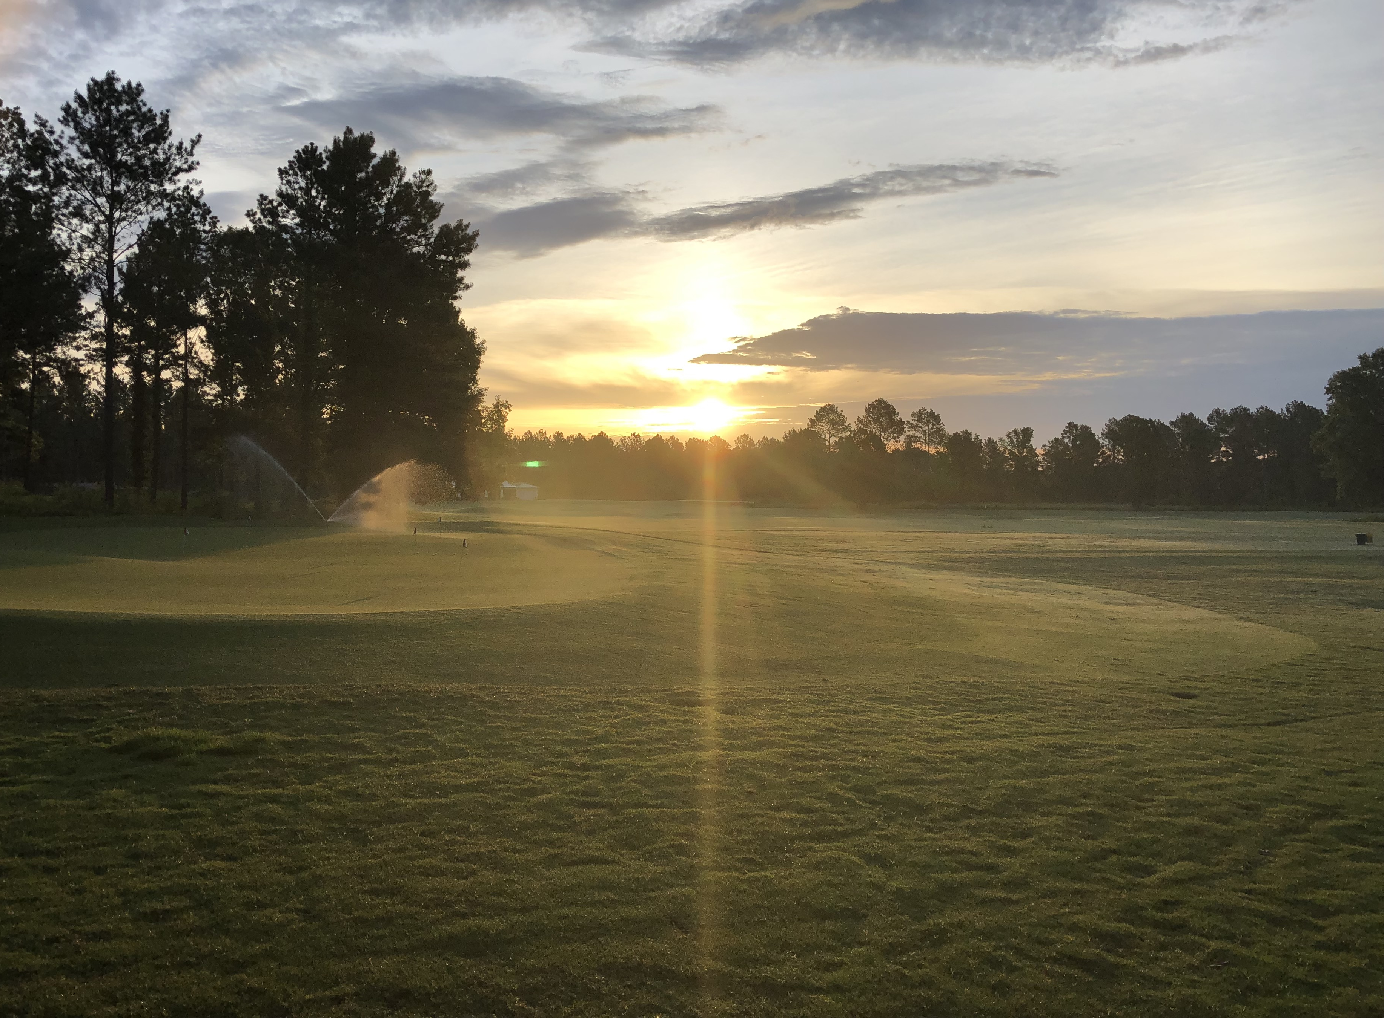
The Good Samaritan

Slide 2
“Teacher, what shall I do to inherit eternal life?”
Luke 10:25

Slide 3
But he, desiring to justify himself, said to Jesus, “And who is my neighbor?”
Luke 10:29

Slide 4
“But a Samaritan, as he journeyed, came to where he was, and when he saw him, he had compassion.”
Luke 10:33

Slide 5
“He went to him and bound up his wounds, pouring on oil and wine. Then he set him on his own animal and brought him to an inn and took care of him.”
Luke 10:34

Slide 6
“And the next day he took out two denarii and gave them to the innkeeper, saying, ‘Take care of him, and whatever more you spend, I will repay you when I come back.’”
Luke 10:35

Slide 7
This is no ordinary story
Love covers a multitude of sins
Actions speak louder than words
You love God by loving your neighbor
“Who is my neighbor?” is the wrong question
Do what you can, where you are
I am the helpless man

