Slide 2
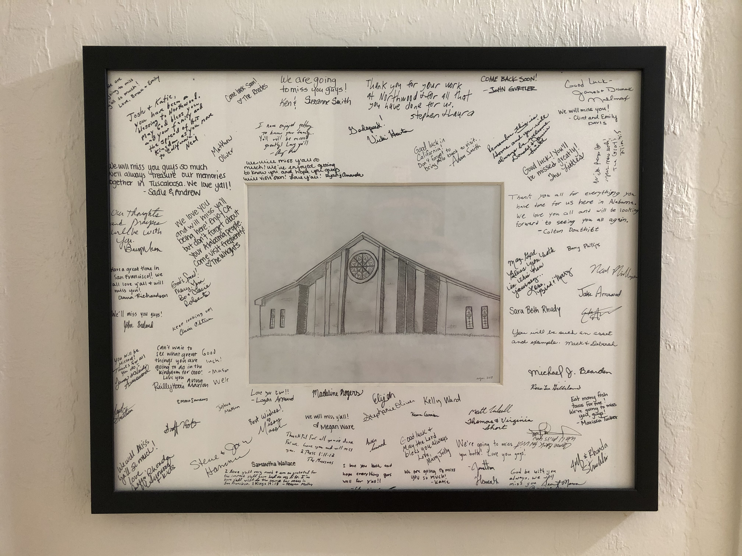

Slide 3
“Be Transformed By The Renewal Of Your Mind”
1. A Transformative Identity: A Holy Nation
2. A Transformative Event: The Resurrection
3. A Transformative Mindset: Joy
4. A Transformative Hope: Heaven

Slide 4
A Holy Nation
A Transformative Identity

Slide 5
They stumble because they disobey the word, as they were destined to do. But you are a chosen race, a royal priesthood, a holy nation, a people for his own possession, that you may proclaim the excellencies of him who called you out of darkness into his marvelous light. Once you were not a people, but now you are God’s people; once you had not received mercy, but now you have received mercy.
-1 Peter 2:8b-10

Slide 6
They stumble because they disobey the word, as they were destined to do. But you are a chosen race, a royal priesthood, a holy nation, a people for his own possession, that you may proclaim the excellencies of him who called you out of darkness into his marvelous light. Once you were not a people, but now you are God’s people; once you had not received mercy, but now you have received mercy.
-1 Peter 2:8b-10

Slide 7
“A”
Singular
Revelation 7:9, 10 (unity in diversity)
Galatians 3:26-29
Similarity more significant than differences
Primary identity

Slide 8
“Holy”
Isaiah 6:3
A communicable attribute of God?
“Be holy, for I am holy” (1 Peter 1:16).
“Be omnipotent, for I am omnipotent” (Nowhere 0:00).
“He disciplines us for our good, that we may share his holiness” (Heb. 12:10).
2 Peter 1:3, 4 (“escaped from the corruption”)
“God has not called us for impurity, but in holiness” (1 Thess. 4:7).

Slide 9
“nation”
Greek, éthnos
God “made from one man every nation of mankind to live on all the face of the earth” (Acts 17:26).
John 1:10; 8:23; 15:19; 18:36
The word of God is what makes us different from the world and similar to each other (John 17:14-19).
“You have been born again, no too perishable seed but of imperishable, through the living and abiding word of God” (1 Peter 1:23).
Hebrews 4:12 vs. Matthew 10:34-39

Slide 10
“A Holy Nation”
United, Transcendent, Uniform
“I do not ask for these only, but also for those who will believe in me through their word, that they may all be one, just as you, Father, are in me, and I in you, that they also may be in us, so that the world may believe that you sent me” (John 17:20, 21).

