Slide 1
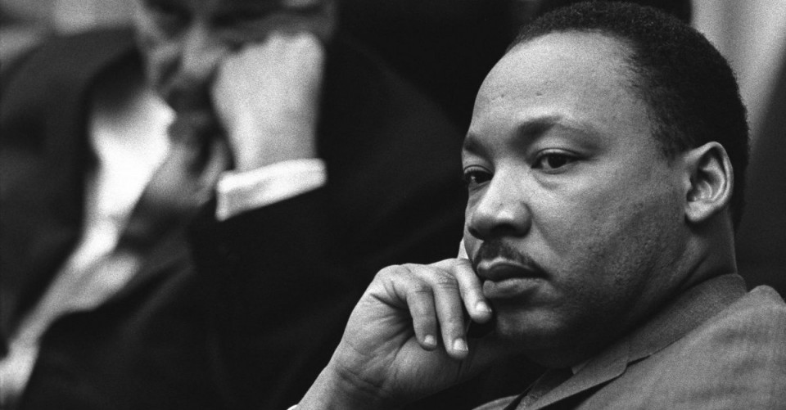

Slide 2
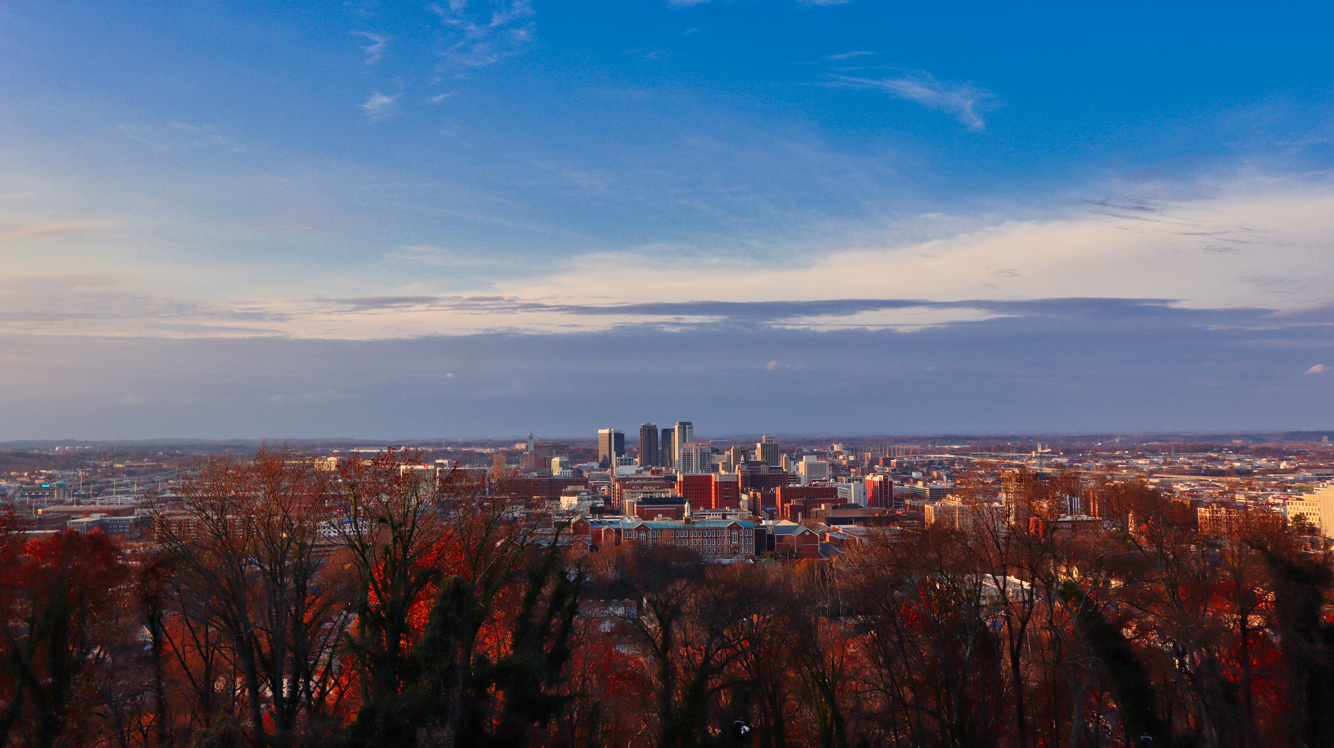
God is good, even when His people aren’t.
Isaiah 56.1-12

Slide 3
You need God’s mercy and forgiveness continually.
1st John 1.5-2.6

Slide 4
Our call is to serve:
Galatians 6.1-10
…in gentle correction.
Vs. 1
… with understanding of our flaws.
Vs. 2-5
… in humility.
Vs. 1-10

Slide 5
God is perfect. His followers are not.
You fall short and need His grace.
Serve others in humility and gentleness.

