Slide 1
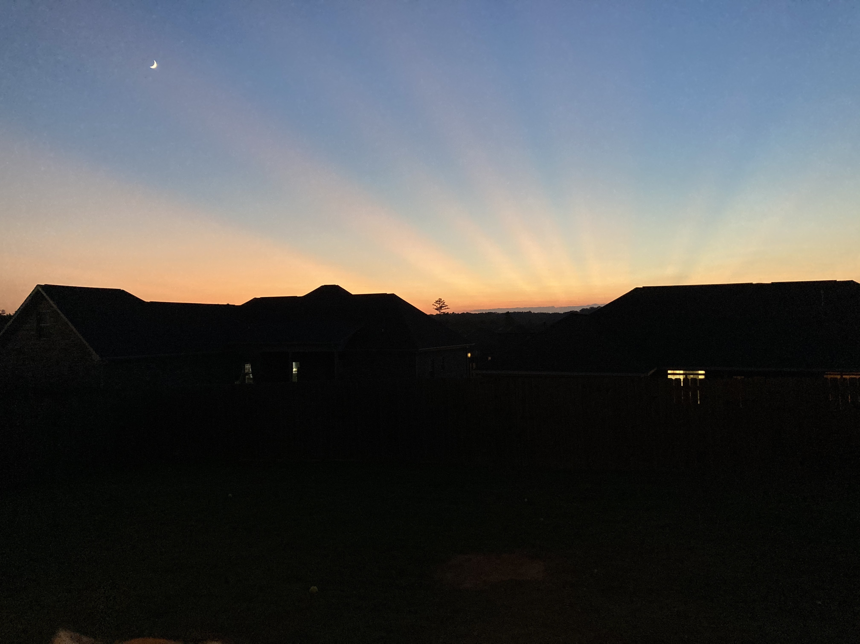
What Matters

Slide 2
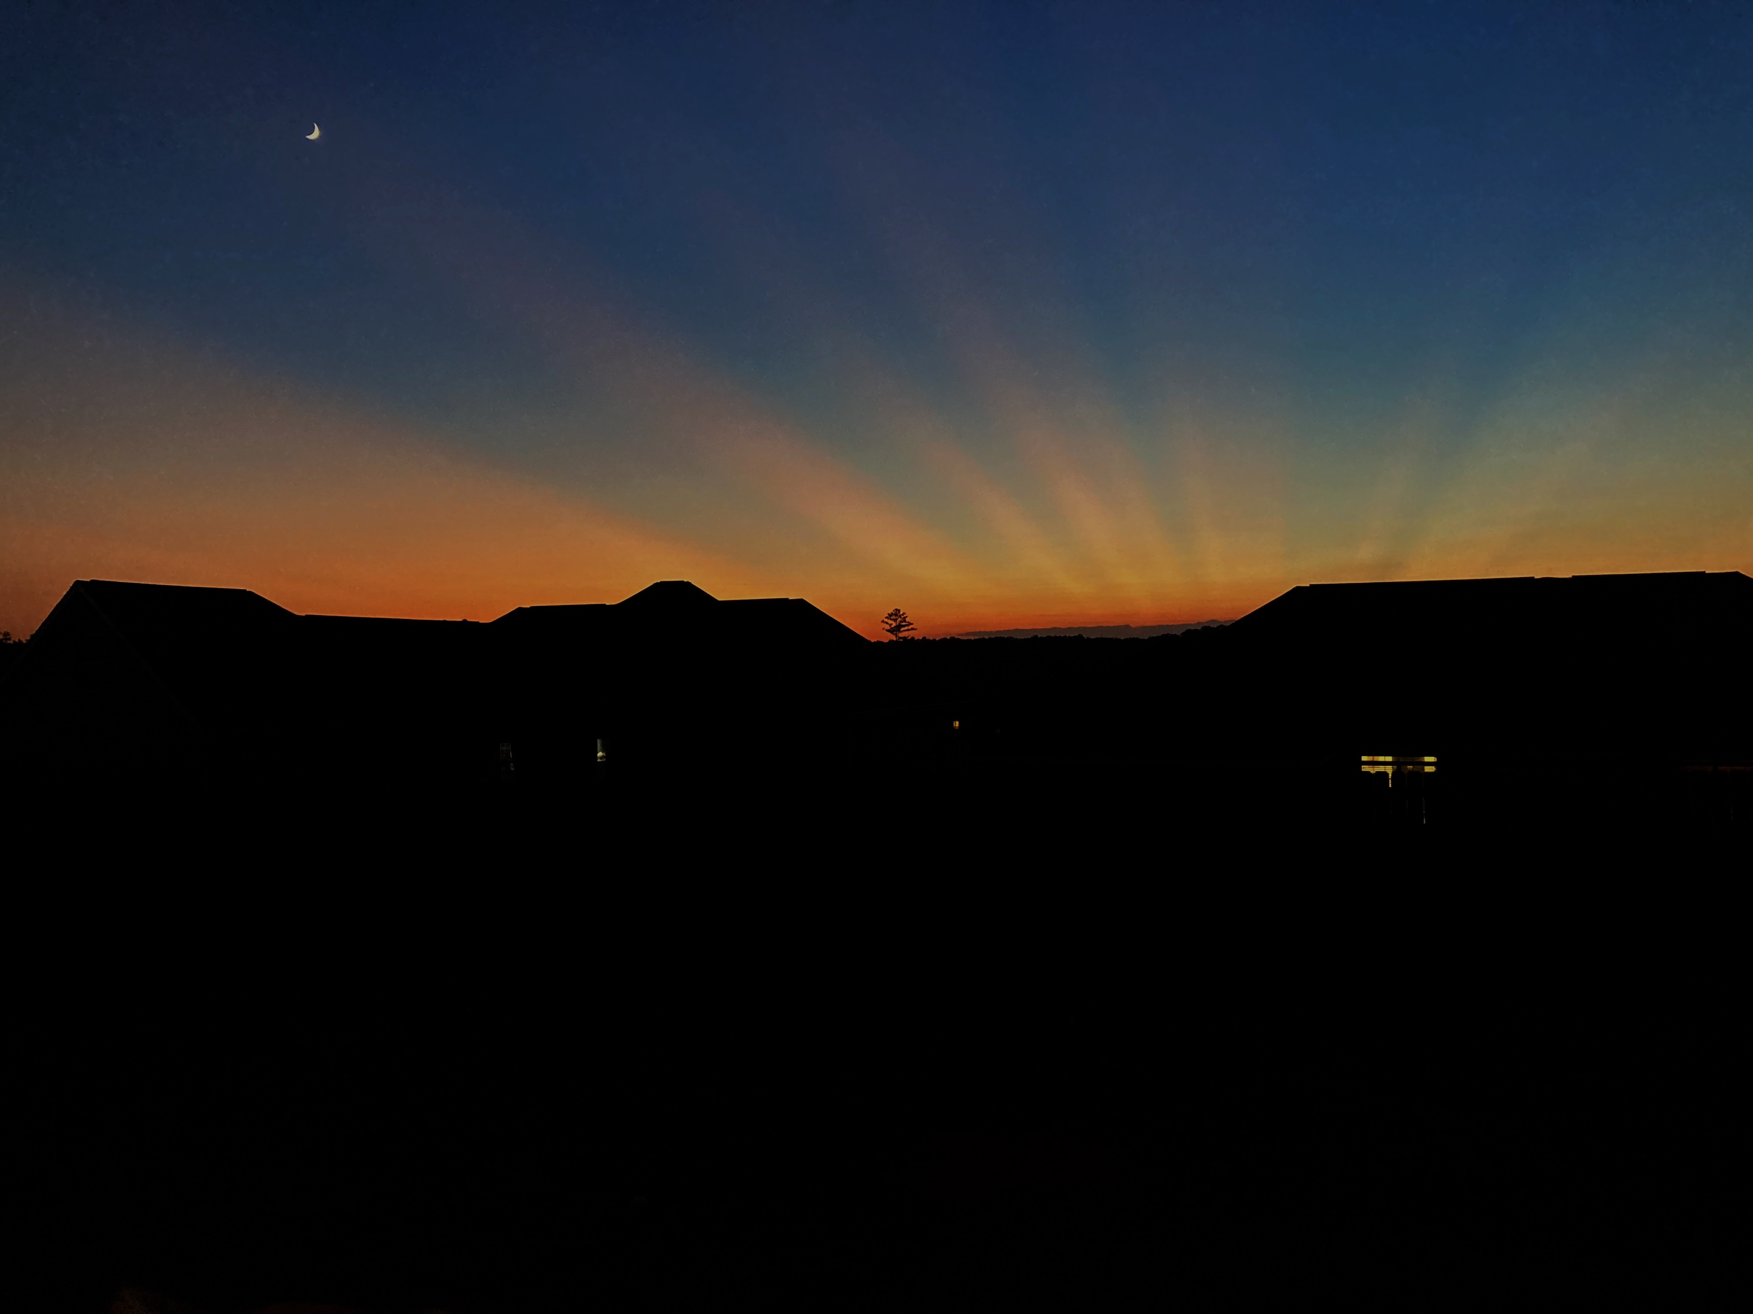
Not money
Not sex
Not food
Not ethnicity
Not freedom
Not marriage
Not circumstances
Not possessions

Slide 3
Keeping the commandments
Pleasing the Lord

Slide 4
We don’t envy those who have these things
We don’t feel superior around those who lack these things
We more easily accept the loss of these things
None of these things interfere with our service to God
Money
Sex
Food
Ethnicity
Freedom
Marriage
Circumstances
Possessions

