Slide 1
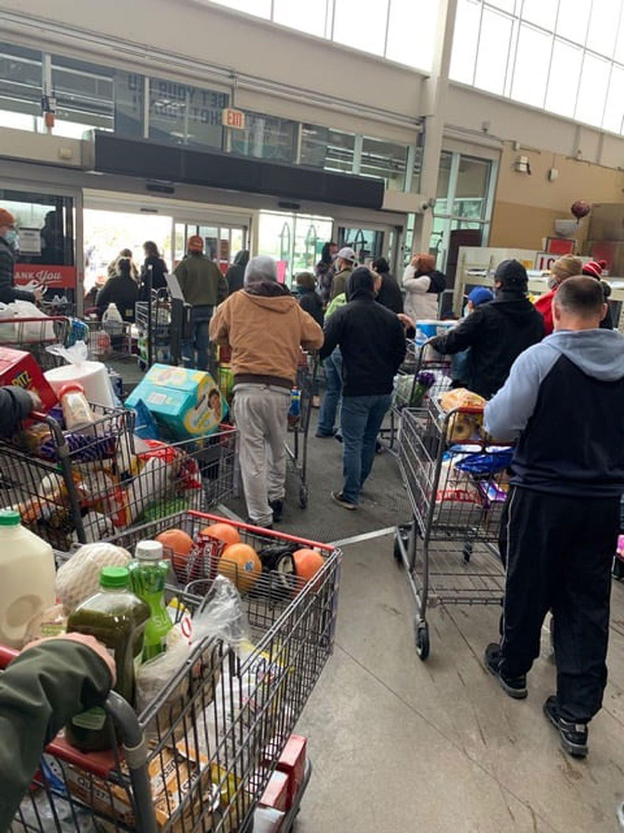

Slide 2
DEFIANT HOPE

Slide 3
THINGS ARE NOT AS THEY SHOULD BE

Slide 4
WE HAVE A HOPE OF SOMETHING BETTER

Slide 5
GOD’S STRENGTH > OUR WEAKNESS

Slide 6
DEFIANT HOPE

