Slide 2
Our Relationship with Ourselves.

Slide 3
Our Relationship with Ourselves.
I was lost… (Ephesians 2.1-3)
…but Jesus found me. (Ephesians 2.4-10)
Am I fully trusting in my Savior or am I trusting in my own goodness?

Slide 4
Our Relationship with Ourselves.
I need to be a servant… (Philippians 2.1-11)
Do I seek to serve those around me or do I forget about the service Jesus showed to me?

Slide 5
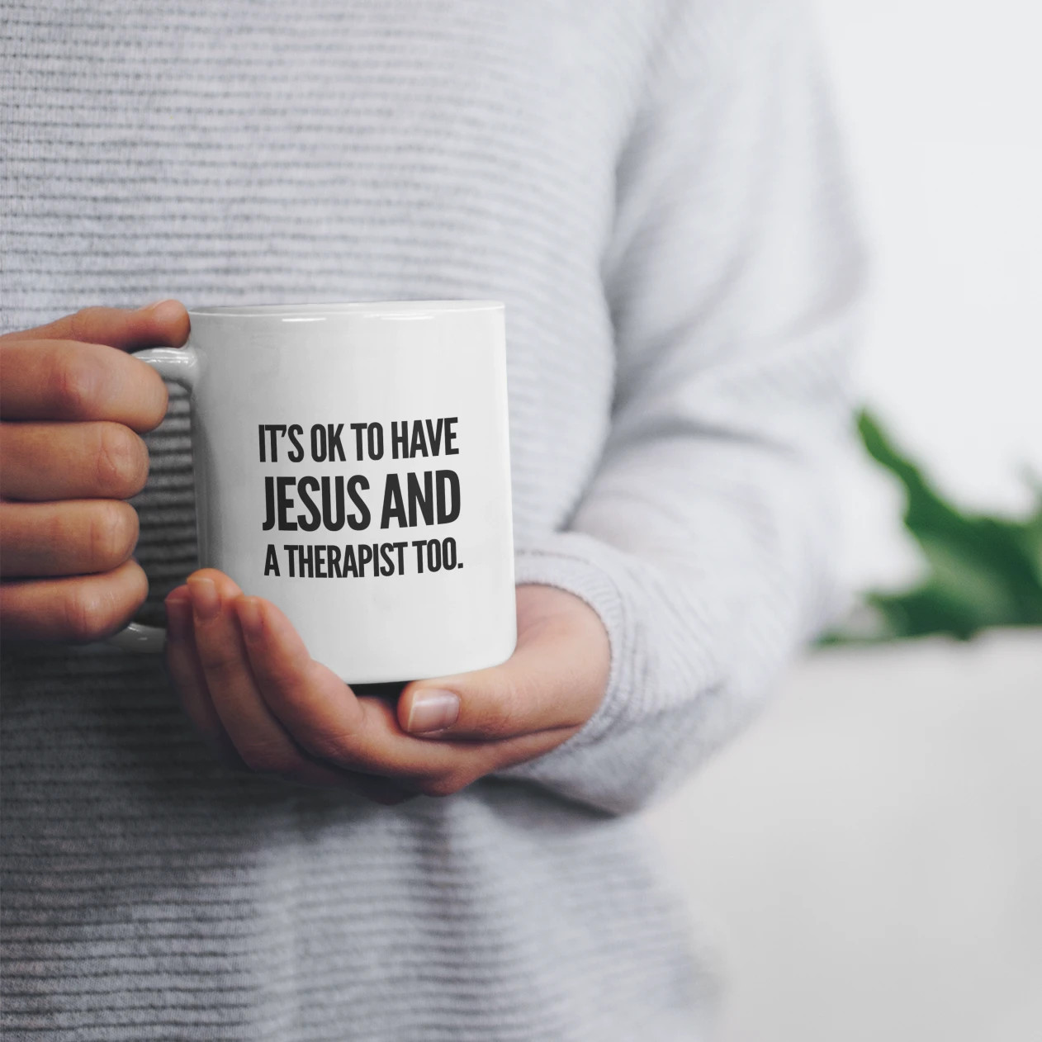
Our Relationship with Ourselves.
… I need to be served. (1st Corinthians 12.21-26)

Slide 6
Our Relationship with Ourselves.
I have received mercy. (Hebrews 4.14-16)
Have I forgotten about God’s grace or I do I boldly speak to Jesus knowing his love for me?

Slide 7
Our Relationship with Ourselves.
I was lost, but Jesus found me. (Ephesians 2.1-10)
I need to be a servant, but I need to be served. (Philippians 2.1-11; 1st Corinthians 12.21-26)
I have received mercy from Jesus, my high priest. (Hebrews 4.14-16)

Slide 8
