Slide 1
Dealing with Suffering

Slide 2
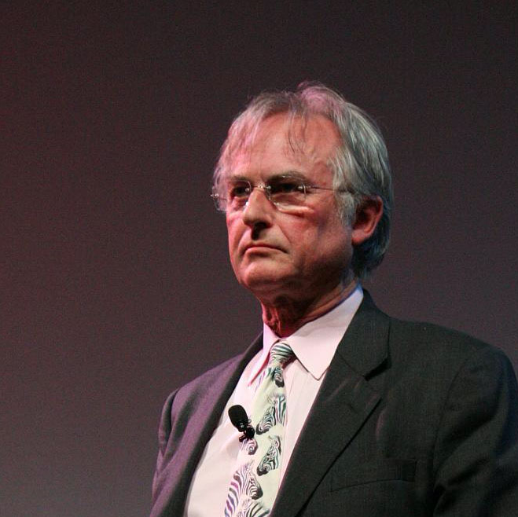
Does Suffering Mean Anything? (Ecclesiastes 3.16-22)
“The universe we observe has precisely the properties we should expect if there is, at bottom, no design, no purpose, no evil, no good, nothing but blind, pitiless indifference.” – Richard Dawkins
Does suffering matter at all? Does it make it better that nothing will be made right?
Removing God from the equation doesn’t make suffering go away – it just means that our pain will never receive an answer.

Slide 3
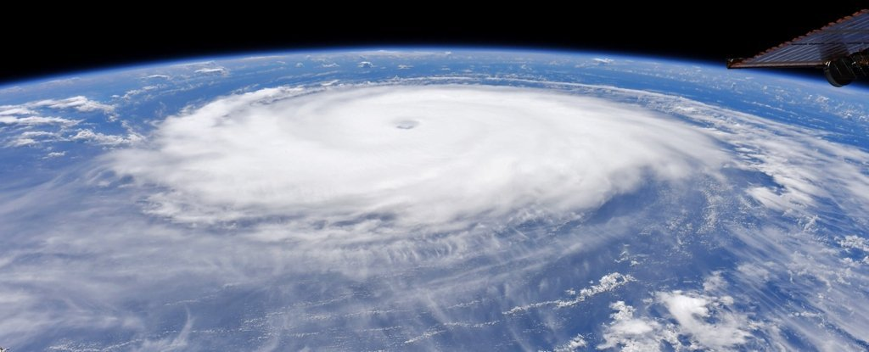
What do we make of “natural” evil? (Amos 4.6-13)
Israel’s disobedience had plenty of warnings of what was to befall them – they just refused to listen – and it would lead to dire consequences.
What else could make us consider our souls and mortality than the fact that we have so little control.
If what I put my trust in here can fail, shouldn’t I put my trust in something that cannot fail?

Slide 4
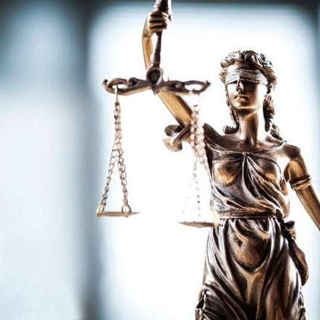
What do we make of injustice? (Ecclesiastes 3.16-22)
The leaders of Israel had not just abandoned their people, but they abused them to the point of barbarism. The evils they committed were against those who had no power. But the Lord would bring judgement on the corrupt.
Injustice on the part of the state is real. But our hope is ultimately in the Lord’s justice when he makes it right. Don’t trust in wealth or a system, but in a righteous God.

Slide 5
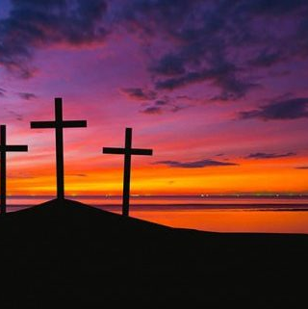
What about when the innocent suffer? (John 9.16-30)
The Lord cares about the innocent so much that he became one to suffer for all.
The ultimate innocent one to ever exist suffered for those who brought the pain upon Him.
On the darkest day, God was able to bring joy and light from it. Even in our pains, the confidence we have in the Lord is our hope.

Slide 6
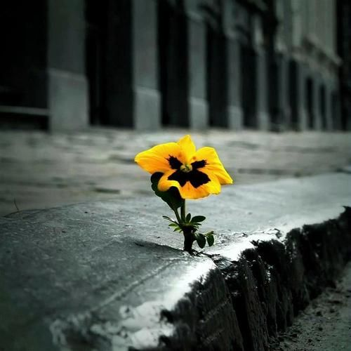
What about understanding mortality? (1st Thessalonians 4.13-18)
Paul corrects a misunderstanding that was in the Thessalonian church – those who passed before Jesus’ return would not be missing a thing.
Grief is a natural part of losing someone. We should not act like that pain doesn’t exist.
Since the Lord resurrected, those who trusted in Him will not be let down. And that includes those who are still there for his appearing.

Slide 7
Practical Thoughts on Suffering
In your suffering, are you using it to grow closer to the Lord or using it to be a bitter person?
The world is suffering – sympathize and love those. Help them to find the meaning you have in Jesus.
3. Remember Jesus. As he came and suffered while also being among the suffering, he showed us that pain is real. He also showed that trusting in the Lord will never let you down. And at the end of it all, he will wipe away every tear.

