Slide 1
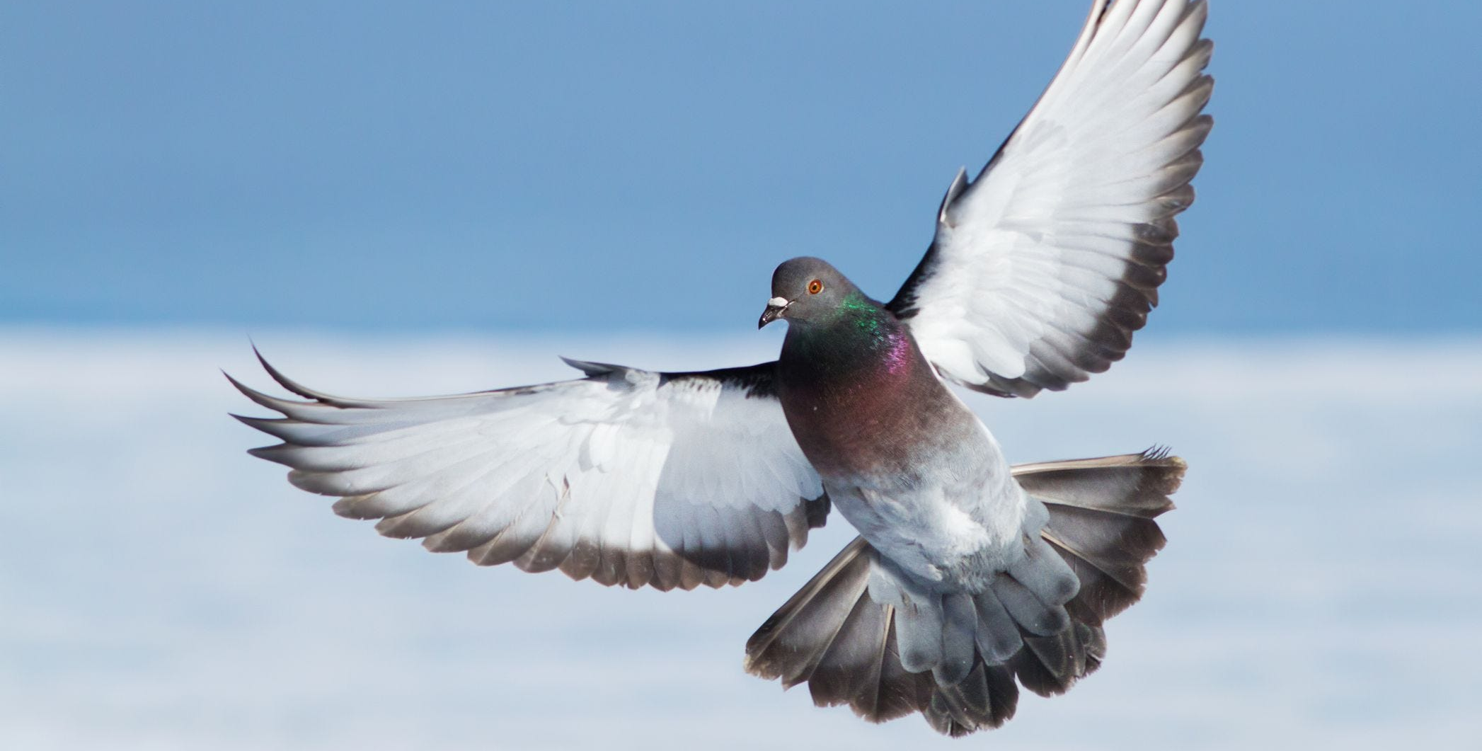
Understanding the Spirit's Role Today

Slide 2
Is the Spirit Finished?
Being finished with one task doesn’t mean finished altogether.
God’s methods of interaction have continually changed: Never did they signal that He was no longer involved in the world.
The Spirit’s work extends beyond what was done in the first century.

Slide 3
Knowing the Difference Between Feelings and Instruction
Where in scripture has the Spirit ever communicated through sensations or a vague sense of intuition?
What good is a feeling of the heart apart from what scripture teaches?
Walking by the Spirit means setting our mind on the things of the Spirit.

Slide 4
The Flow of Communication
We can confirm ourselves through what is revealed in scripture; but the co-testimony from the Spirit is to the Father.
When the Spirit intercedes in prayer, it is also to the Father, and not a communication directed to us.

Slide 5
Thinking Ahead
Appreciate, Emphasize, Understand
Desire what God Offers

Slide 6
Understanding the Spirit's Role Today

