Slide 1
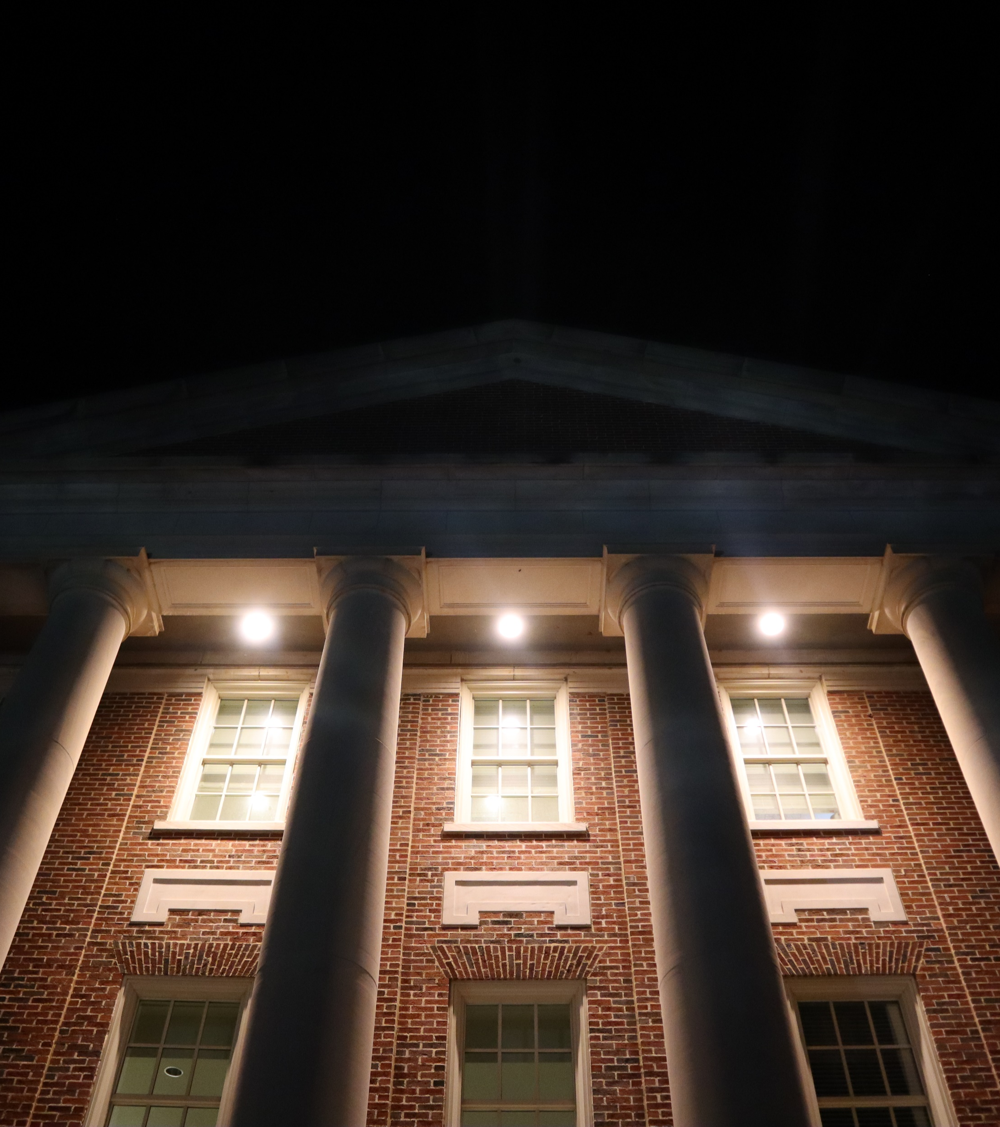
Walking In the truth:
1st john 2.7-27

Slide 2
Themes of our series
Jesus is the center of the gospel
The effect of love: God’s love towards us and us towards him
Walking with the lord means to listen to his wisdom
Walking as Jesus did in compassion, love, and truth.

Slide 3
1st John 2.7-11
There is importance in repeating teaching – we need to hear the same lessons to remind of our need to grow.
“The darkness is passing away and the true light is already shining.” A comfort to know that evil is being overcome.
To claim that you love God, but then you hate your neighbor – it means that you are a liar.
To love your neighbor means to desire their good – is that how you treat your relationship with others?

Slide 4
1st John 2.12-15
To the children:
You have forgiveness of sins and knowledge of the Father.
Confidence
To the fathers:
You have known Him who was from the beginning.
Hope
To the young men:
You have overcome the evil one, you are being strong, and the Word of God abides in you.
Strength
Three levels of Christian maturity, all centering a God who knows us. When we know him, we have confidence in our salvation, hope for the future, and strength even in the difficult times.

Slide 5
1st John 2.15-17
There is a reason that John calls out liars – this world is deceptive.
Didn’t God love the world? (John 3.16) Why should I not love the world?
The lust of the flesh are ungodly and sinful activities, trusting they give something better than God can give. The lust of eyes is desiring what neighbor has, and what he has is greater than what God can give. The pride of life is deciding that my life choices matter more than what God calls me to be.
Can there be something more important than how a perfect God calls me to live? Could anything else possibly satisfy me?

Slide 6
1st John 2.18-27
This is the last hour. In the last hour, deception is real. We must cling to the truth.
People will abandon Christ. They show that they decide the things of the world can somehow provide something greater than what Jesus can.
The antichrist is anyone who denies who Jesus is. You can’t have a relationship with God without one with Jesus. To claim this makes you a liar.
In a world of self-deception, darkness, and death follow the Way, the Truth, and the Life.

Slide 7
1st John 2.15-17
There is a reason that John calls out liars – this world is deceptive.
Didn’t God love the world? (John 3.16) Why should I not love the world?
The lust of the flesh are ungodly and sinful activities, trusting they give something better than God can give. The lust of eyes is desiring what neighbor has, and what he has is greater than what God can give. The pride of life is deciding that my life choices matter more than what God calls me to be.
Can there be something more important than how a perfect God calls me to live? Could anything else possibly satisfy me?

Slide 8
CRM
Challenge: Just life last week: write out 1st John 2.7-27. I also want you to consider this week – do you wish the good for the people you encounter? What can you do to do this better?
Reminder: No lie is of the truth. Don’t be deceived by the lies of the world. The Lord who promises life to you will not fail you.
Meditation: With Thanksgiving in just a few days, there’s a lot to be thankful to God for: his love for us, and showing us how to love, confidence we have in him, the fact that we won’t be deceived by him, life that he promises, and ultimate truth. In your prayers, be thankful for all the incredible gifts from the Lord.

