Slide 1
Getting Wise
Toward Sin
The Foolishness of God: Lesson 5

Slide 2
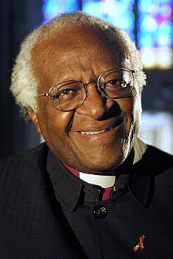
"I would not worship a God who is homophobic,"I would refuse to go to a homophobic heaven. No, I would say, 'Sorry, I would much rather go to the other place.’”
- Desmond Tutu

Slide 3
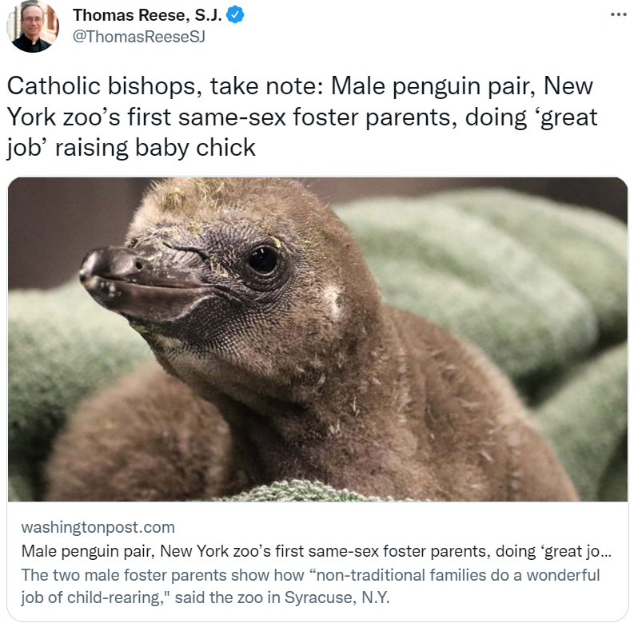

Slide 4
Foundational Wisdom About Sin
God’s people are not immune to sin!
Sin should be a cause for mourning.
Most sin is readily identifiable.
Saving souls is more important than saving face.

Slide 5
The Wisdom of Removing Sin from the Camp
The unclean, the unholy, are taken outside.
Leaven (sin) must be taken outside the confines of the camp as well.
When the leaven remains, we must take stock of why we allow it to be.

Slide 6
The Wisdom that Keeps Us Unstained
Paul acknowledges that living in the world means contact with the world—but does not encourage friendship with the world…
Paul prescribes a drastic change in relationship to remove sin and keep God’s people unleavened.
Failing to do so gives sin a stamp of approval

Slide 7
Thinking Ahead
Don’t Allow Sin to Become Old Hat.
Take Care Who Sets Your Standards.

