Slide 1
1. Ownership
2. Debt
3. Personalities
4. Power
5. Children
6. Extended Family

Slide 2
Serving Money
Matthew 6:24

Slide 3
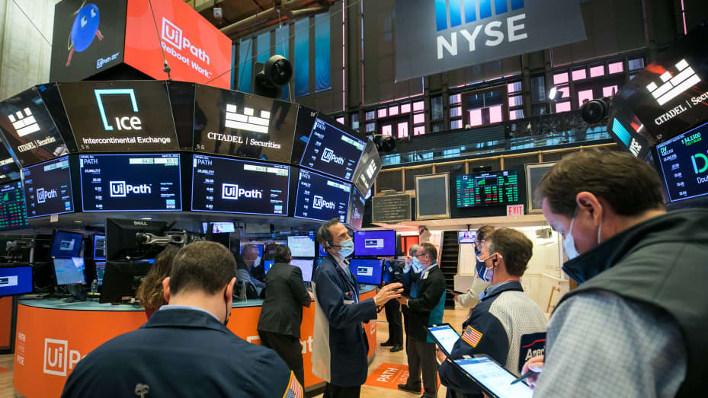

Slide 4
IF YOU FOLLOW MY ADVICE, YOU WILL BE RICH BEYOND YOUR WIDLEST DREAMS

Slide 6
IF YOU FOLLOW MY ADVICE, YOU WILL BE RICH BEYOND YOUR WIDLEST DREAMS

Slide 7
What We Need – When We Need It
For if Abraham was justified by works, he has something to boast about, but not before God.
For what does the Scripture say? “Abraham believed God, and it was counted to him as righteousness.”
Do you want to be shown, you foolish person, that faith apart from works is useless?
Was not Abraham our father justified by works when he offered up his son Isaac on the altar?

Slide 8
What We Need – When We Need It
Go to the ant O sluggard… When will you arise from your sleep?
A little sleep, a little slumber, a little folding of the hands to rest, and poverty will come upon you like a robber, and want like an armed man.
Proverbs 6, 9-11
Do not toil to acquire wealth; be discerning enough to desist. When your eyes light on it, it is gone, for suddenly it sprouts wings, flying like an eagle toward heaven.
Proverbs 24:4-5

Slide 9
WE Think About It
How much of our time is spent thinking about things related to money?

Slide 10
WE Think About It
How much of our time is spent thinking about things related to money?
Planning, preparing, checking, comparing, returning, and worrying

Slide 11
WE Think About It
How much of our time is spent thinking about things related to money?
Planning, preparing, checking, comparing, returning, and worrying
Our thoughts can’t be in two places at once – Spiritual things take a back seat

Slide 12
WE Find Joy In It
Our happiness is often tied to our ability to purchase the next fun thing

Slide 13
WE Find Joy In It
Our happiness is tied to our ability to purchase the next thing
Contrasted with the things of this world, spiritual things don’t sparkle the same

Slide 14
WE Find Joy In It
Our happiness is tied to our ability to purchase the next thing
Contrasted with the things of this world, spiritual things don’t sparkle the same
What if there was no Christmas, vacations, birthdays or purchases?

Slide 15
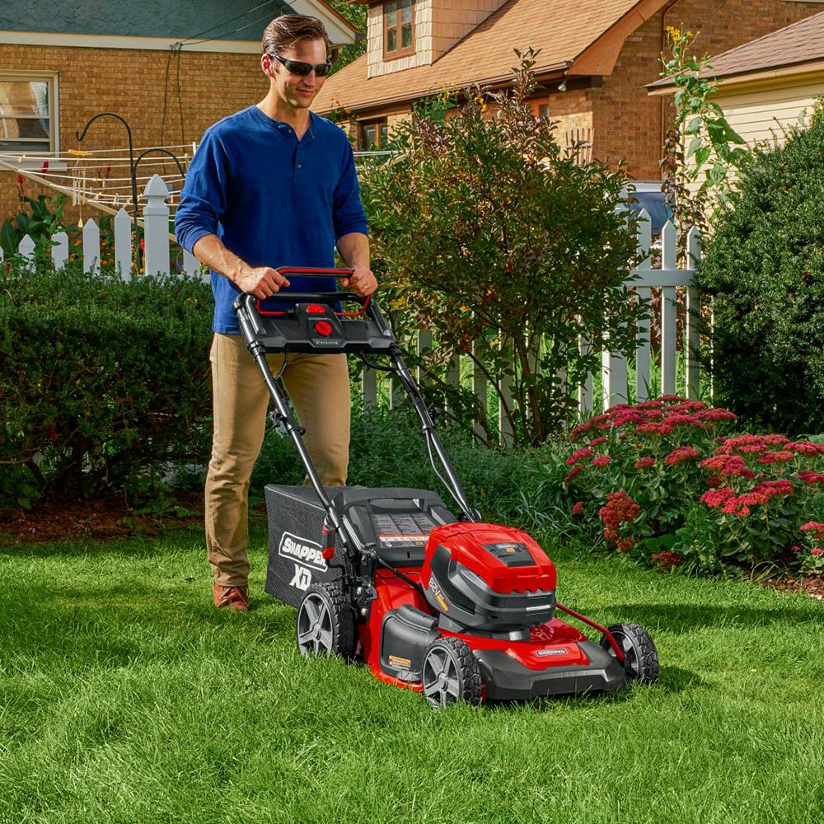
WE Sacrifice for It
We will spend our valuable time to acquire more things than we need

Slide 16
WE Sacrifice for It
We will spend our valuable time to acquire more things than we need
We will spend additional time taking further care of it

Slide 17
WE Sacrifice for It
We will spend our valuable time to acquire more things than we need
We will spend additional time taking further care of it
We will do whatever is required to ensure we keep it coming

Slide 18
WE Trust In It
Our safety and security is tied to our wealth

Slide 19
WE Trust In It
Our safety and security is tied to our wealth
We meticulously plan our lives in order to control the future

Slide 20
WE Trust In It
Our safety and security is tied to our wealth
We meticulously plan our lives in order to control the future
When the false security is gone, we don’t know how to live in contentment

Slide 22
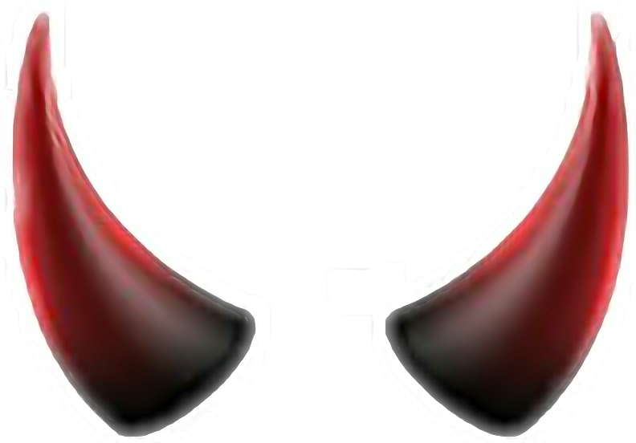

Slide 23
Care less about the things of this life.
(1st John 2:15)

Slide 24
Pursue contentment as hard as the world pursues wealth.
(Luke 3:14)
Care less about the things of this life.
(1st John 2:15)

Slide 25
Pursue contentment as hard as the world pursues wealth.
(Luke 3:14)
Care less about the things of this life.
(1st John 2:15)
Be on guard against every form of greed.
(Luke 12:15)

Slide 26
Pursue contentment as hard as the world pursues wealth.
(Luke 3:14)
Care less about the things of this life.
(1st John 2:15)
Be on guard against every form of greed.
(Luke 12:15)
Work for the real reward.
(1st Timothy 6:19)

