Slide 1
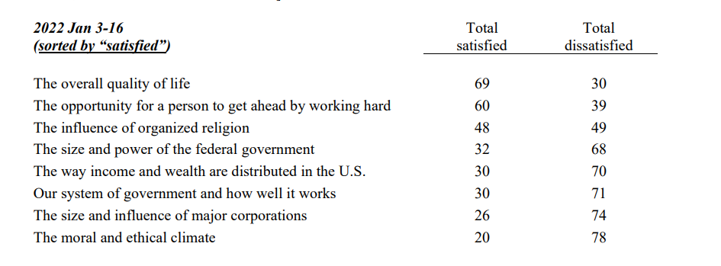

Slide 2
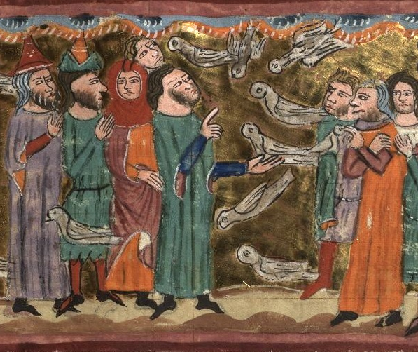
“Your grumbling is not against us, but against the LORD…” (Exodus 16)
Why are people unhappy? For the same reason Israel is. Despite the obvious and wonderous blessings of God, they look at them these blessings with disdain. They are desperate for more. This is the heart of gluttony.
It is a tremendous comfort to know God hears our heartfelt prayers. It must also frighten us that God hears our ungrateful grumblings as well.
Even bread from heaven was not seen as worthy of thankfulness. They do not trust God to provide enough for the day or they want more than they’ve been provided. They break the rules because they are ungrateful and faithless.

Slide 3
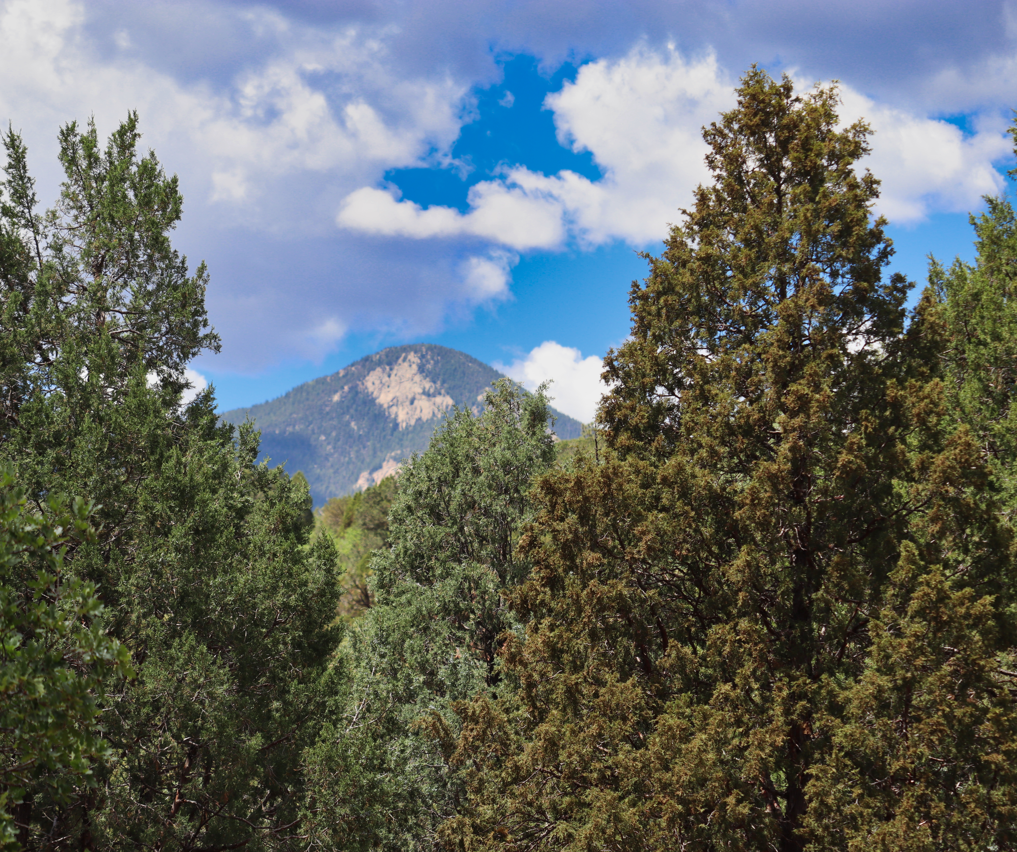
Ahab, the petulant child (1st Kings 21)
Gluttony doesn’t exist only in food. It exists in excess – desiring more, and never being satisfied with the current grace.
Ahab is wealthy – incredibly wealthy. But his story reflects that even in the heights of wealth, a soul that always longs for more will never be satisfied. Only the Lord provides satisfaction.
If we don’t think our gluttony will affect others, we dare not ignore what happens in this story. Ahab’s selfishness ends the life of a man who did not deserve this cruelty.

Slide 4
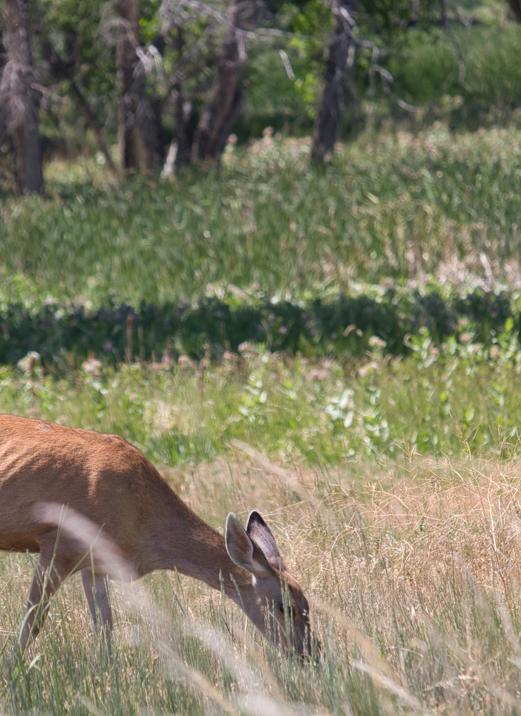
“They received their food with glad and generous hearts…”
(Acts 2.42-47)
• After the founding of the church, how do you handle a lot of people who are strangers but also family? You treat them as Christ has treated you – sacrificing so that you may serve their needs.
• Was every meal perfect, every home comfortable, every person perfect, and every bed comfy? Most likely not. But they had God, they had family, and they had thankfulness. What else could they need?

Slide 5

“But godliness with contentment is great gain…” (1st Timothy 6.3-10)
• The motivation for false teaching comes from selfishness. They abuse God’s name for the sake of their pocketbooks. Gain for themselves, “joy” in excess.
• But to the contrary – true godliness, sound doctrine, leads to contentment. With merely food and clothing we should be content. Is that true for us? Or do we constantly desire more?

Slide 6
Glad and Generous Hearts
Do not allow the desire of more than what you have fester. God is the giver of every good and perfect gift. Be able to say, “Whether I have a little or I have a lot, I am content because I have Jesus.”

