Slide 1
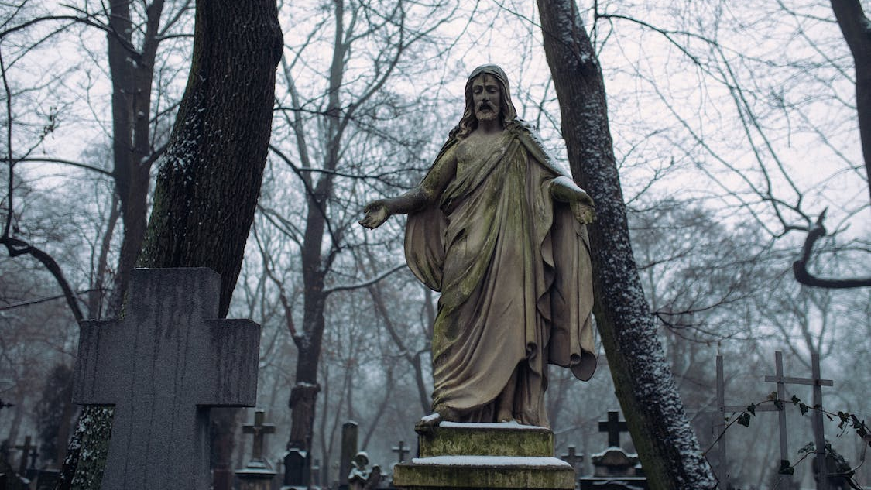
Death and Resurrection
Spending Time with the King: Lesson Four

Slide 2
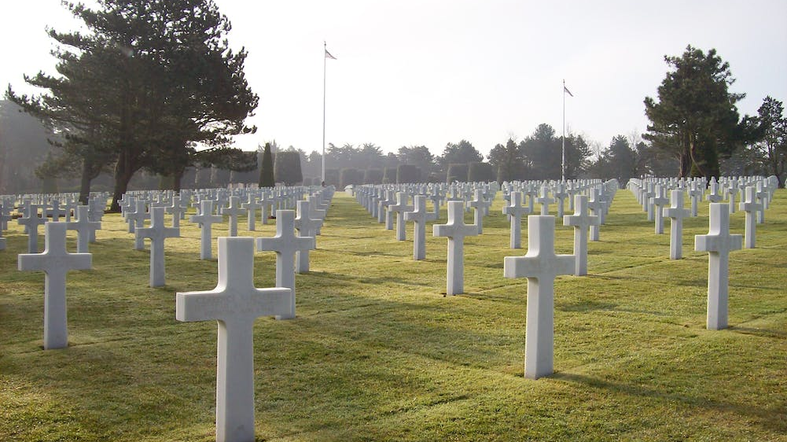
The Death of an Innocent Man
The trials before the Roman authorities were an attempt to bury Jesus’ reputation before they buried His body.
But even the Roman courts could clearly see the innocence of Jesus.
The crowds knowingly and with great cowardice delivered a man with no guilt to death on a cross.

Slide 3
The Testimony of an Innocent Man
On the road to the cross Jesus’ thoughts were on those who needed to repent before it was too late.
While He hung on the cross, His mind was on forgiveness of others.
As He prepared to die, His heart was bent toward a penitent sinner.

Slide 4
The Resurrection of an Innocent Man
Everyone went away from the cross with an intense sense of despair.
Many honored His memory, but many also lost hope.
But when the stone was rolled away, God had declared that hope was here to stay.

Slide 5
Thinking Ahead
Born to Die…
So that We Might Live…

Slide 6
Death and Resurrection
Spending Time with the King: Lesson Four

