Slide 1
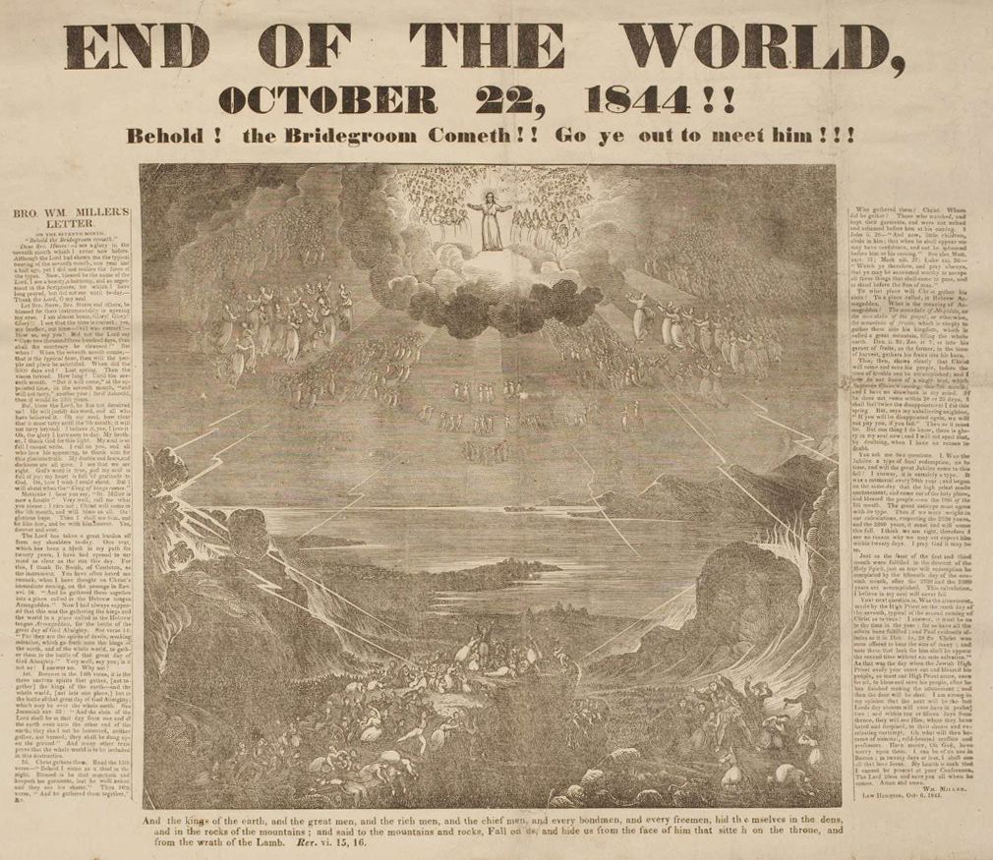

Slide 2
“test the spirits”

Slide 3
Deuteronomy 18: Priests, False Prophets, and the True Prophet
God provides for and with true teachers. The Levites were blessed with the sacrifices but had a responsibility to be faithful ministers to Israel.
False teachers took away faith and demanded sacrifice to get control, instead of relying on God for provision. This went so far as something as horrendous as sacrificing their children. (vs. 10)
The true prophet, Jesus, is the indicator of God’s faithfulness and sticking to His promises. If anyone claims to have a Word from the Lord and it doesn’t come to pass – avoid that “teacher”.

Slide 4
i. Why is Peter so serious about this issue? ii. What is the main thing that false prophets/teachers do? iii. If you listen to false teachers, what will they lead you into?

Slide 5
2nd Peter 2: A Harsh Rebuke
Jesus is our Master. That means the demands He places on our life, we must follow, but it a joy to follow the one who loves us.
Peter’s harsh rebuke reminds us of some important thing: false prophets and teachers don’t care about you. They care about their own sensuality. And they’ll convince you that is true freedom.
If someone comes around and tries to tell you sin isn’t that bad, or find ways to justify their sin and sensuality – run!

Slide 6
1st John 4.1-6: Christ-Centric Teaching
False teachers are here. We can’t escape them, but we can stand in the power of God – that is the only way we can overcome.
Teaching Christ must be central to everything – all our teaching, all our worship, all of our lives. He must be ruler, king, Savior, and God.
Be wary if teaching ever places anyone greater than Jesus or teaches incorrected about his love, grace, and truth.

Slide 7
i. Make sure that as a church, we are keeping our standards focused on Christ, not ourselves or how good we are. We’re nothing without our Savior. ii. Everyone is worshipping something. Are you showing that worshipping Jesus is about truth, love, kindness, and compassion?

