Slide 1
The Reality of Lying and Value of Truth

Slide 2
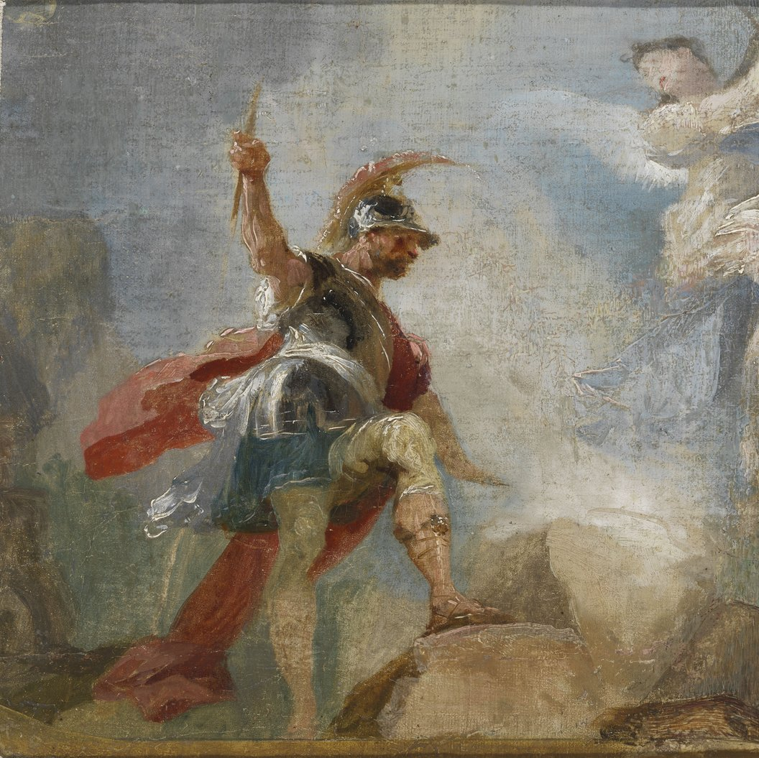
Lying to Ourselves (Judges 8.22-35)
Gideon tells everyone, “I will not rule over you, and my son will not rule over you; the LORD will rule over you.” (Judges 8:23) But then everything else he does stands contrary to this message of God fearing. He makes an idol for the people of Israel that they worship, he marries a lot of women (very common most kings in history), and names his son, “My father is the king.” His claim is that God will rule over them, but the reality is Gideon is asserting his own king status.
We commonly lie to ourselves. Whether we are inconsistent in holding others to a higher standard than ourselves or even asserting our worthlessness. We must have a balance of living consistently as well as understanding our value and dignity is upheld by the cross of Christ.

Slide 3
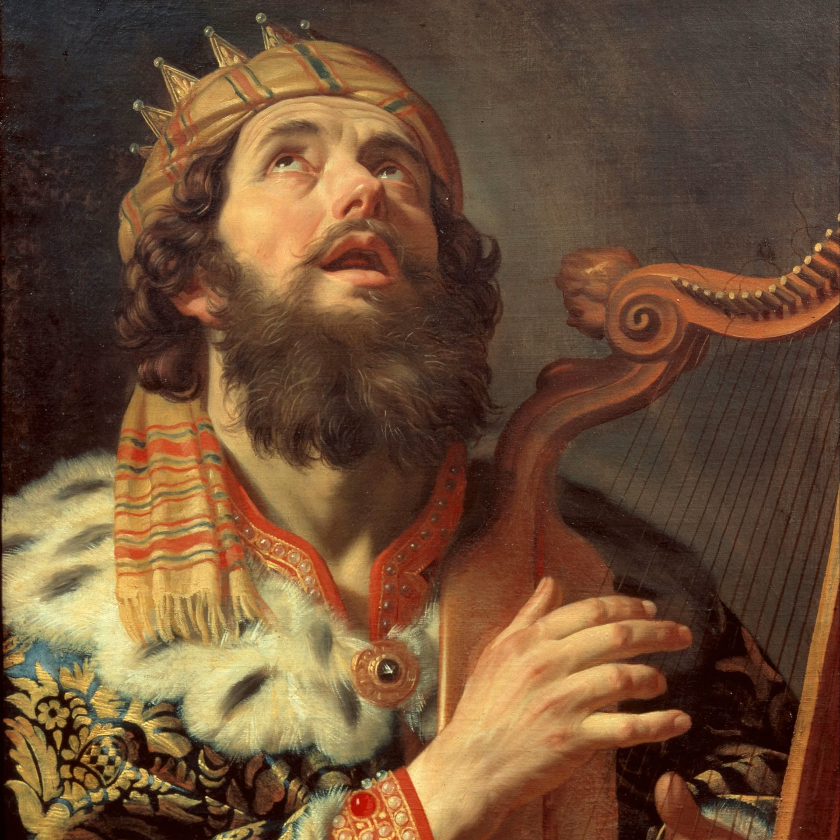
Lying to Others
(2nd Samuel 1.1-16)
This story matches sincerity with insincerity. David genuinely is sad about the killing of Saul, and of course, Johnathan. He takes seriously the killing of the Lord’s anointed. Meanwhile, the Amalekite is lying and insincere. He cares for his own glory.
When we lie to others, it is because we care more for their approval than selflessness and giving God the glory He deserves. We aren’t honest about our weaknesses and shortcomings. Truth matters to others and it especially matters to God – we must trust in Him to be our strength.

Slide 4
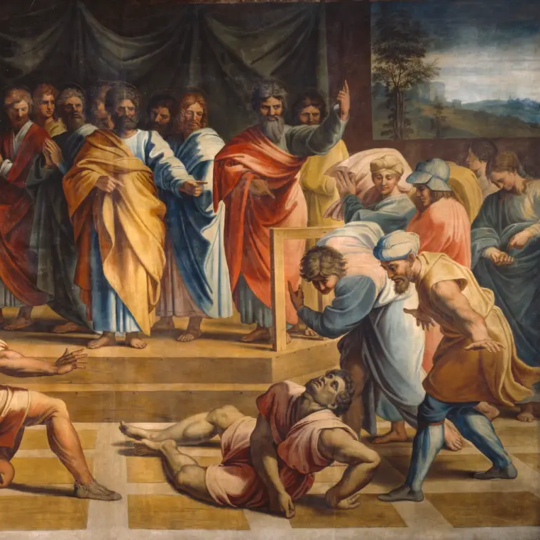
Lying to God
(Acts 5.1-11)
This act of God may seem overly harsh. But it tracks with how we see lying as an offense to God throughout the Biblical narrative. God is truth and truth requires humility.
Ananias and Sapphira cared, not about truth, but about giving their glory to themselves. No amount of selfishness can compare to truth. The others in the Christian community cared about each other and service of God. Do we care about our church in this way?

Slide 5

Building our Honesty
Being honest when you’re asked how you’re doing. Whether things are great or awful, being honest with other people will give them insight into how they can love a messy person, because we’re all messy people.
Being honest when you ask how someone else is doing. If you ask the question without actually caring for the answer, you’re giving the appearance of compassion, but no substance. That’s the disgusting reality of our lies.
“God is spirit, and those who worship him must worship in spirit and truth.” (John 4:24)

