Slide 2
The Tree of Life

Slide 3
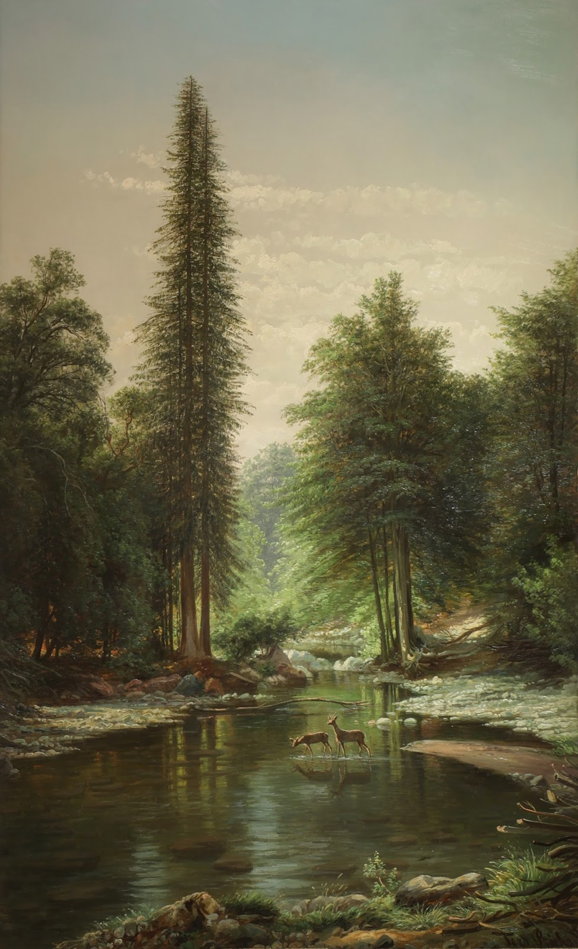
The Tree of the Life in Eden (Genesis 2.1-17)
The Genesis account introduces the one true God – YHWH Elohim, a God who is incredibly powerful, but also desires a relationship with His creation.
Eden (delight) is not just a garden – it is a temple. A place of life, where God dwells with man in perfect harmony. A symbol of presence of God is the tree of life. We see that when man eats of it, it allows them to live forever. (Genesis 3.22)
The tragedy of Eden is that even when blessed with everything, mankind will still desire more – godhood for themselves. Instead of trusting in the goodness of God, they reject Him and along with it – lose access to the tree of life. The rest of the Bible is about restoration of mankind’s relationship with their holy and merciful God.

Slide 4
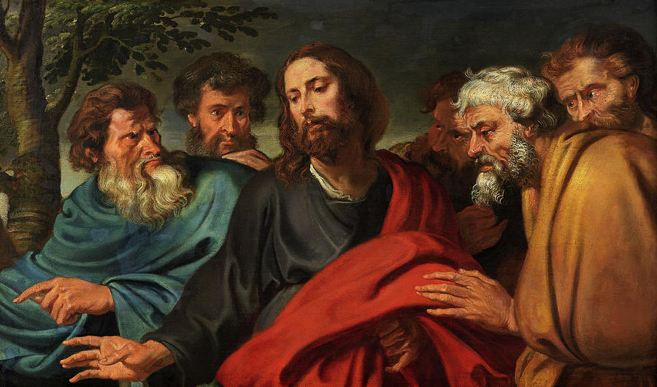
Abiding in Christ (John 15.1-17)
Very interestingly – Jesus relates himself to a plant, a vine, from where all good things grow. When we abide in Christ, we will bear fruits reflecting this following of Christ.
Abide – “to accept or act in accordance with”. Do you act in accordance with Jesus, or do you seek to conform him to your image?
To commune with Jesus is to rejoin the presence of God that was lost in the rebellion in the garden. Abiding in Jesus reconciles us to the Father and to one another.

Slide 5
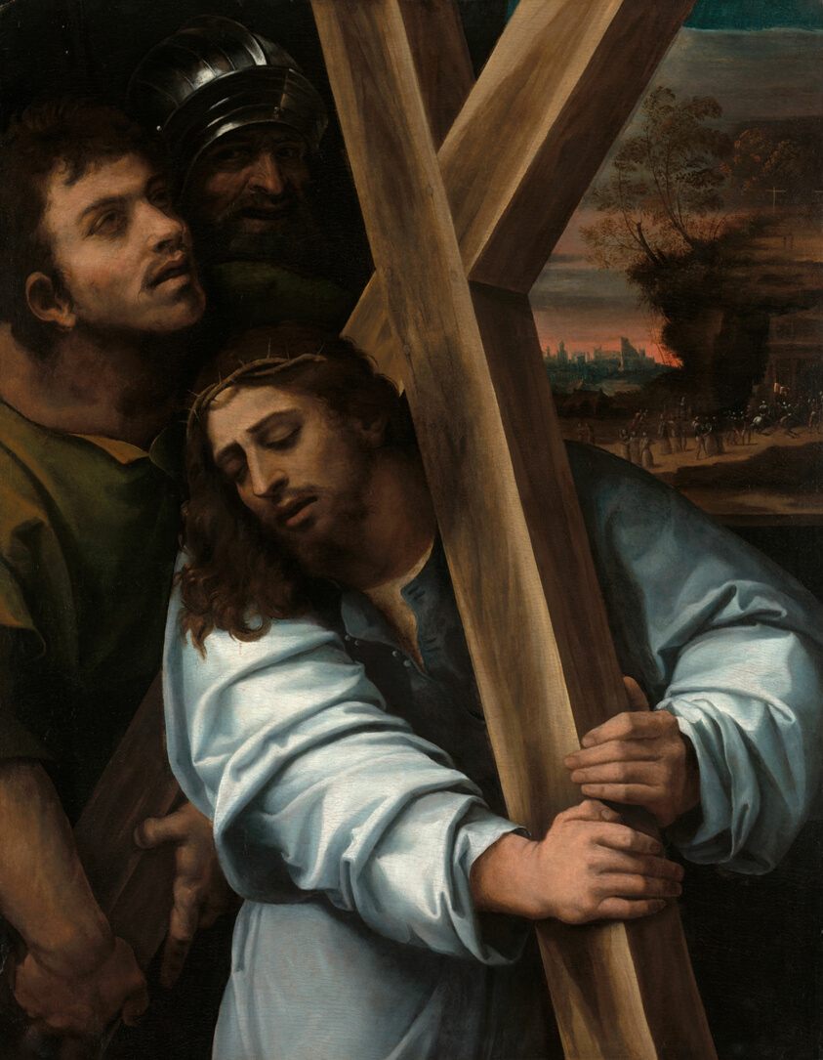
The Tree of Life – The Cross (Galatians 3.10-14)
Without Jesus, we are living under the curse of our sin. We fail to live up to the perfect standard of God, and therefore without him – we are hopeless.
Fortunately, Jesus died on a tree. The image of the cross in Roman culture is all about death and humiliation. For us, we rejoice in the cross. Despite our failures, Christ loved us enough to bring us new life.

Slide 6
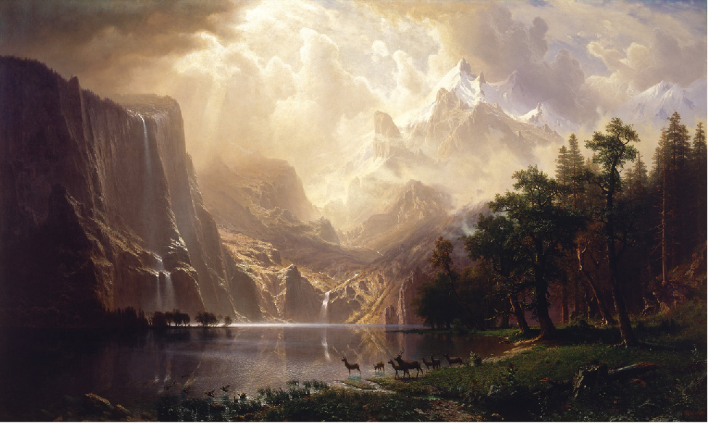
The Tree of Life in the New Life (Revelation 22.1-5)
The tree of life appears in the last chapter in the Bible and it’s tied into healing – whether that be our spiritual ailments or continued reconciliation between people. The tree of life no longer reminds us of what we have lost, but the hope of our return to a place with our Lord.
The most important part of this image, however, isn’t the tree of life – it is the presence of God. It is He who has given the tree, it is He who is the source of life, it is He that we desire to be with. In Him is life truly found.

Slide 7
Application
• Learning to and making sure we abide.
Do we truly accept and live like Jesus is our Lord?
• Giving glory to God.
Our good deeds ought to point to greatness of God.
• Love as Jesus loved.
True life begins when we lose ourselves in love for our Savior and love for those made in His image.

