Slide 1
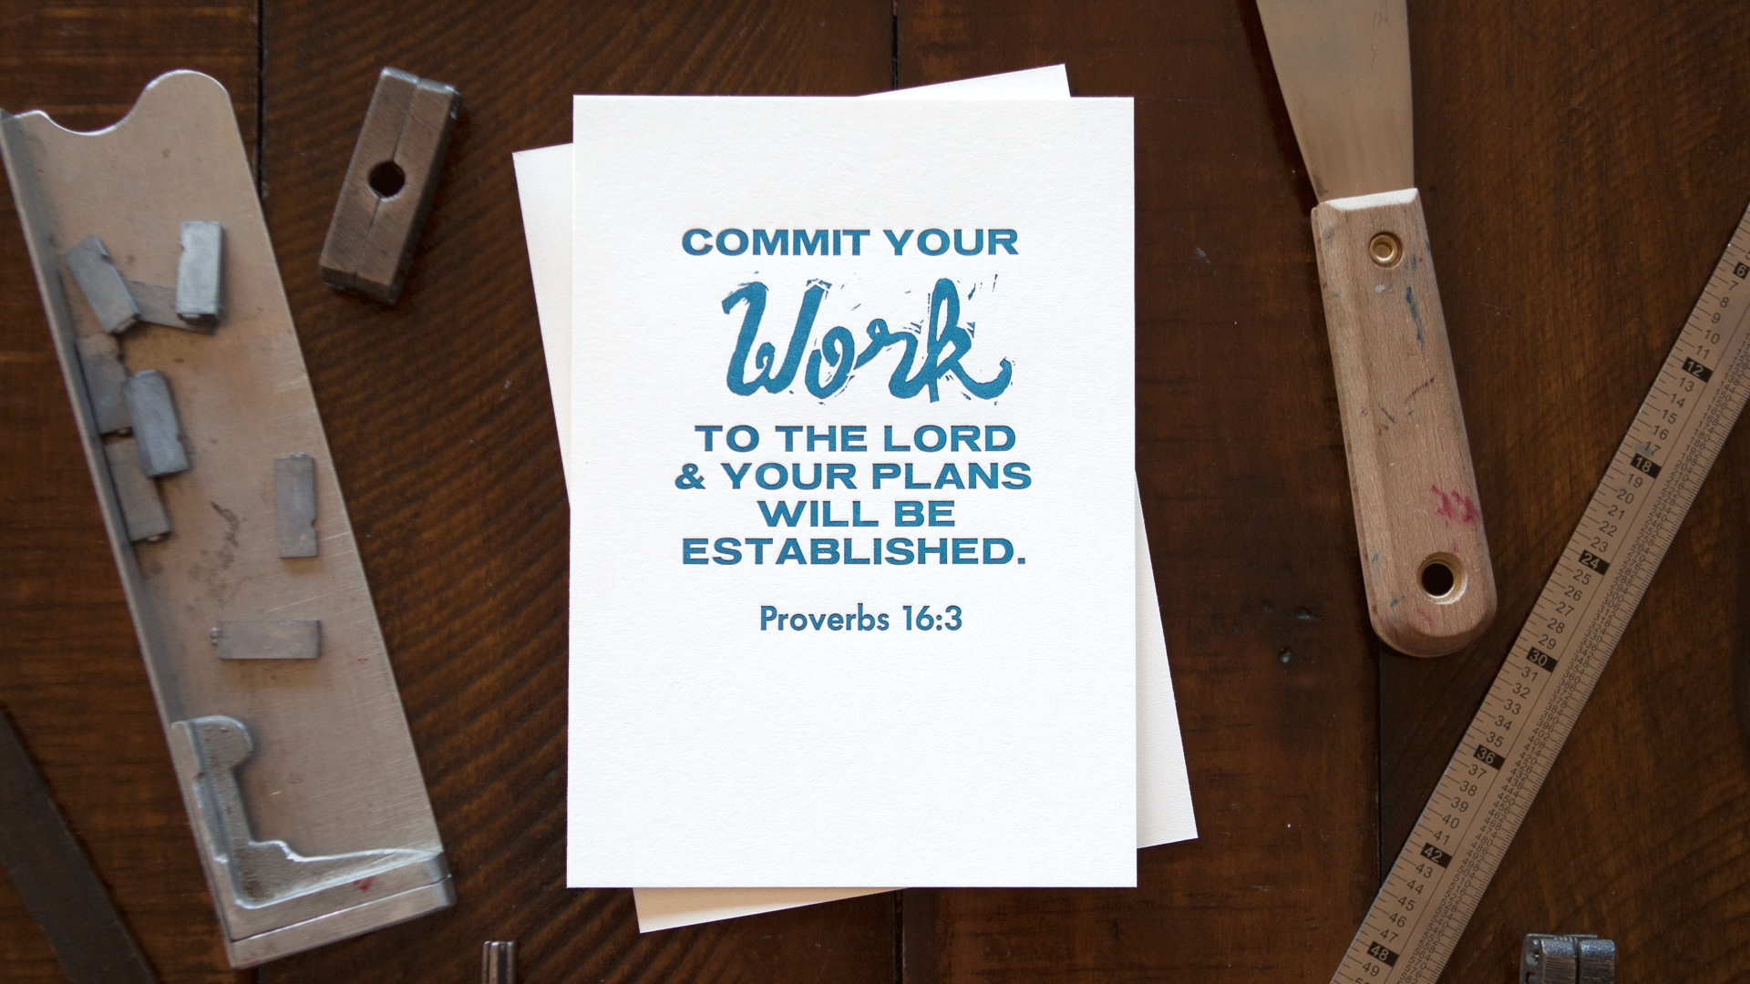
Walking in Good Works

Slide 2
The Nature of Work
When man’s sin brought the curse, work became more difficult—but work itself was not the curse.

Slide 3
The Nature of Work
When man’s sin brought the curse work became more difficult. But work itself was not the curse.
God created man with the intention of man being a working being: He gave men dominion—stewardship—and expected them to find fulfillment in the exercise thereof.

Slide 4
Further Thoughts on Stewardship
If God’s rule extends over everything, then everything has been placed in our stewardship.

Slide 5
Further Thoughts on Stewardship
If God’s rule extends over everything, then everything has been placed in our stewardship.
Practically, this means that we are held accountable for more than our stewardship of physical blessings alone.

Slide 6
Finding Direction as a Steward
In the same way that God directed Adam to work in the garden, God has given us direction to work in this world.

Slide 7
Finding Direction as a Steward
In the same way that God directed Adam to work in the garden, God has given us direction to work in this world.
This begins with having an attitude that is willing to work to provide and be able to share with others…

Slide 8
Finding Direction as a Steward
But is ultimately fulfilled in the work we do in the Kingdom.

Slide 9
Finding Direction as a Steward
But is ultimately fulfilled in the work we do in the Kingdom.
How diligently do we work to find God’s direction in that work, and how diligently do we seek to involve ourselves in its execution?

