Slide 2
Thorns, the Curse of Rebellion, and the Deceitfulness of Sin

Slide 3
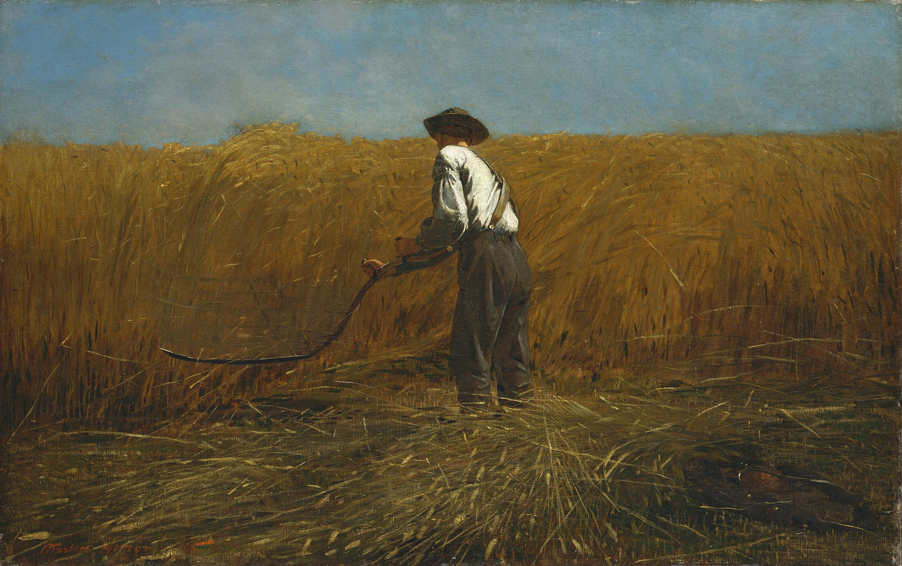
“…thorns and thistles it shall bring forth for you…” (Genesis 3.17-21)
The choice of Adam to listen to a contradiction of God’s word brings a curse on the ground and for all mankind. Thorns, sweat, pain and death are present because of Adam’s sin and our ongoing rebellion.
Just as we don’t submit to God, so also does the ground not submit to us. Our lives should rather be dedicated to submission because we understand God loves us – thorns represent our rejection of His better.

Slide 4
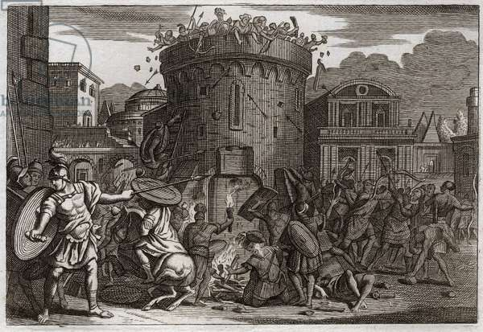
A consuming thornbush (Judges 9.7-21)
• Israel was searching for a king. They tried to find it in people, instead of turning to God. Their choice in a “king” couldn’t be worse.
• Jotham’s curse reflects the evils of rebellion. It undoes the blessings of God, the “shade” only pierces and shreds, and ruin will come for all who participate in it. Sin only consumes.

Slide 5
“Why do the wicked prosper?” (Jeremiah 12)
Jeremiah is living in an evil place surrounded by evil people – but instead, the wicked were prospering. Jeremiah also notes that, as God says in the law, their land is suffering from their evil.
God’s love for Israel evident. So is His anger. They had rebelled and acted unrighteously and therefore, their evil would be poured back out on them. God’s punishment will come, but a part of their punishment is sowing things that profit nothing. Sin is a weariness.

Slide 6
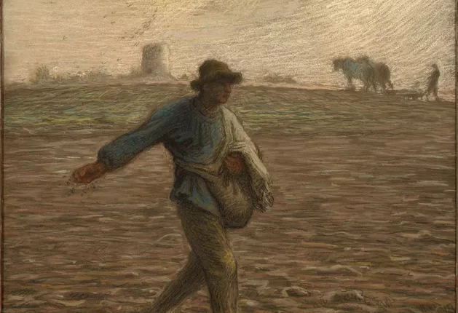
“He who has ears to hear, let him hear” (Matthew 13.1-9; 18-23)
• The seed is also good. It is the news of the kingdom, that our unrighteousness has been paid for. But we need to repent. When God’s word has its full effect, the fruit will yield much fruit.
• Unfortunately, some people will turn away from the word for different reasons. They reject it because it never gets through to them, that persecution comes, or the world gets to them.
• The word claims to offer us things that will give us hope, joy, peace, and strength. But just like sin, all it will do is consume more as you try to fit in. Sin lies to you.

Slide 7
Application
•Reflect on God’s love.
What does it mean to you that God has loved you, even in your hateful and most rebellious moments?
• Because of God’s love, replace thorns with fruit.
In a dark world, reflect that God has changed everything about your life. Overcome evil with good.

