Slide 1
The Way Jesus Speaks
How to transform empty talk into meaningful, spiritually focused, conversation.

Slide 2
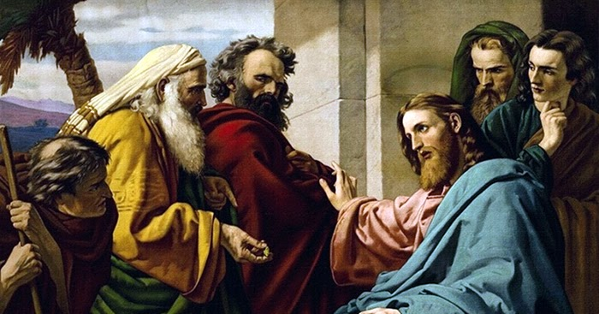
John 4.1-6: Setting the Scene
Jesus may have been driven away because of the Pharisees, but His mission was not hindered. He continues to teach and arrives at Sychar with the intention to teach.
How can our conversations become more intentional?

Slide 3

John 4.7-15: Look Up
As the Samaritan women does, so often we are focused on the physical. Jesus’ challenge to her is to ask important questions:
  What is the gift of God?
  Who is the one speaking to her?
  What is the living water?
This draws her mind away from the physical and towards the spiritual truths – the most real of all things.

Slide 4
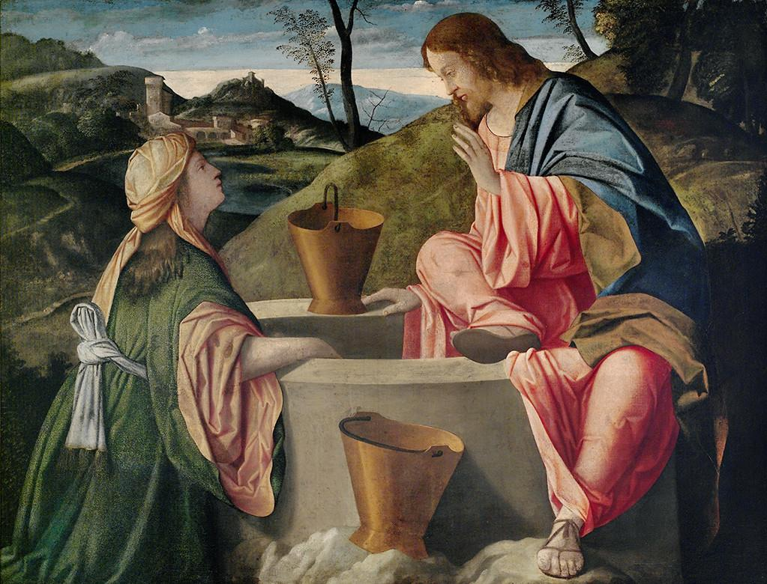
John 4.16-26: Conviction
Jesus doesn’t hide from the truths this woman needs to hear. She is a sinner, and she doesn’t understand what she’s worshipping. But speaking with conviction leads to important truths:
True worship of God will not be limited to a place, but a people in Spirit and Truth. Additionally, He is the Messiah – her redeemer.

Slide 5
John 4.27-42: The Center of It All
This whole story points back in the direction of Jesus. The joy of the Samaritan woman, the reason the fields are ready for harvest, and the belief of the Samaritan people all are centered on Jesus.
This indeed is the Savior of the world. The message of salvation comes down to who is doing saving: Jesus, the Christ.

Slide 6
Four Keys to Good Conversation
Be intentional when you converse.
  Do we have a goal when we speak? Or is it just for nothing?
Meditate on the words of Jesus and spiritual things.
  The reason we don’t talk about Jesus is probably because we aren’t thinking about Him.
Speak with compassion and truth.
  If one of these things is missing, we have left the way of Christ.
Always point to Jesus.
  The longing of every soul.

