Slide 1
O
In your pie chart, estimate the time you spend at work, with family, with your hobbies, and time spent with the Lord.

Slide 2
Prioritizing God

Slide 3
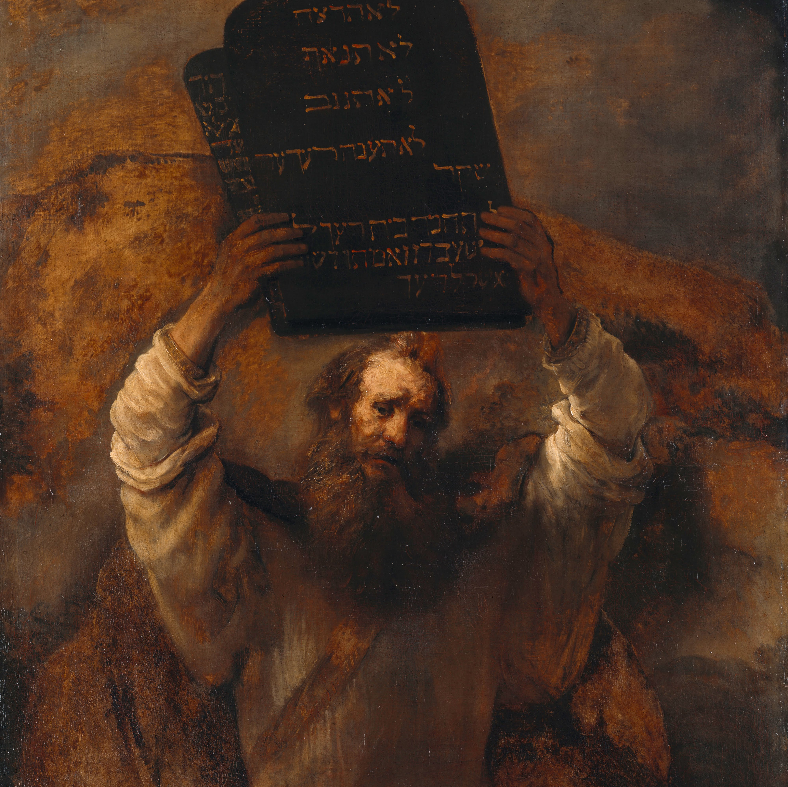
Deuteronomy 8.1-20: “My power and my might…”
God has been faithful to Israel – He had brought them through the wilderness, provided, and was fulfilling the promises. The land they were being brought into was a beautiful place.
The danger is in forgetting God – they believe it is by their power that they have gotten their wealth and this land. We must remember all we have is by God’s mercy. And with that, we must never forget He is who we are to honor always.

Slide 4
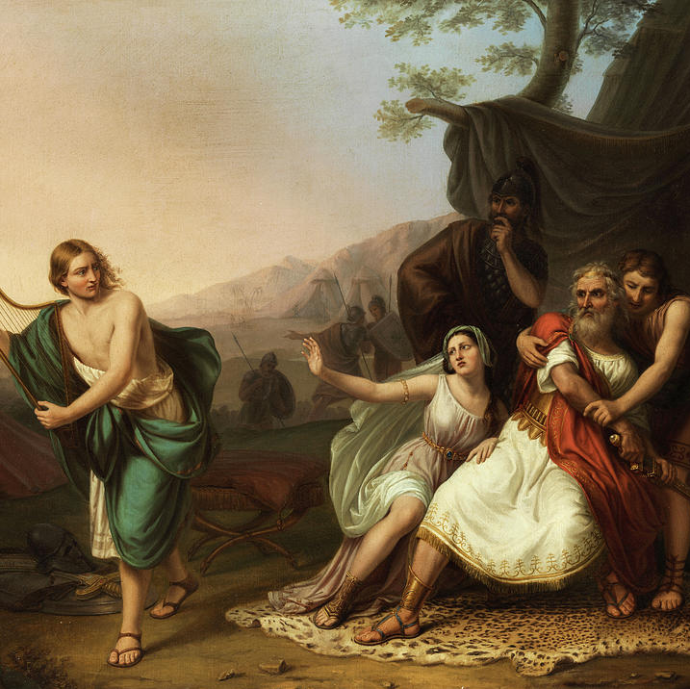
1st Samuel 24.1-15: “Out of the wicked comes wickedness.”
Saul didn’t prioritize God and was willing to neglect his responsibility in order to get personal revenge.
David’s men didn’t prioritize God and were willing to “manipulate” God in order to get personal revenge.
David prioritized God, and it is reflected in his mercy, humility, and trust that God will be his vindication.
Does our conduct reflect that God is what is most important, or have we set up our agendas over His will?

Slide 5
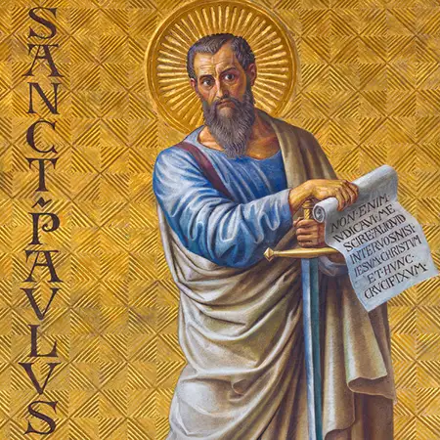
Philippians 3.1-11: The Surpassing Worth of Christ
What does culture say about what is worthwhile? The fleshly and the appearance of virtue, but none of the substance.
For Paul (as it should be for every Christian), what matters more than anything is a knowledge of Christ. To share in His resurrection is the sole priority and the most important identity.

Slide 6
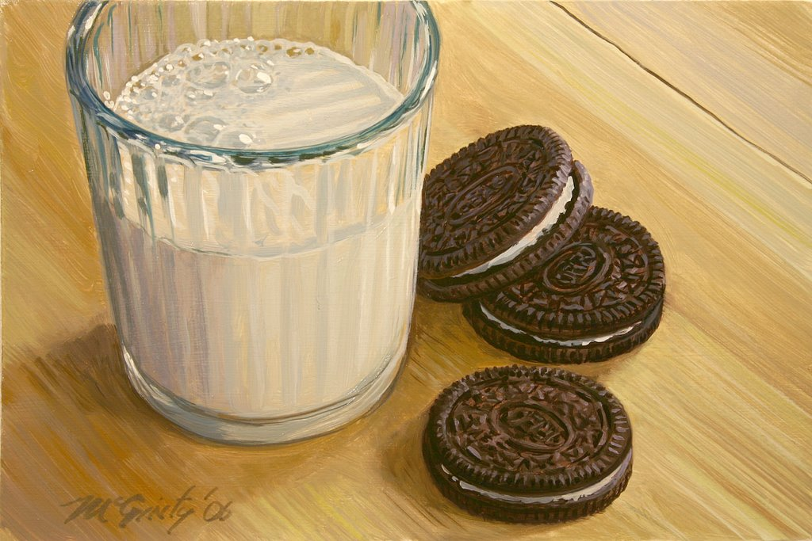
God doesn’t fit into a pie chart of our lives. He should be the whole of it. He is the motivate for hard work, love for family, and even times of rest.
God is also the hope once this life is over – everything we do should be desiring to know Him, and ultimately to live with and enjoy Him forever.

