Slide 1
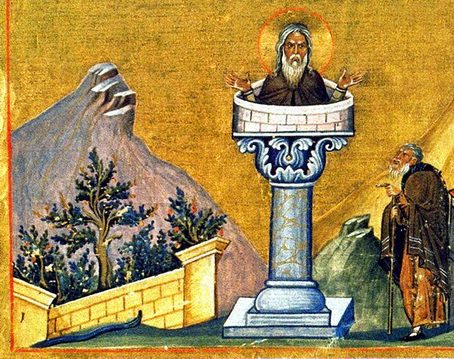
Humility, Self-Denial, and Fasting

Slide 2
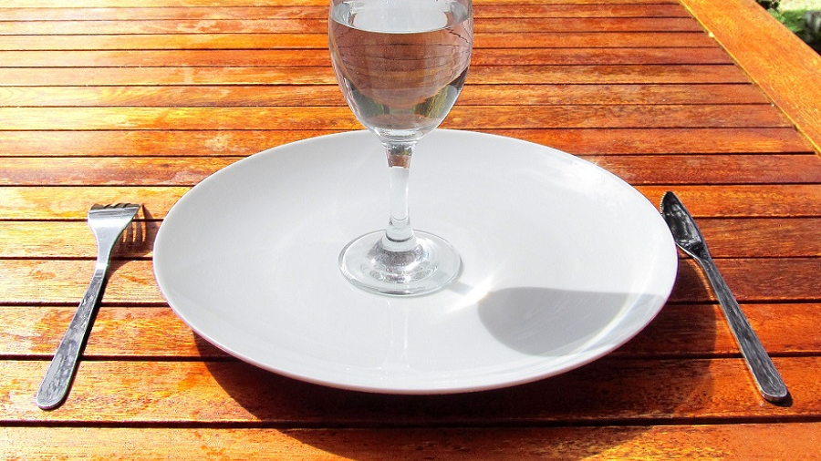
What is Fasting Anyway?
More than doing without food, even more than going without for a purpose, Biblical fasting can include many forms of abstinence.
At its core fasting is about humility and self-denial.

Slide 3
Occasions and Purposes of Fasting
Occasions of sorrow and repentance…
Building of trust…
Facing Temptation…
Anticipation.

Slide 4
What Defeats the Point?
Fasting to be seen by others…
Fasting to put God on a string…
Fasting without real purpose.

Slide 5
Applications for the Modern Day
Traditional abstinence from food…
Fasting from pleasures and luxuries…
Fasting from technology and convenience

Slide 6
Humility, Self-Denial, and Fasting

