Slide 1
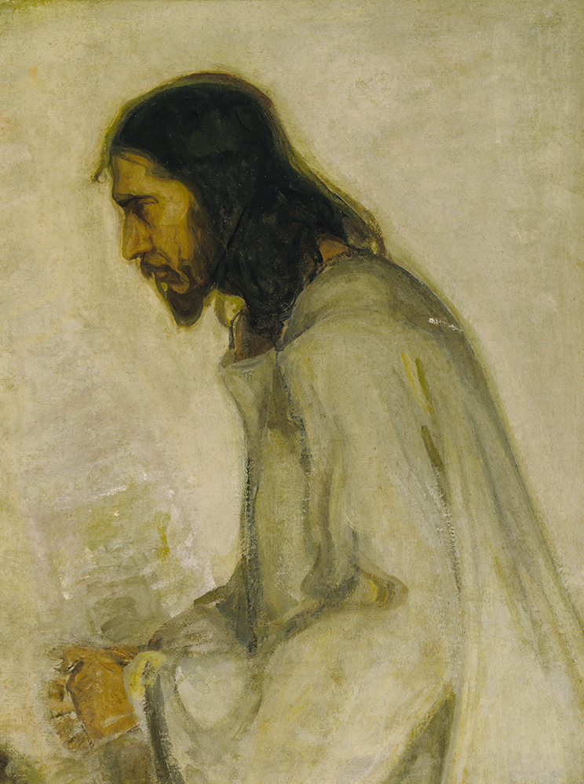
Colossians:
New Life in Christ
Part i: Increasing in the Knowledge of God

Slide 2
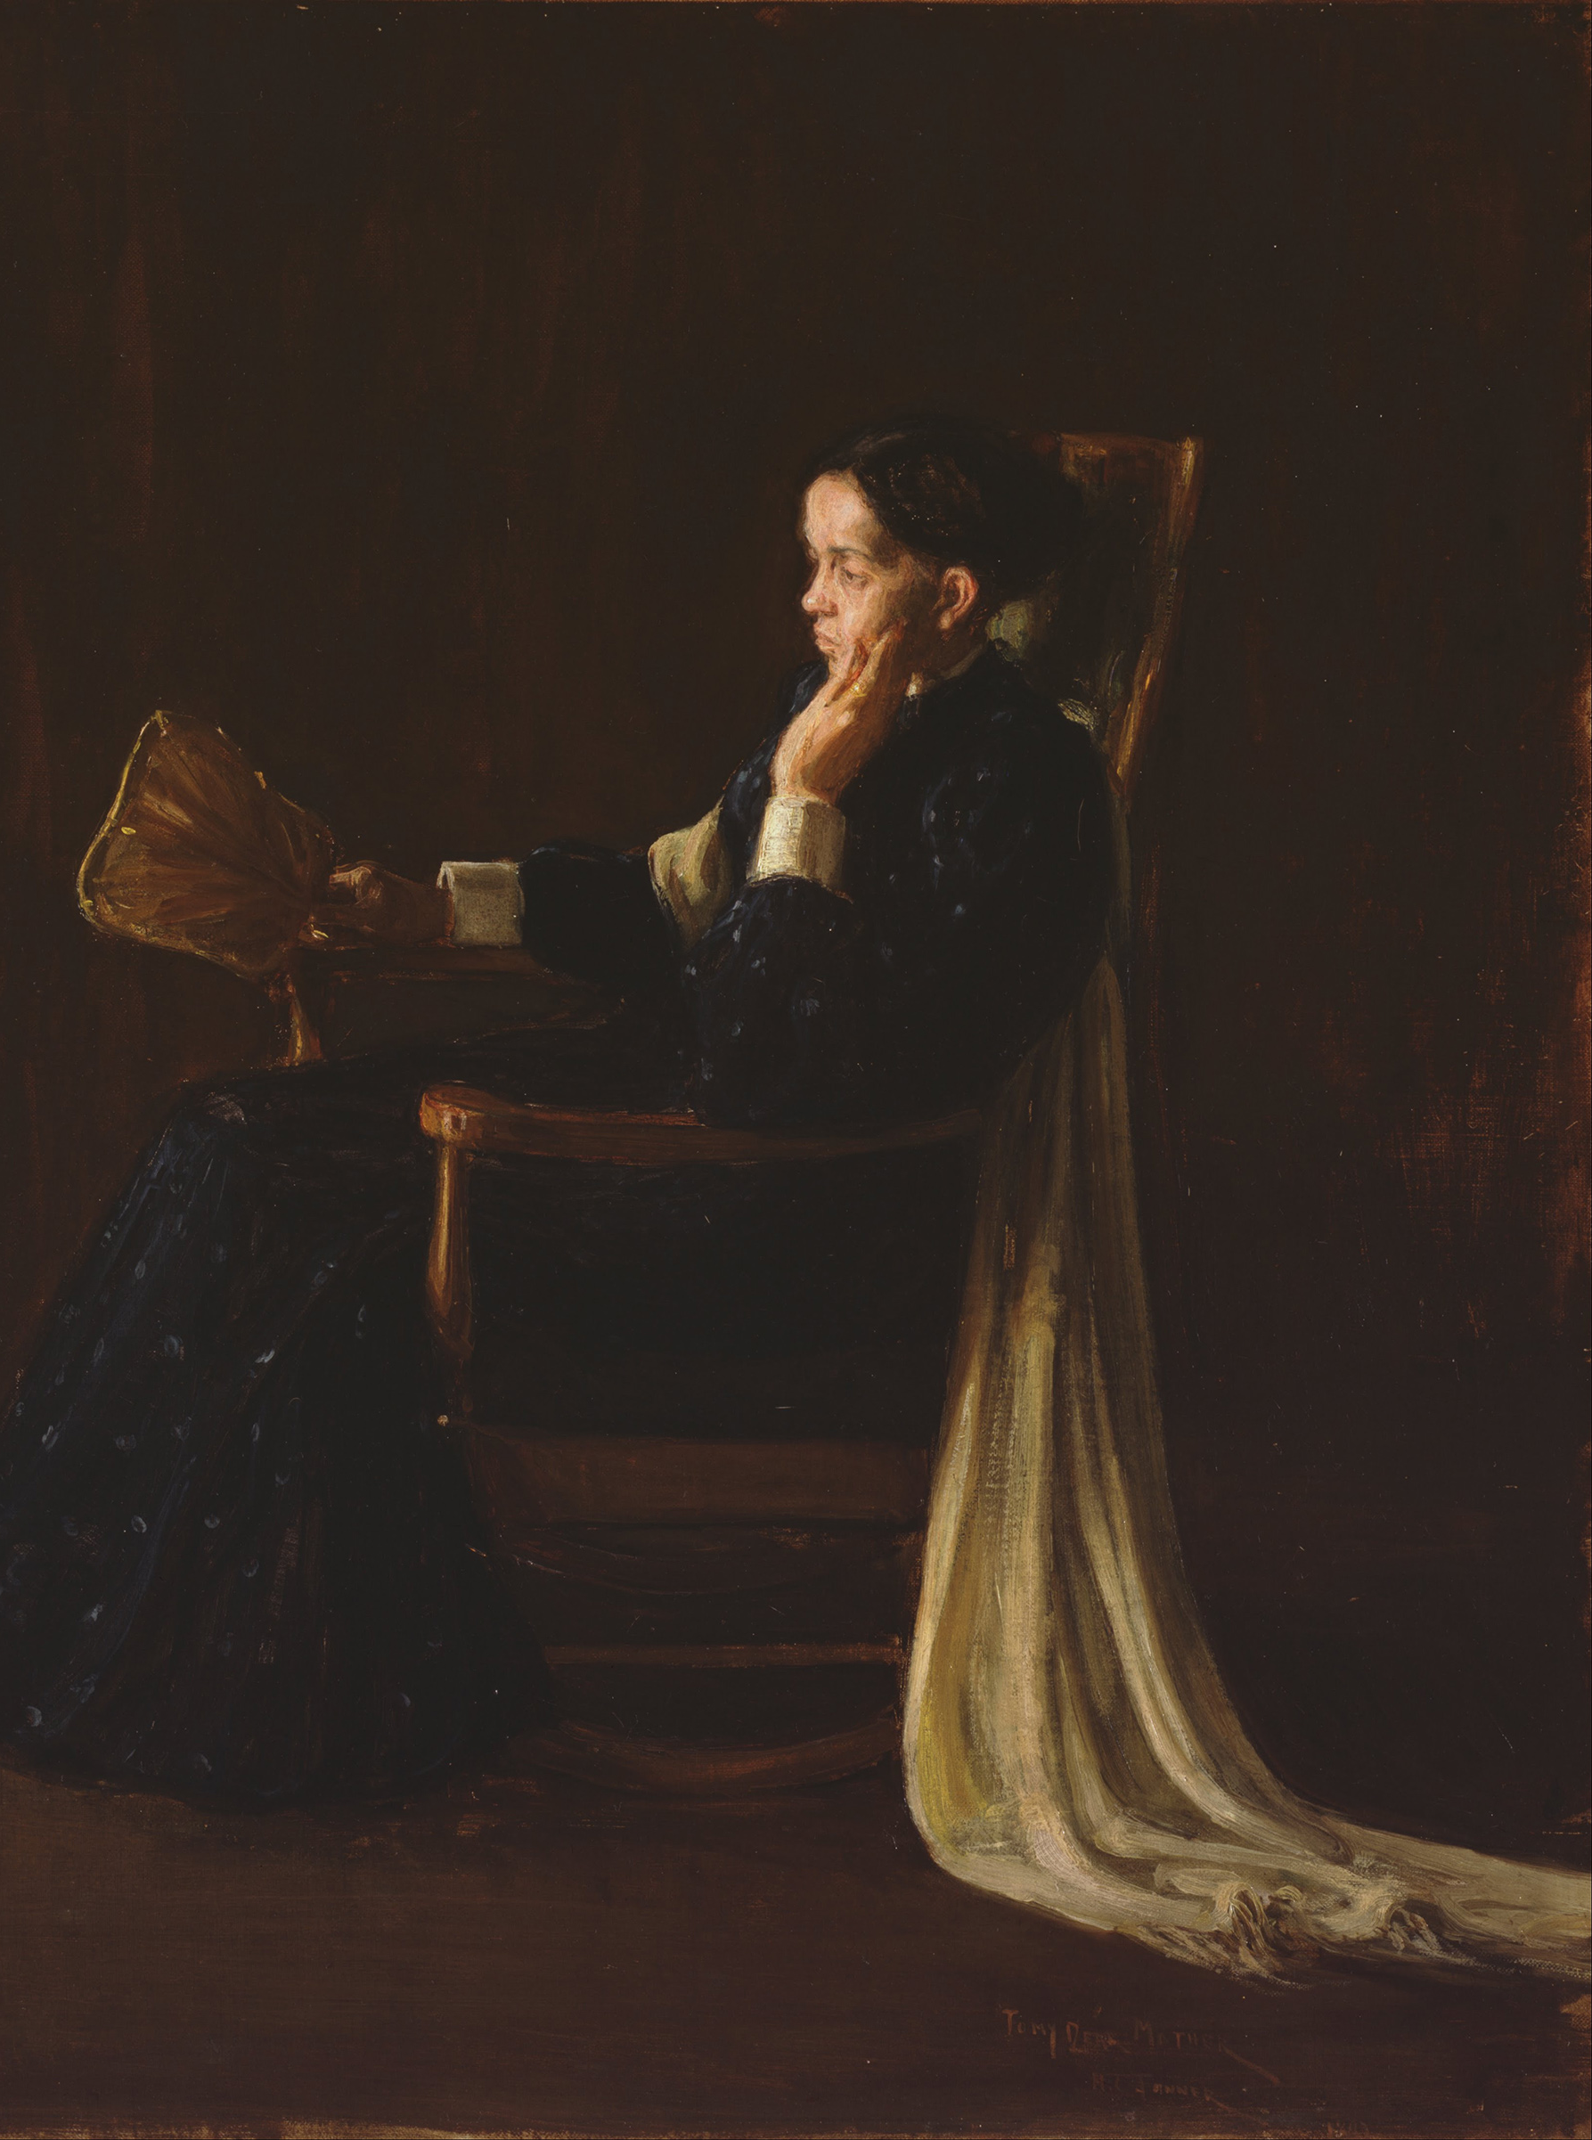
Themes of Colossians
The Supremacy of Jesus.
  He is the king, the authority, and our only hope.
A Call to Maturation.
  Don’t stay where you are, know more and bear more fruit!
The Encouragement of the Saints.
  The Colossians were known for their love, as all Christians should be.

Slide 3
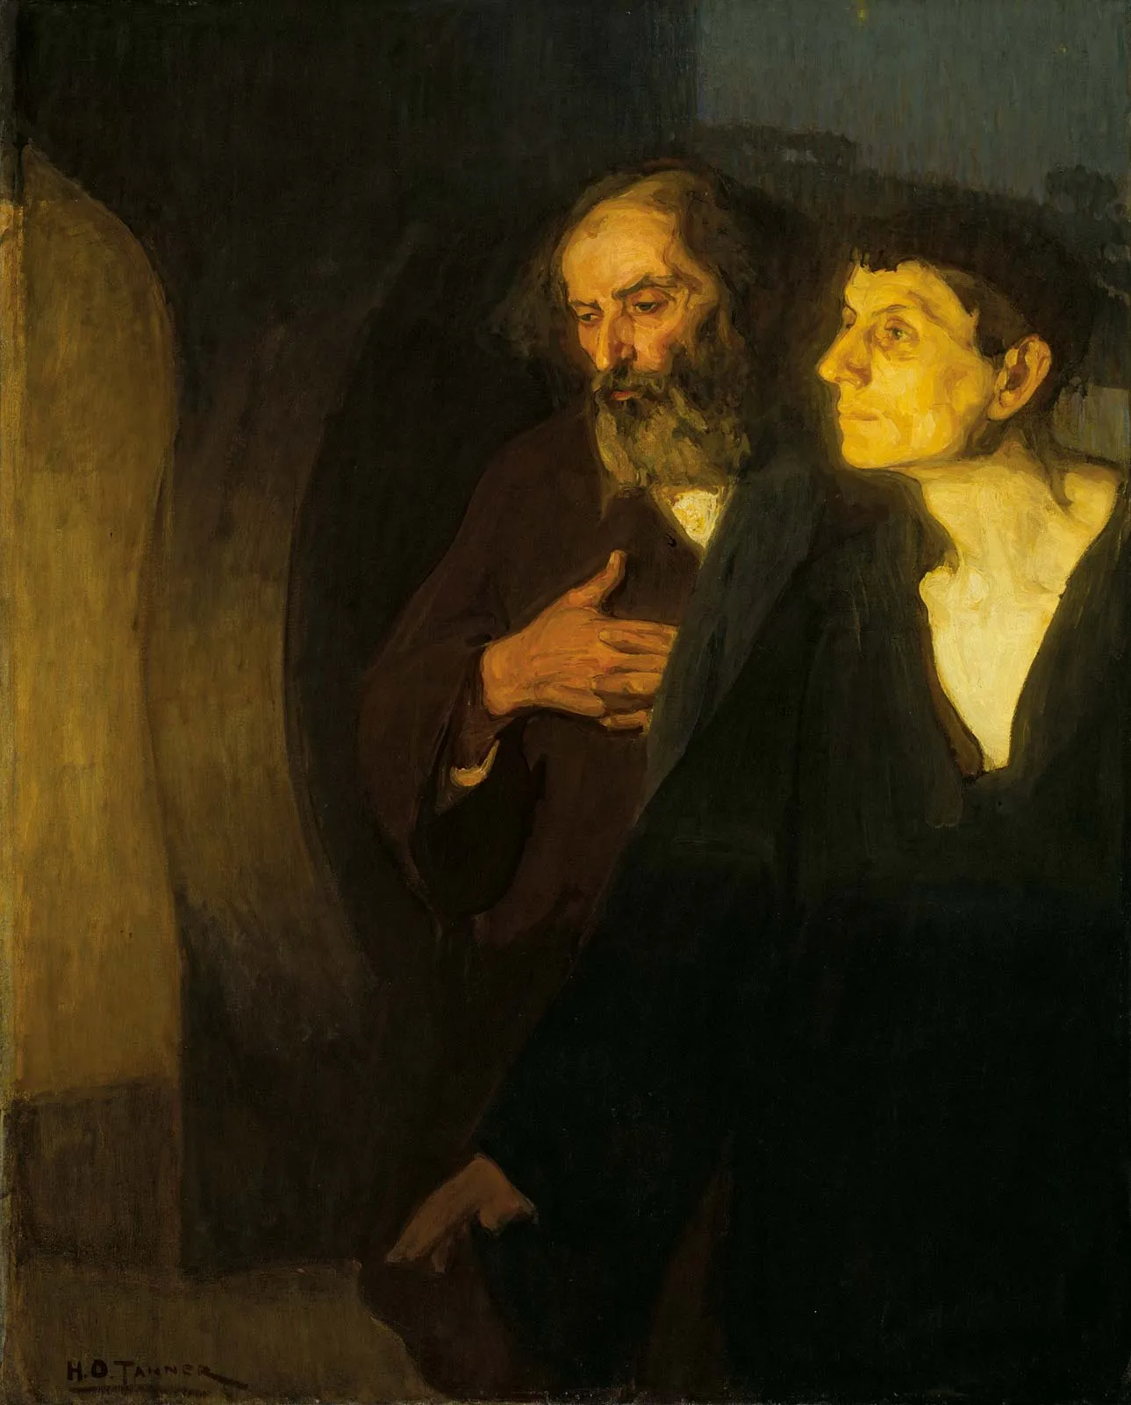
Colossians 1.1-2: Grace to you and peace from God our Father.
Paul’s introduction is his traditional one. He asserts his apostleship because His teaching should be taken as authoritative.
He’s also writing to a mixed audience here in Colossae, and so he uses greetings for both. Grace and Peace are truly found in Christ.

Slide 4
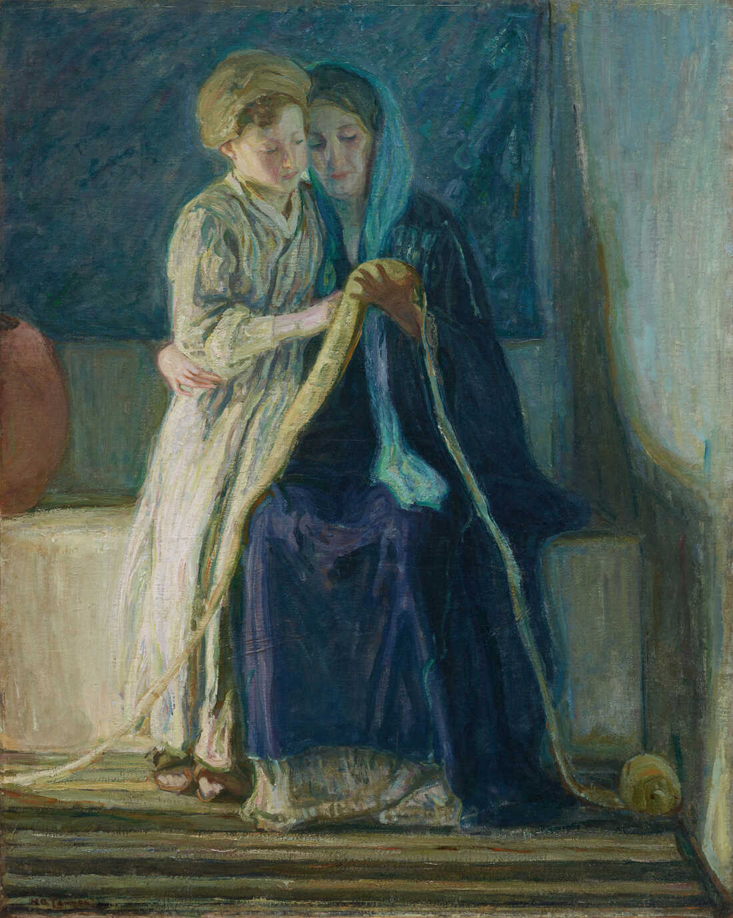
Colossians 1.3-8: Faith, Love, and Hope
Paul’s thanksgiving comes because of their faith placed in Jesus, their love they show other saints, and the hope of them all dwelling in heaven. Is our Christian practice known for these three things?
The Colossians heard the teaching and understood (meaning it was put into practice). It is reflective of their soft hearts, but also good teaching from Epaphras.

Slide 5
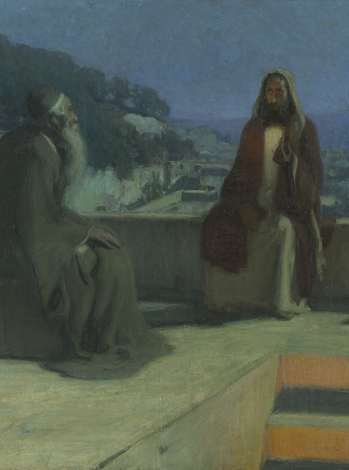
Colossians 1.9-14:
Keep Growing!
The Colossians were surrounded by all sorts of people claiming to have wisdom and knowledge. Paul is praying that they will “be filled with the knowledge of his will in all spiritual wisdom and understanding,” not swept away by false wisdom.
Our transformation isn’t from okay people to good people in Christ – it is from darkness to light, dead to alive, hopeless to hopeful.

Slide 6
Colossians 1.15-20: In Him, all the fullness of God was pleased to dwell…
Christ is not only Creator (vs. 15-16), but sustainer (vs. 17) and all creation belongs to Him. (vs. 16) He is the hope to overcome death (vs. 18) and the revelation of God (vs. 15, 19)
Jesus is also the head of the church (vs. 18). Everything we do must be under His authority and according to His wisdom. Also, all reconciliation comes because of Him (vs. 20), and He suffered violence so that we could know peace through Him.

Slide 7
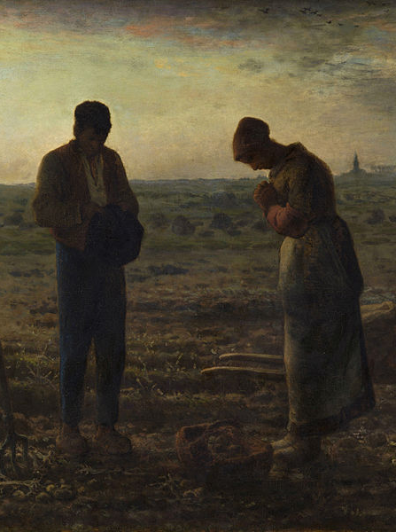
Colossians 1.21-23: Stand Firm!
Humans are alienated outside of Christ. They’re far away from God, they don’t build healthy relationships one another, and there is so much selfishness.
In Christ, He turns us from our flesh into something that is holy and blameless. We can’t make ourselves perfect, it is Christ alone who can help us.

Slide 8
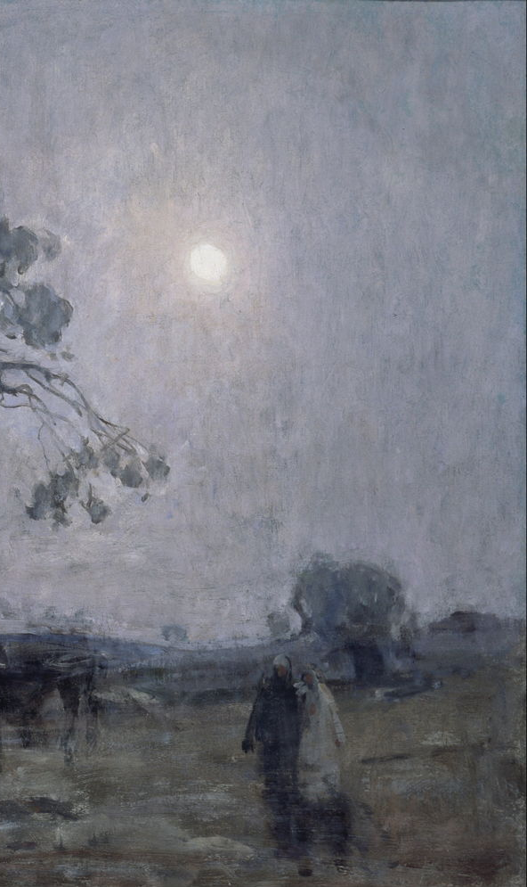
Application:
Do something to show your love for a saint – something where you thinking exclusively for the good of another saint. Encouraging another, showing thankfulness, making something, visiting to them, whatever the case may be.

