Slide 1
Service Isn’t Overlooked

Slide 2
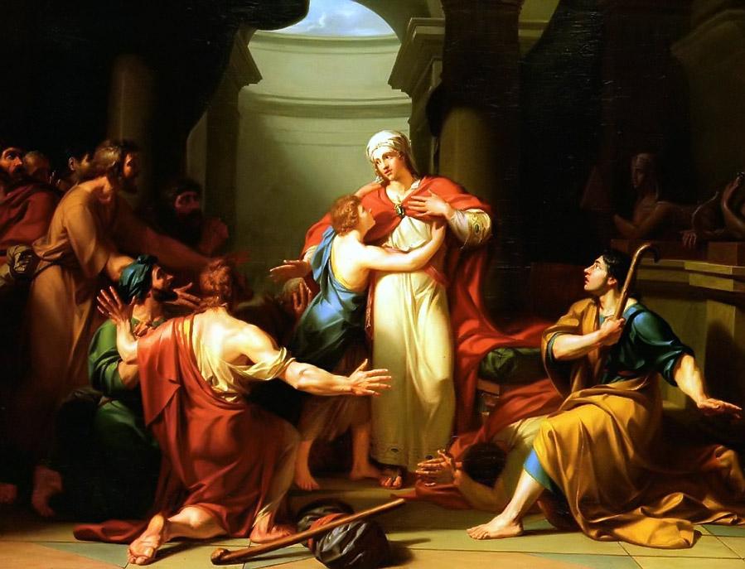
Judah (Genesis 44.14-34)
Judah failed… hard. Both with his brother and his family. He was entirely selfish. The picture we have in Genesis 44 is a new man. All of his appeal to Joseph is about what would happen to Jacob and Benjamin, not about him. He can’t atone for what he did, but what he can do the right thing now. It requires selflessness.

Slide 3
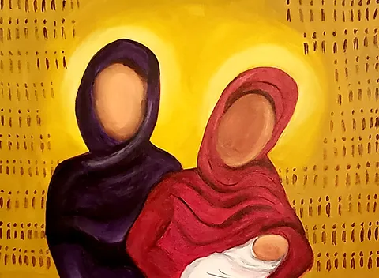
Shiphrah and Puah (Exodus 1.8-22)
When powerful people instruct us to do evil, it can be tempting to simply give in. Shiphrah and Puah show tremendous courage by just doing their job well, protecting their nation through service. God doesn’t overlook them and blesses the nation through their efforts.

Slide 4
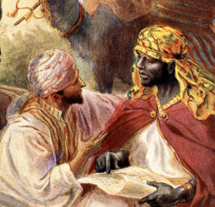
Ebed-melech (Jeremiah 38.1-13)
Jerusalem is supposed to be a place where God dwells. The attitude of Zedekiah and those surrounding him reflects only evil. It takes Ebed-melech, a foreigner, to step up and do what is right for Jeremiah. He doesn’t just report on the evil, but also makes the effort to save him.

Slide 5
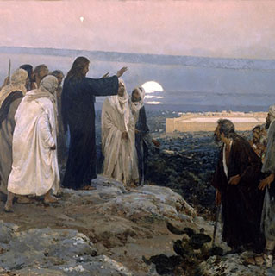
“Come, you who are blessed by my Father.” (Matthew 25.31-46)
Jesus’ words in Matthew 25 are both comforting and challenging. He reminds us that simple things done in faithful service lead us to the blessed land that’s prepared for us. However, if we overlook these “simple” things, we are forgetting the goodness of our king. The ways that Jesus has served us, ‘the least of these’, so also ought to we to serve. Not for the sake of moral dessert, but because we want to glorify, honor and see our worthy God.

