Slide 1
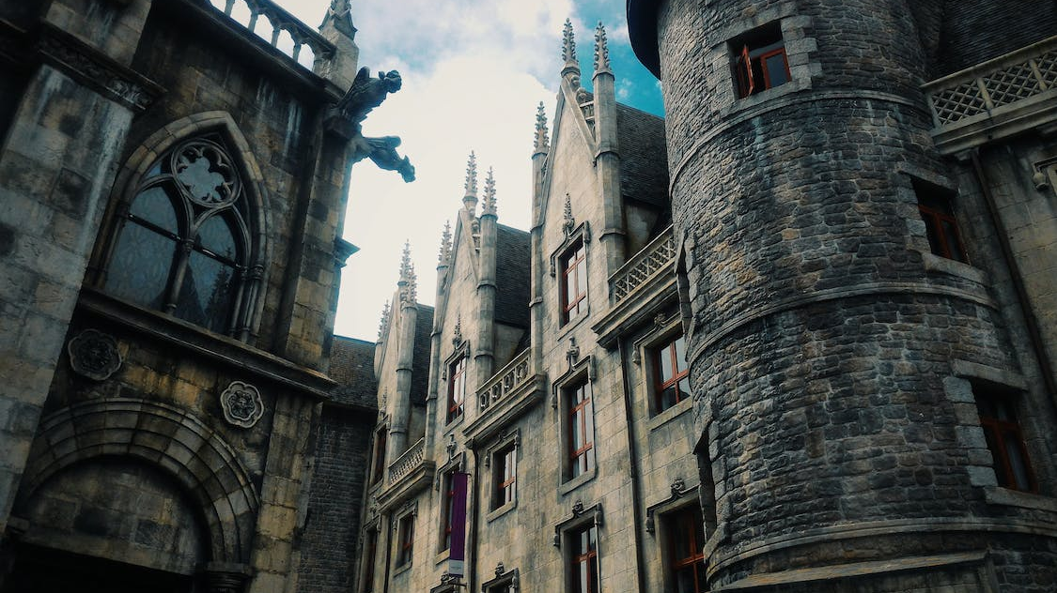
Living in the City of Truth

Slide 2
Citizens of the City of Truth
When we read warnings against falsehood, we need to ensure that we appreciate the greater context of how it goes against God’s nature.
God’s people are to mirror His nature of absolute honesty and walk in a way that demonstrates truth in every part of our lives.
Aside from being true to our new natures, our honest is intended to be a blessing to those in the world around us.

Slide 3
Common Cultural Mistakes
Treating lies as a casual act can make dishonesty a natural state.

Slide 4
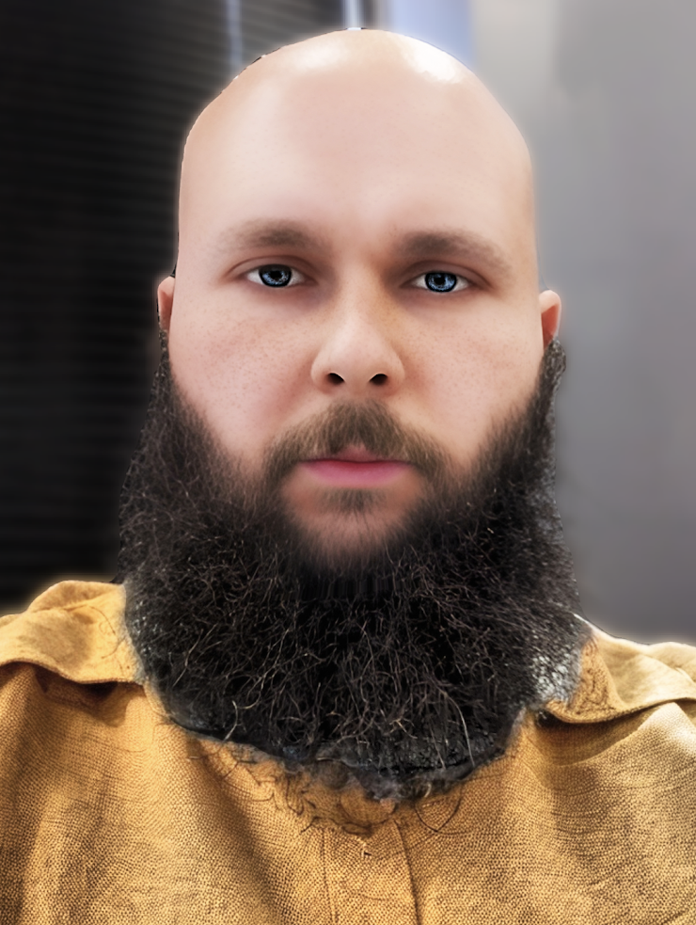

Slide 6
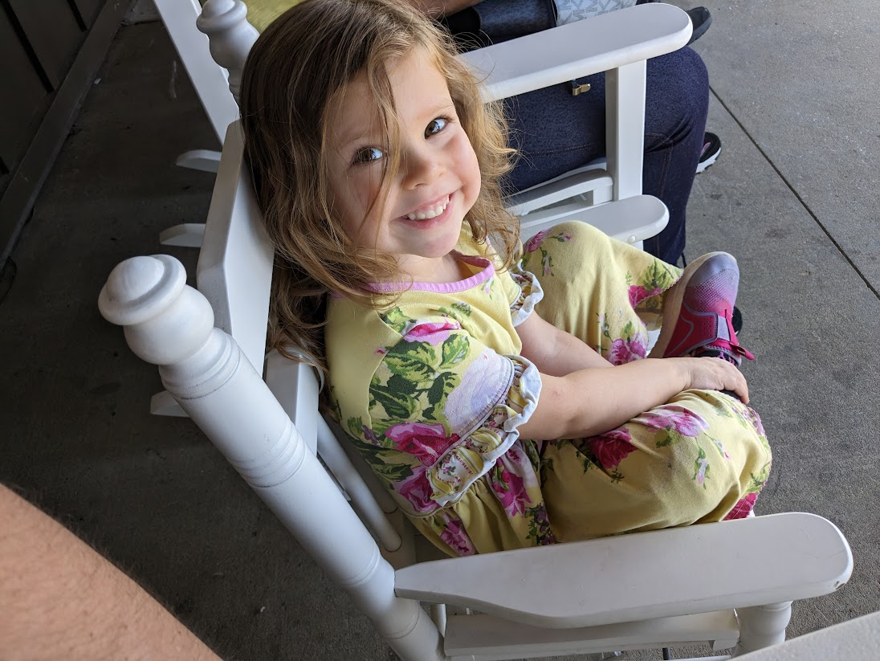

Slide 8
Common Cultural Mistakes
Treating lies as a casual act can make dishonesty a natural state.

Slide 9
Common Cultural Mistakes
Treating lies as a casual act can make dishonesty a natural state.
We can easily mistake dishonesty for being “business savvy.”
Allowing pride or other misguided notions push us toward doubling down drags us further away from correcting our mistakes.

Slide 10
Thinking Ahead
Does your conduct match your citizenship?
Do you understand the severity?
Have you done what you can?

Slide 11
Living in the City of Truth

