Slide 1
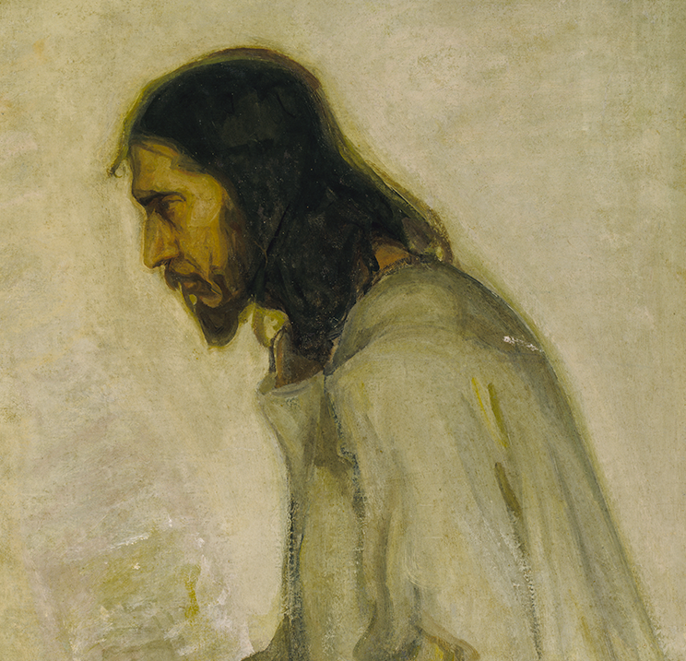
Colossians:
New Life in Christ
Part iii: Christ, Who Is Your Life
Colossians 2.16-3.17

Slide 2
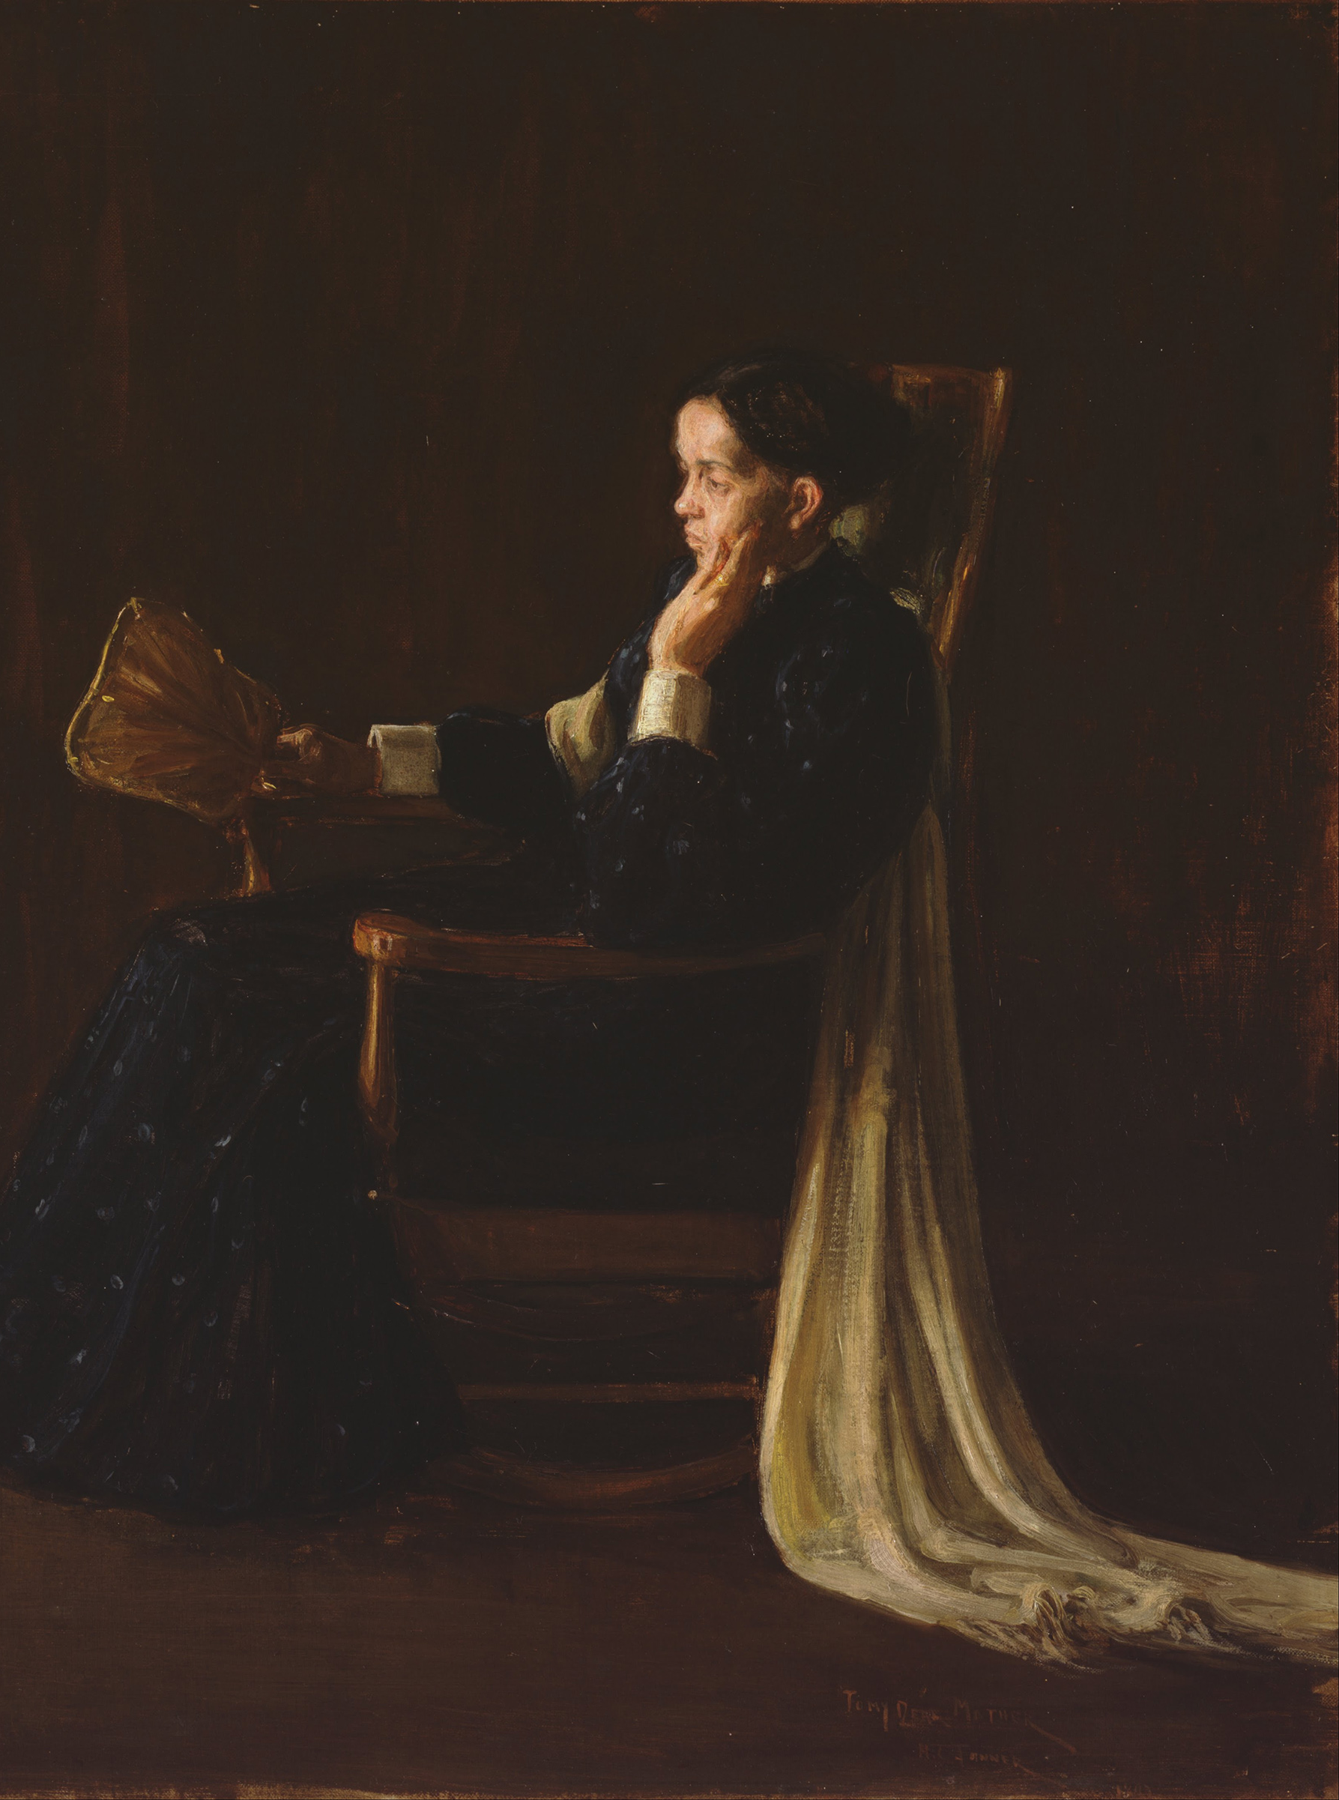
Themes of Colossians
The Supremacy of Jesus.
  He is the king, the authority, and our only hope.
A Call to Maturation.
  Don’t stay where you are, know more and bear more fruit!
The Encouragement of the Saints.
  The Colossians were known for their love, as all Christians should be.

Slide 3
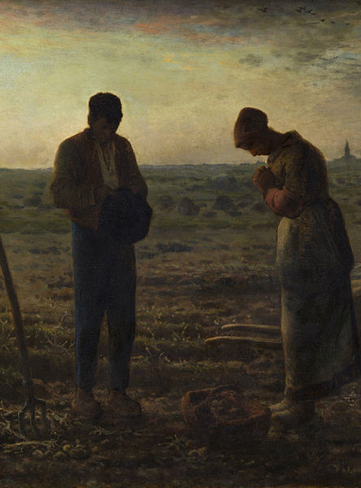
Colossians 2.16-19:
Jesus is Enough
Paul keeps setting this contrast – the empty against the full, the puffed up against the substance.
True religion is Jesus centered – if any fasting is done or Sabbath is celebrated, it must be with Christ is mind. We need to hold fast to Him and make sure all teaching draws us closer to Him.

Slide 4
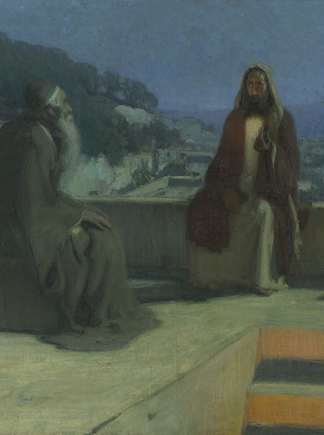
Colossians 2.20-3.4:
Self-Made Religion vs. New Life in Christ
Self-made religion is dangerous because it is based on human precepts. They look religious but instead they puff up and they can’t stop the indulgence of the flesh.
In Christ we have all confidence and hope. Our life is hidden in Him. So, instead simply looking religious, we need to hold to Jesus, our true religion.

Slide 5
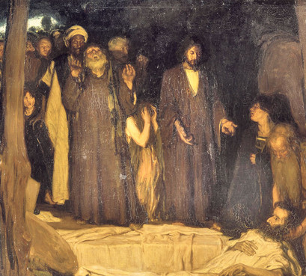
Colossians 3.5-11:
The Earthly needs to die…
Christians are supposed to be regulated, but it is a regulation placed on us by our good and righteous God. That means that all we are rejecting is evil.
Just as sin is a universal problem, Jesus is hope for all who trust in Him.

Slide 6
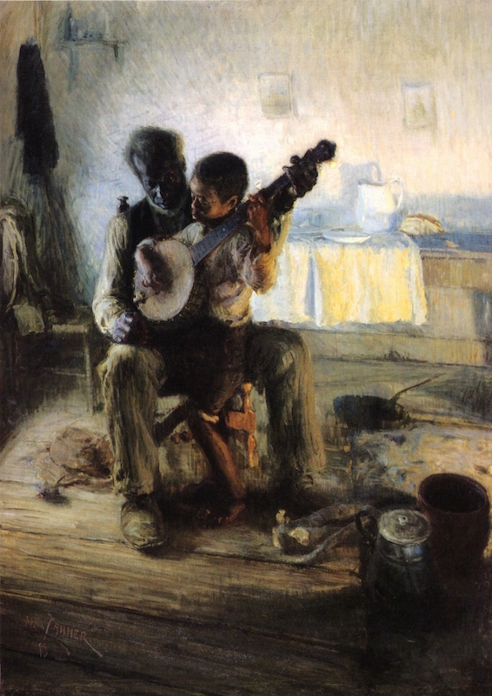
Colossians 3.12-17:
… so the Spiritual can live.
We are to reject the evil and put on the good. The things we first see in Christ is how we’re supposed to practice our religion with all others. He needs to dwell in us.
“And whatever you do, in word or deed, do everything in the name of the Lord Jesus, giving thanks to God the Father through him.”
(Colossians 3:17)

Slide 7
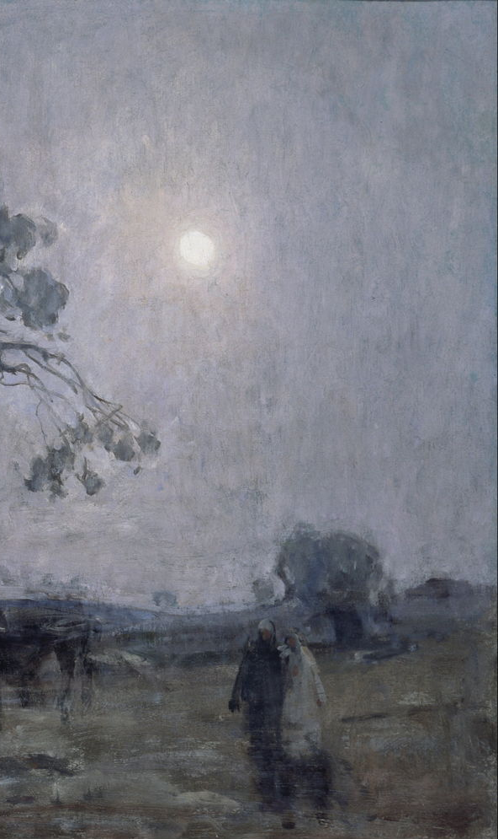
Application:
Our knowledge of God needs to grow, and it grows through:
o The word of Christ dwelling in us richly.
o Listening to wisdom and being teachable.
o Teaching one another through song.

