Slide 1
Judge Not? Matthew 7.1-6

Slide 2
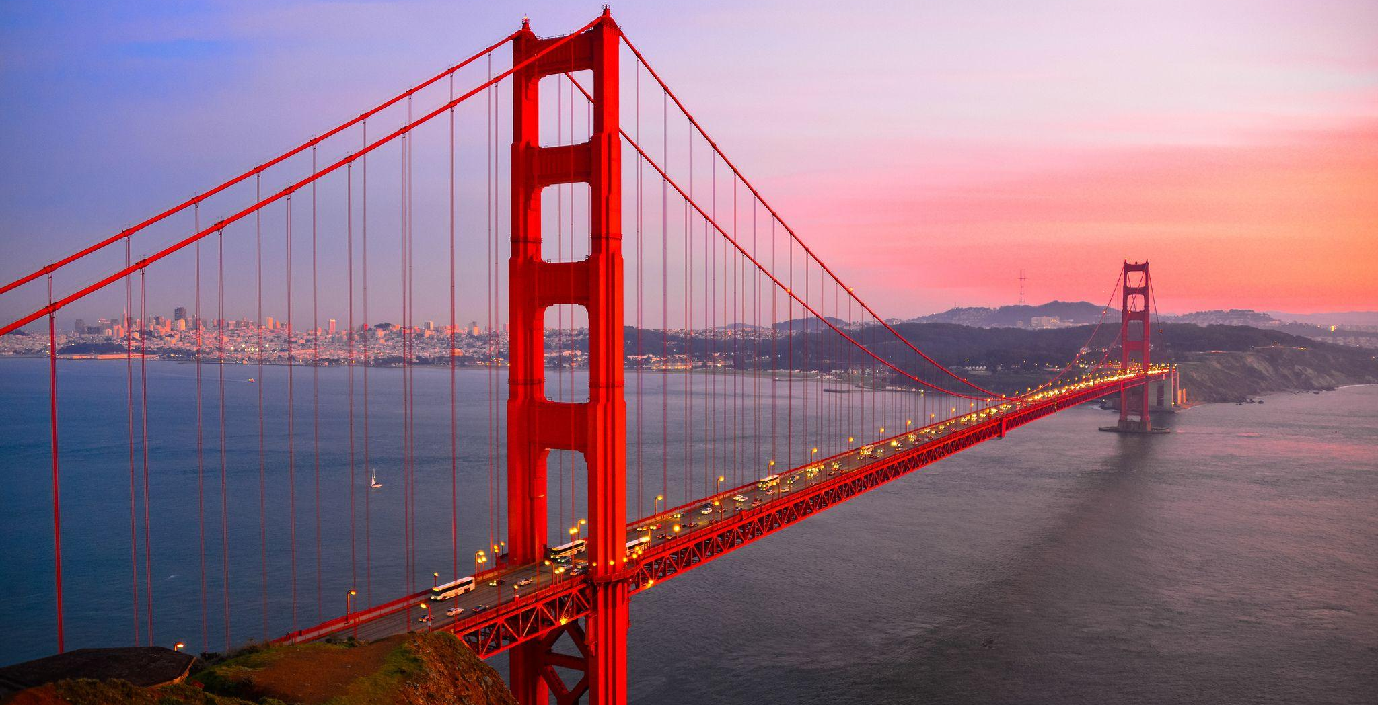
Righteousness
Unrighteousness
Self-Righteousness

Slide 3
Joshua 6.15-7.5
Unrighteousness is displayed in this passage in two major ways:
i. Achan rebelliously taking the things devoted to God, acting like the belonged to him.
ii. Joshua and Israel arrogantly setting out a plan without considering God at all.
The rewards for obedient our evident. Going our own way leads to our doom.

Slide 4
Jonah 3.10-4.11
Jonah is a prime example of someone who believes they deserve mercy from God, but others don’t. This mentality is destructive – it sets up mere man as good while rejecting God as the standard.
Which way is better? Our way or God’s?

Slide 5
Matthew 7.1 – Judge Not?
Lots of people read this passage as only “judge not”, meaning we shouldn’t call out evil or say anything is evil.
In response, some Christians read this passage even shorter: “judge”. But is that what Jesus is trying to teach those who are following Him?

Slide 6
Matthew 7.1-2 – Judge Not?
Jesus is calling us to judge properly. Too often when we make judgements, they come from our biased perspective. Jesus is teaching that the standard we hold others is the standard we will be held to. That’s why the “law of liberty” (James 2.12-13) gives all believers hope. When we act in mercy, we can trust Jesus will act mercifully. He’s already shown us the way.

Slide 7
Matthew 7.3-5 – Trees in our Eyes
Jesus’ teaching of this is humorous, but humorous to teach a point.
Literal trees in our eye would have huge ramifications:
We’d have a huge blind spot.
We couldn’t get into most places.
We’d likely hurt a ton of people, even unintentionally.

Slide 8
Matthew 7.3-5 – Trees in our Eyes
If we approached people by firstly evaluating how we’re doing in that area, our congregations would be dramatically different. Our desire wouldn’t just to call people out but love them and care for the state of their souls. Take the log out of your eye!

Slide 9
Matthew 7.6 – Pearls Before Swine
A part of judgement is wisdom and discernment. Lots of people need your help and your effort – but some people don’t want it. They’re going to scoff at you. All you do is pray for God’s mercy for them and use the effort towards those who are striving to change.

Slide 10
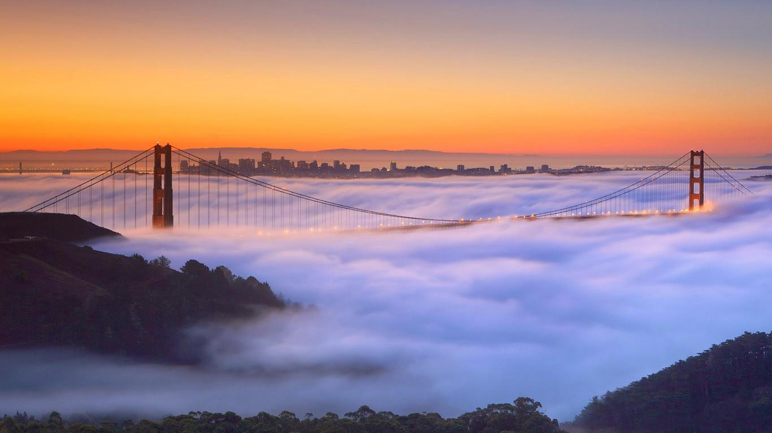
Examine yourself. See if you’re chasing unrighteousness with the claim that God approves of your life. See if you’re being self-righteous, judgmental with no compassion and no accountability for your own actions. Jesus calls us to abandon broken justice and pursue His. And once you’re on the way, you understand how much better His way is.

