Slide 1
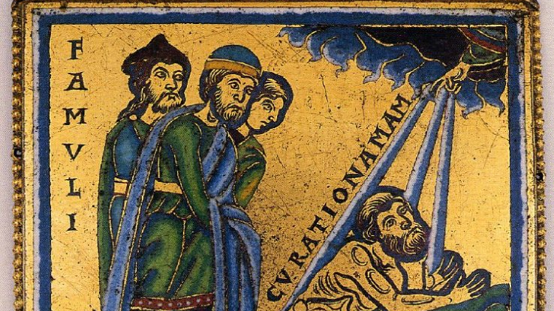
Baptism: Submission, Death, and Life

Slide 2
Submission
Men cannot/will not respond to the gospel until they have decided that they are ready to make a total change.
We are relinquishing control of our lives to Jesus; we have not come before Him to discuss the terms of our surrender.

Slide 3
Death
Paul uses charged imagery because it is fitting for the occasion…
Without the death of the old self and the creation of a new self, we are still under the condemnation of death.
Death is required because we are not “good people” who need Jesus.

Slide 4
Life
Baptism is not the removal of some danger so that we might continue to walk the same path now free from obstructions…
With our old life left behind us, we must now actively pursue something that is wholly new.

Slide 5
Baptism: Submission, Death, and Life

