Slide 1
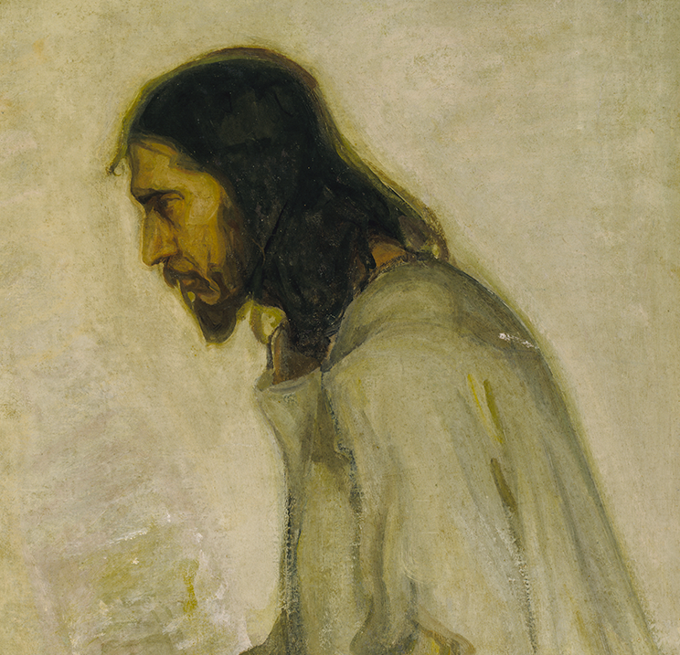
Colossians:
New Life in Christ
Part iv: How Christ Transforms Relationships (Colossians 3.18-4.18)

Slide 2

Themes of Colossians
The Supremacy of Jesus.
  He is the king, the authority, and our only hope.
A Call to Maturation.
  Don’t stay where you are, know more and bear more fruit!
The Encouragement of the Saints.
  The Colossians were known for their love, as all Christians should be.

Slide 3
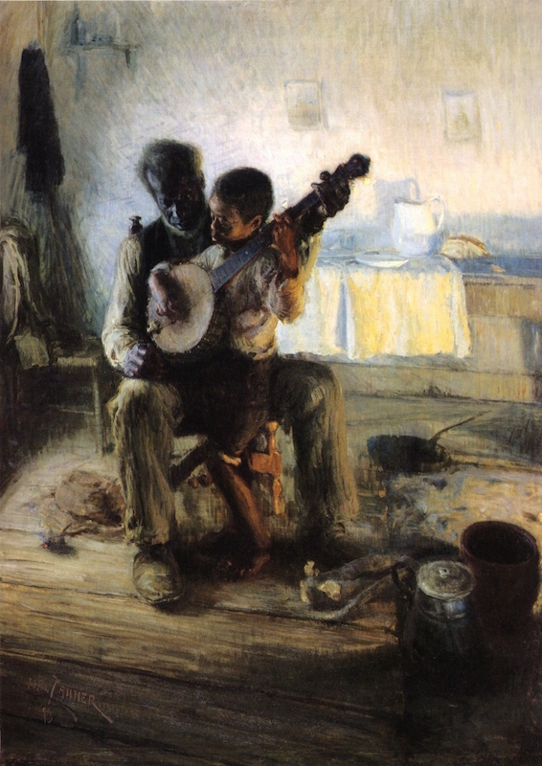
Colossians 3.18-21:
The Family in Christ
The destruction of the Christ-centered family spells disaster. As it fails in the world, it can’t fail in Christ.
Working in harmony, with respect, submission, and love reflects the safety to be found in the family

Slide 4
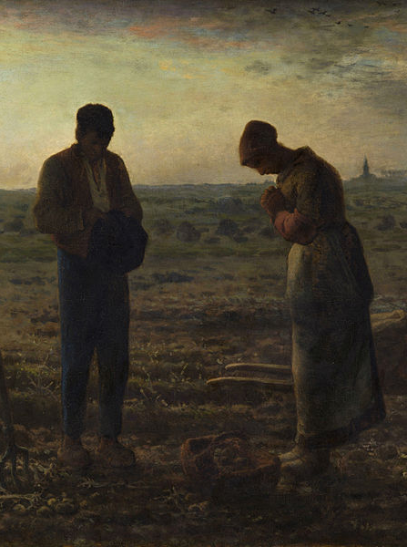
Slaves and Masters – Colossians 3.22-4.1
Three Reminders:
  i. The basis of every teaching is Jesus. The slave or bondservant is to follow the true servant, their Lord and Savior
  ii. Christianity is not a social movement. It moves to change hearts and with that, societal change will come.
  iii. Judgement is real. Slave masters throughout history who have acted with cruelty towards their slaves will receive proper judgement from the Lord.

Slide 5
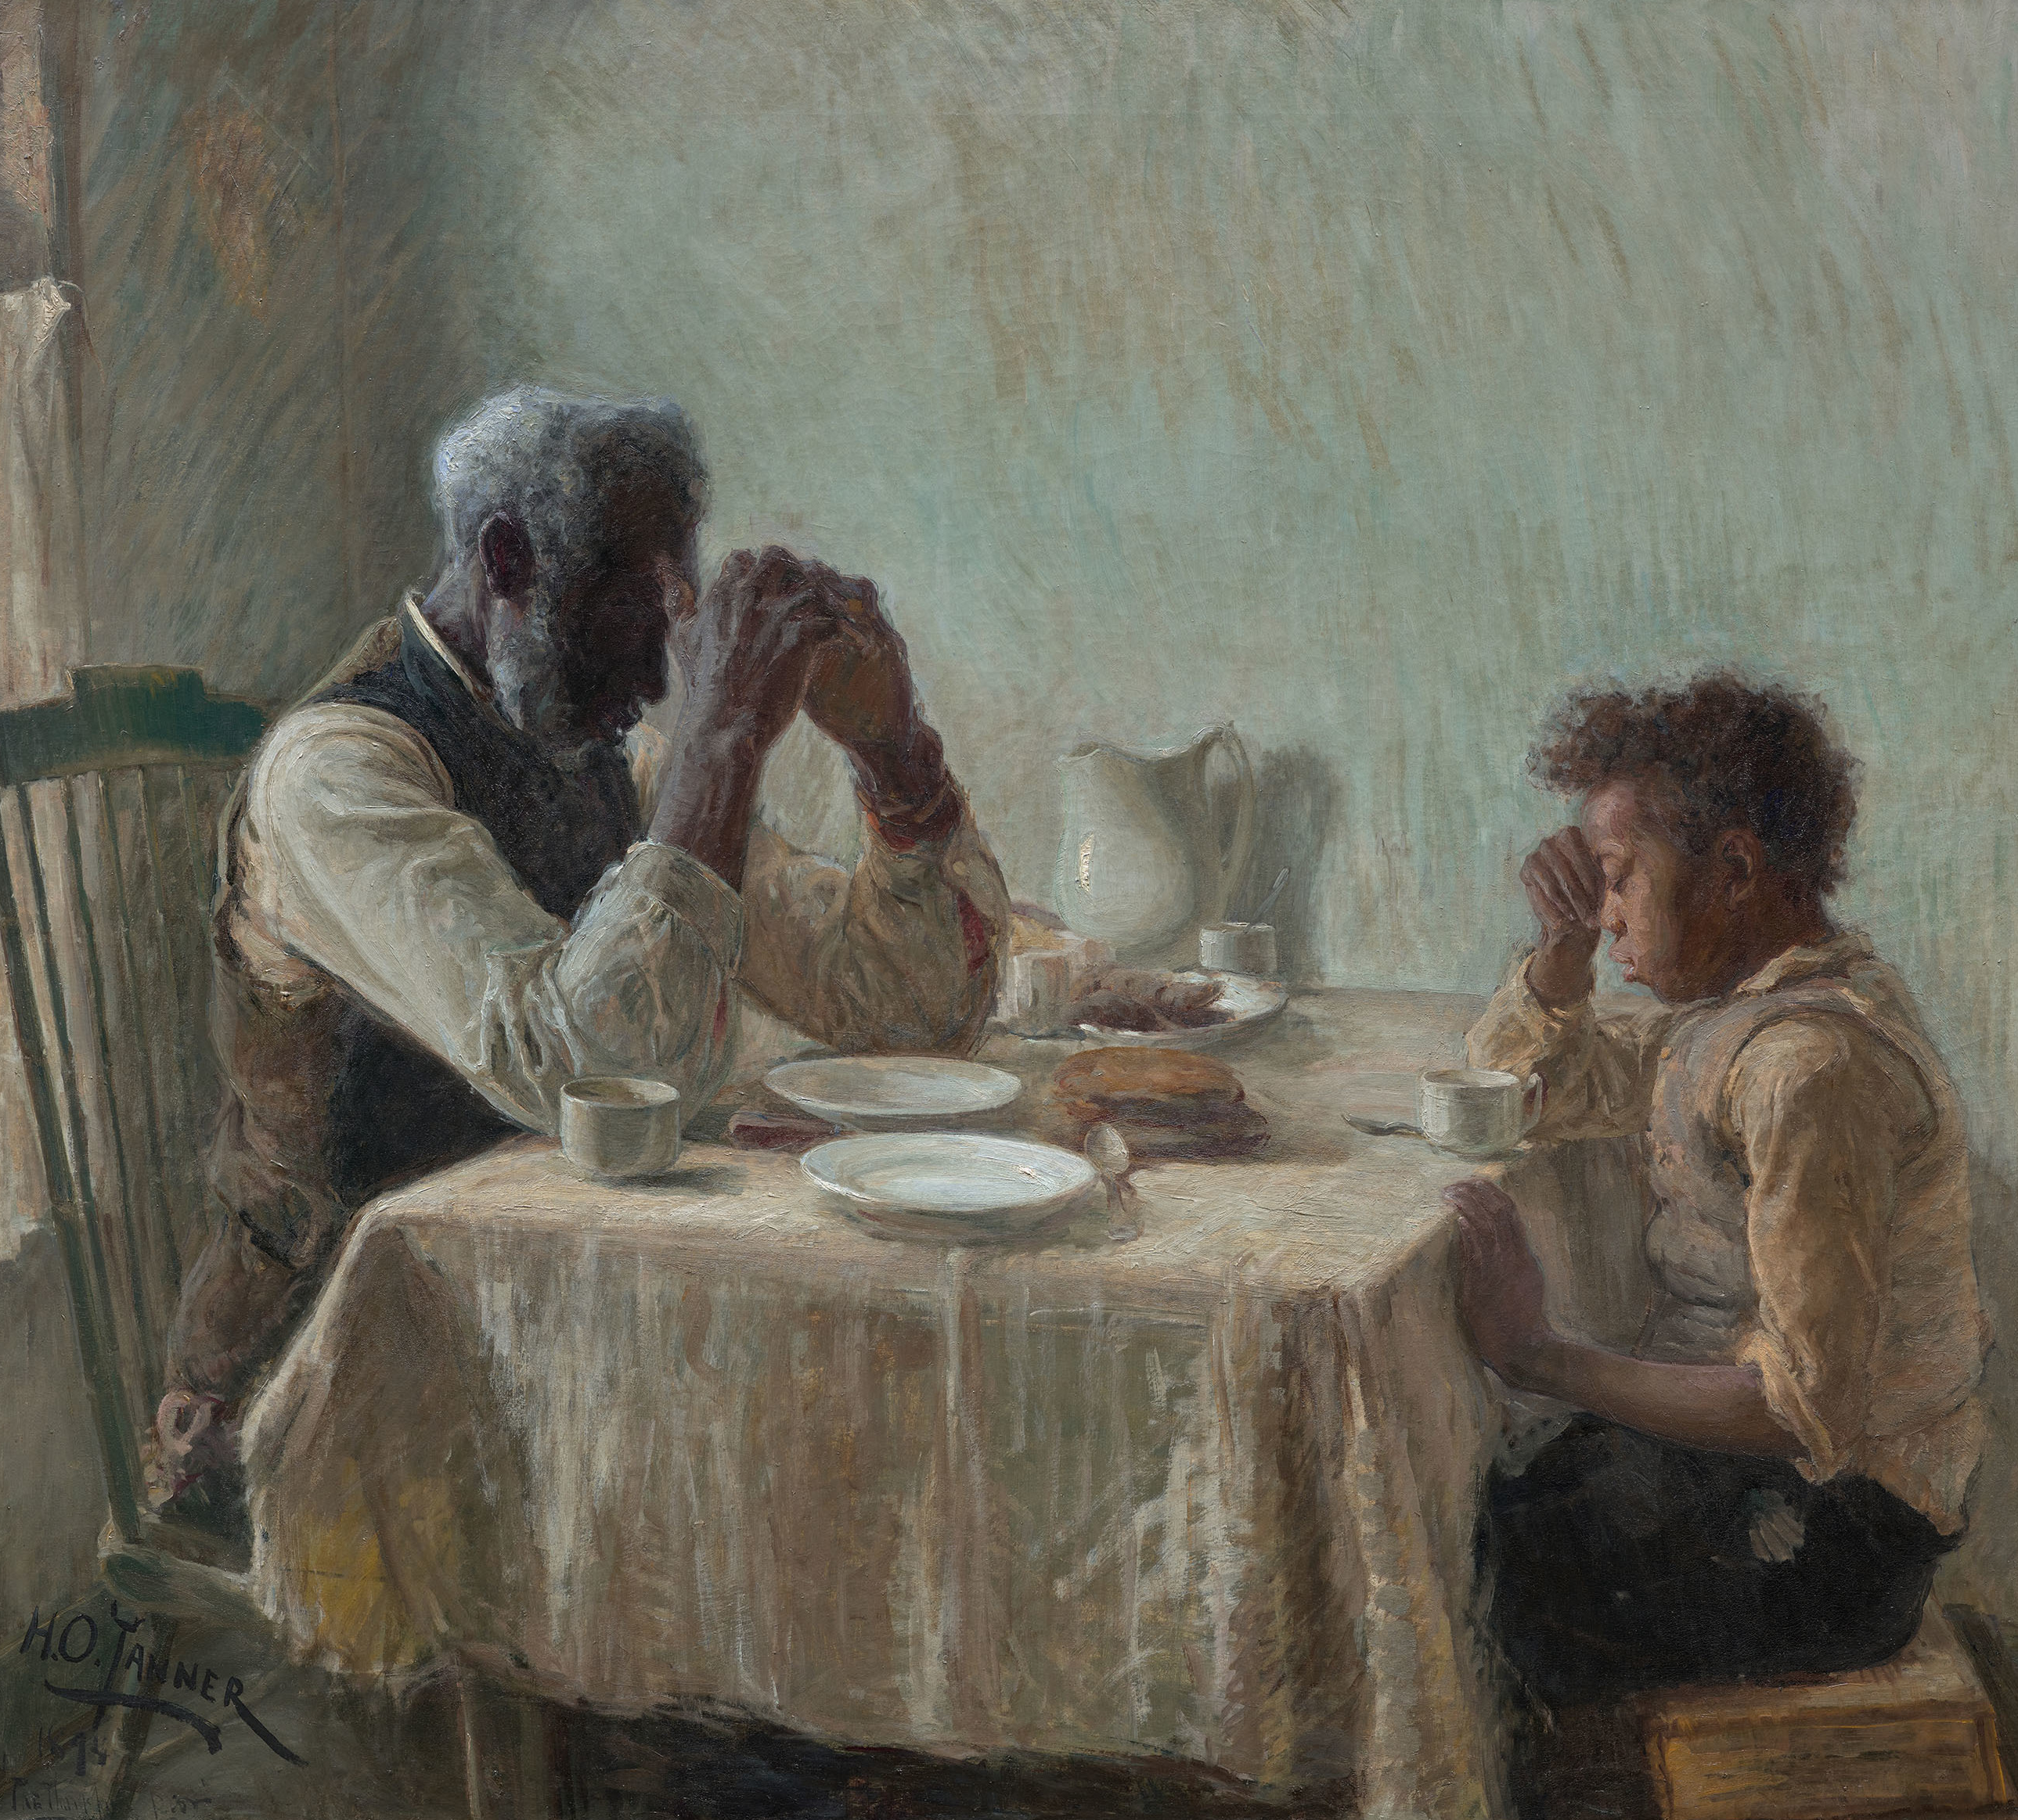
Prayers for Wisdom – Colossians 4.2-6
Paul urges wisdom in Christians, but it is wisdom he knows he needs himself – God’s wisdom is ours to seek.
We need to be considerate of how we use our time and our speech. What would people know about our faith based on our lives?

Slide 6
Paul’s Companions and Lessons – Colossians 4.7-18
The Encouragers – How can we imitate their love?
o Tychicus, the minister
o Epaphras, the minister who struggles for them.
o Nympha, the Hospitable
The Redeemed Ones – How can we be reminded we’re defined by who we are in Christ?
o Onesimus, the former slave and current brother
o John Mark, the welcomed prodigal

Slide 7
Paul’s Companions and Lessons – Colossians 4.7-18
The Faithful and Loyal – What do we do to stay loyal and faithful?
o Luke, the beloved physician
o Aristarchus, the beaten but unrelenting
o Jesus or Justus, the welcomed one
The One On Mission – What does it mean to fulfill your ministry?
o Archippus, the fellow Soldier

Slide 8
Paul’s Companions and Lessons – Colossians 4.7-18
The One Who Turns Away – What things could make us flee Jesus? How do we make sure they don’t?
o Demas, the abandoner

Slide 9
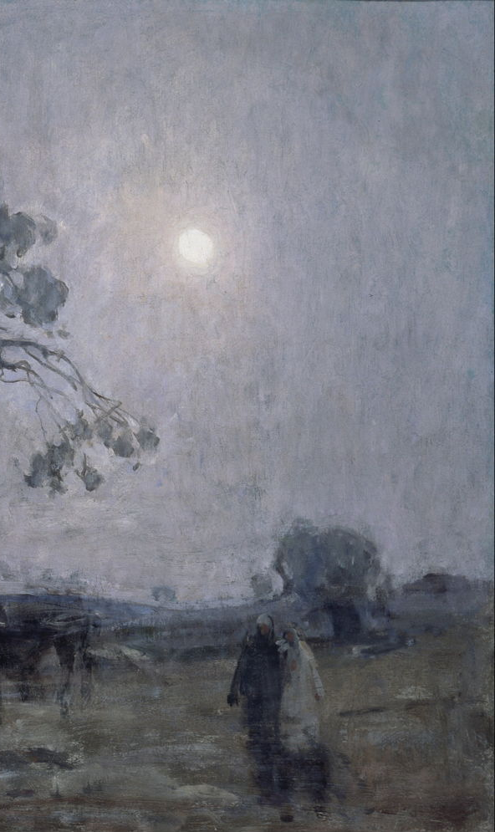
Application:
- Encouragers – How can we imitate their love?
- Redeemed Ones – How can we be reminded we’re defined by who we are in Christ?
- The Faithful and Loyal – What do we do to stay loyal and faithful?
- The One On Mission – What does it mean to fulfill your ministry?
- The One Who Turns Away – What things could make us flee Jesus? How do we make sure we don’t?

