Slide 1
The Biblical Language of God’s Anointed

Slide 2
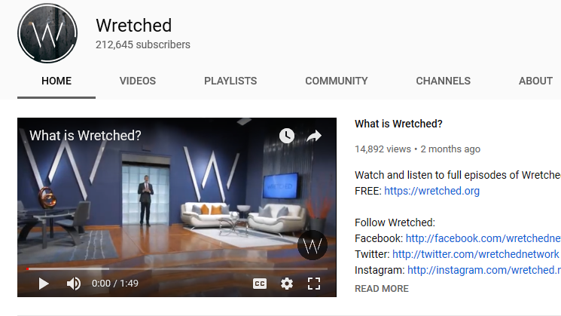

Slide 3
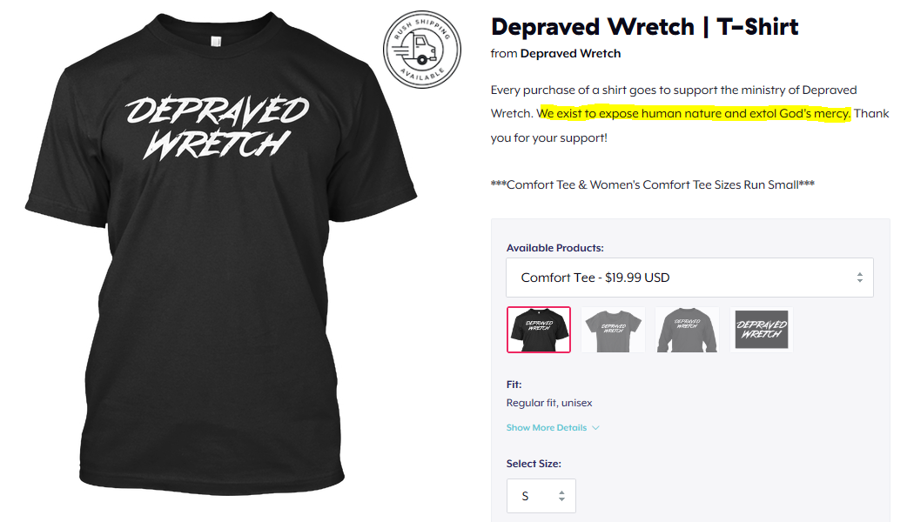

Slide 4
Therefore repent and return, so that your sins may be wiped away, in order that times of refreshing may come from the presence of the Lord; and that He may send Jesus, the Christ appointed for you—Acts 3:19-20
and He Himself bore our sins in His body on the cross, so that we might die to sin and live to righteousness; for by His wounds you were healed—1 Peter 2:24

Slide 5
And you were dead in your trespasses and sins, in which you formerly walked according to the course of this world, according to the prince of the power of the air, of the spirit that is now working in the sons of disobedience. Among them we too all formerly lived in the lusts of our flesh—Ephesians 2:1-3a

Slide 6
For as through the one man’s disobedience the many were made sinners, even so through the obedience of the One the many will be made righteous—Romans 5:19

Slide 7
Therefore, strengthen the hands that are weak and the knees that are feeble, and make straight paths for your feet, so that the limb which is lame may not be put out of joint, but rather be healed.—Hebrews 12:12-13
My little children, I am writing these things to you so that you may not sin. And if anyone sins, we have an Advocate with the Father, Jesus Christ the righteous;--1 John 2:1

Slide 8
Which of you, having a slave plowing or tending sheep, will say to him when he has come in from the field, ‘Come immediately and sit down to eat’? “But will he not say to him, ‘Prepare something for me to eat, and properly clothe yourself and serve me while I eat and drink; and afterward you may eat and drink’? “He does not thank the slave because he did the things which were commanded, does he? “So you too, when you do all the things which are commanded you, say, ‘We are unworthy slaves; we have done only that which we ought to have done.’ ” –LK 17:7-10

Slide 9
Therefore, if anyone cleanses himself from these things, he will be a vessel for honor, sanctified, useful to the Master, prepared for every good work—II Tim. 2:21
But because of your stubbornness and unrepentant heart you are storing up wrath for yourself in the day of wrath and revelation of the righteous judgment of God, who WILL RENDER TO EACH PERSON ACCORDING TO HIS DEEDS: to those who by perseverance in doing good seek for glory and honor and immortality, eternal life; --Romans 2:5-7

Slide 10
The Biblical Language of God’s Anointed

