Slide 1
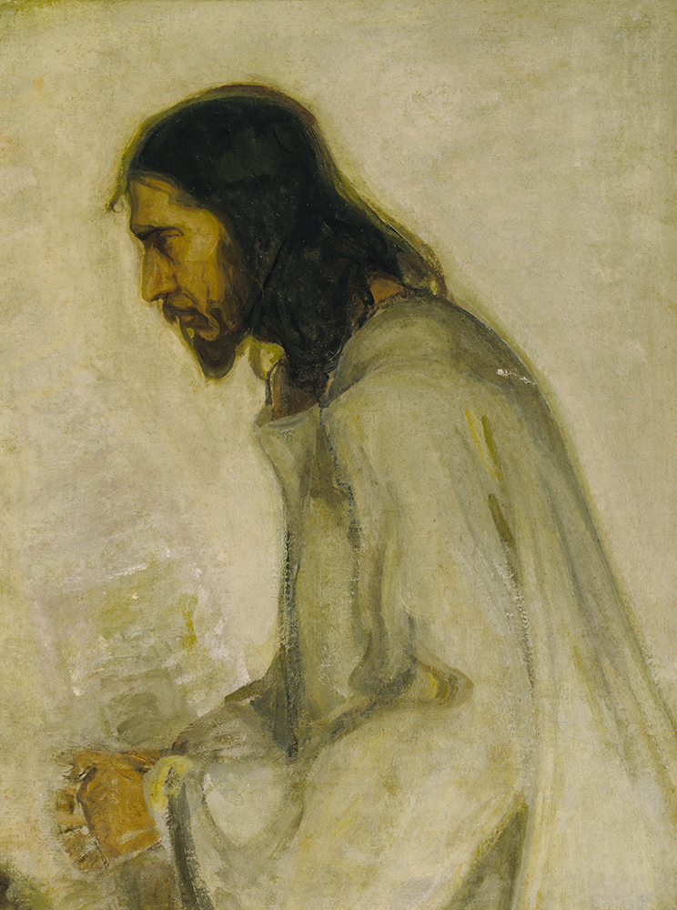
Colossians:
New Life in Christ
Part ii: Revealing the Mystery

Slide 2
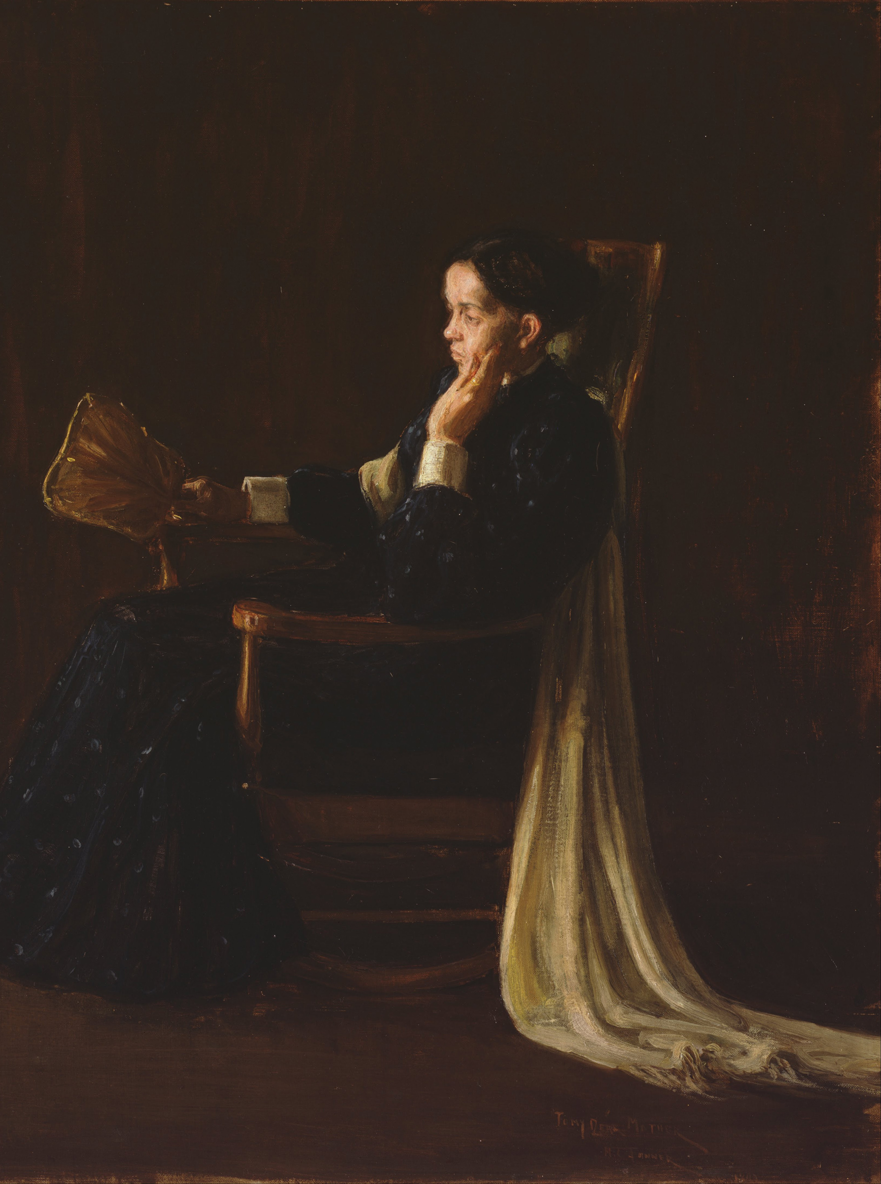
Themes of Colossians
The Supremacy of Jesus.
  He is the king, the authority, and our only hope.
A Call to Maturation.
  Don’t stay where you are, know more and bear more fruit!
The Encouragement of the Saints.
  The Colossians were known for their love, as all Christians should be.

Slide 3
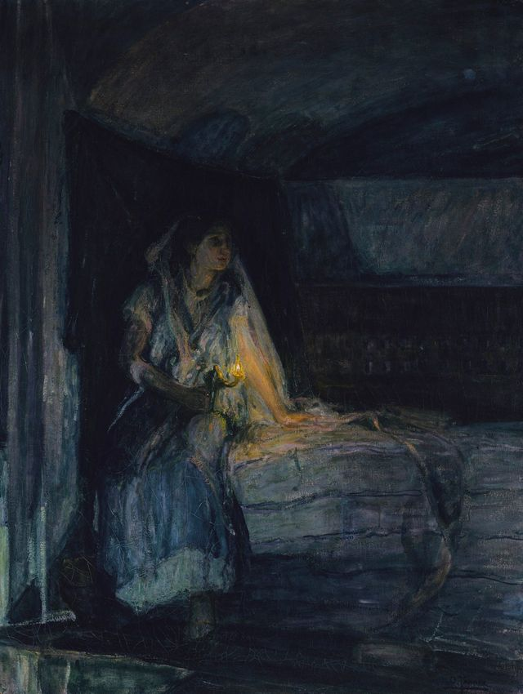
Colossians 1.24-29: What is the Mystery?
Since Paul has become a Christian and a minister, his life has been filled with suffering. But he considers it a worthy cause for the sake of Christ and His church.
The mystery of scripture is this: the indwelling of the Holy Spirit for the believer, both Jew and Gentile.

Slide 4
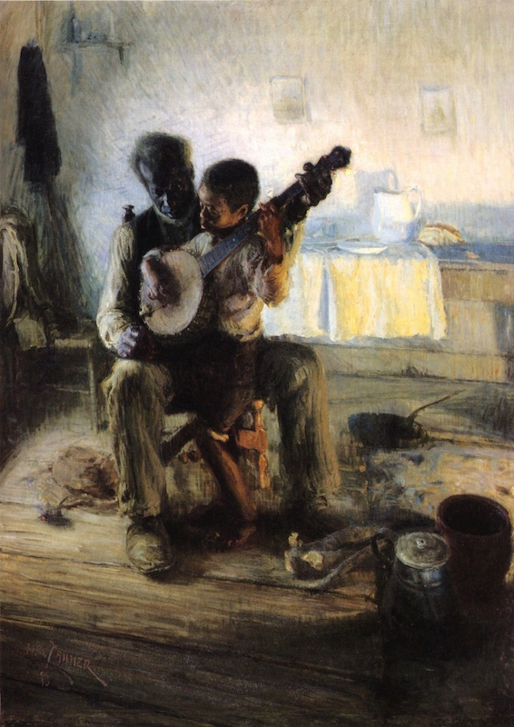
Colossians 2.1-5: Encouraged, Knit, and Wise
“…that their hearts may be encouraged, being knit together in love, to reach all the riches of full assurance of understanding and the knowledge of God’s mystery, which is Christ, in whom are hidden all the treasures of wisdom and knowledge.” Paul’s hope for the Colossians and the Laodiceans should be our goal as a congregation.

Slide 5
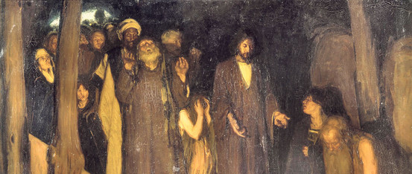
Colossians 2.6-10: See to it that no one takes you captive…
Paul’s key word: empty. The surrounding religion of the Colossian world was in pursuit of things that in the end, were meaningless. Nothing has changed. Those who try to “captivate” have nothing to build on.
Christ is everything – the fullness of hope, the key to the mystery, the King of all.

Slide 6
Colossians 2.11-15: Made Alive in Christ
The waters of baptism is God’s choice to show where and how a true believer dies and is raised in Christ.
Christ’s power and love are demonstrated on the cross. It is the humiliation of all other things, but the hope of all of us who believe.

Slide 7
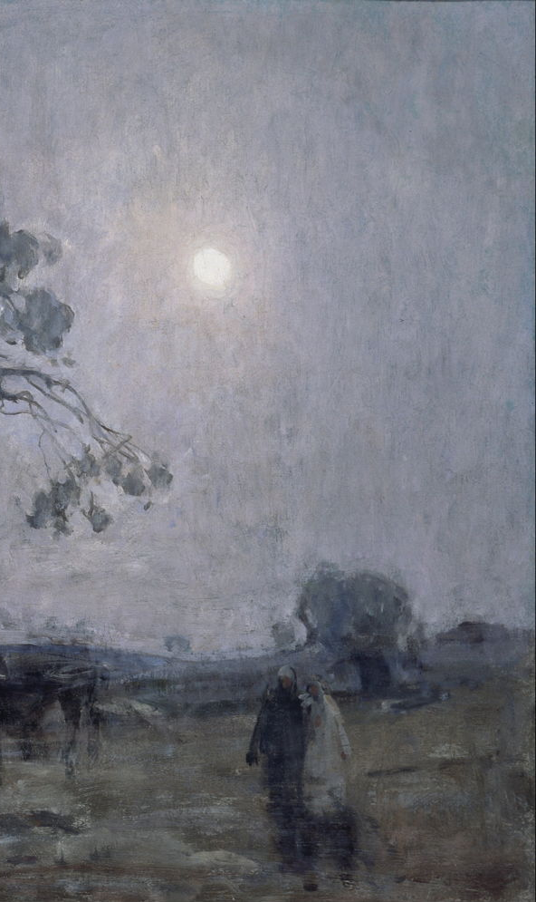
Application:
“…that their hearts may be encouraged, being knit together in love, to reach all the riches of full assurance of understanding and the knowledge of God’s mystery, which is Christ, in whom are hidden all the treasures of wisdom and knowledge.”
How can we be encouragers?
How can we be knit together in love?
How can we grow in understanding of God?

