Slide 1
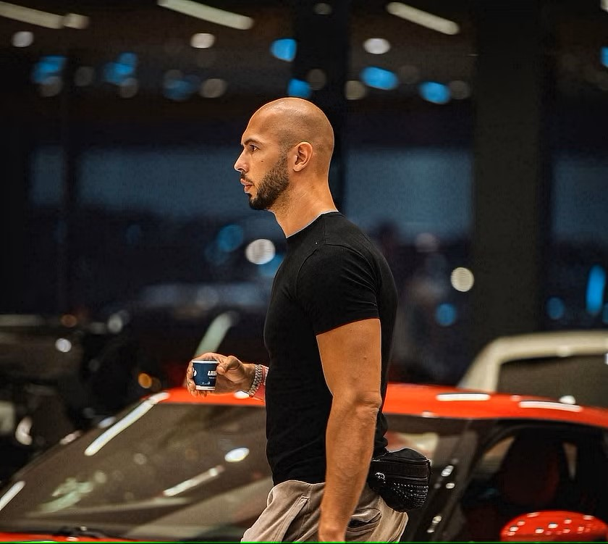
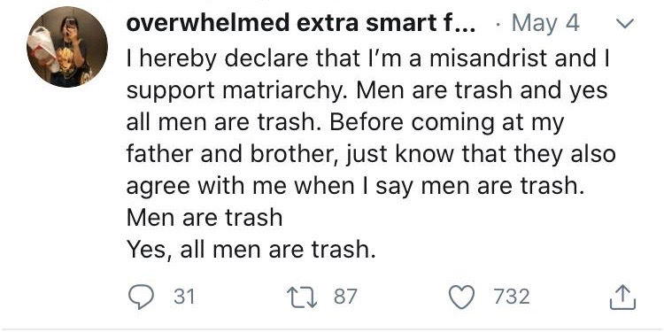
“I do know how to administer CPR. However, I will not administer CPR unless you’re a hot female… If you’re some fat dude and you just had a heart attack and I don’t really know you, you’re gonna die… No, not even if you’re a friend.”

Slide 2
The Ideal Man
We can learn a lot from good men, but we should only follow the ideal man: Jesus.

Slide 3
Being Protectors – John 8.2-11
The Pharisees were trying to abuse the word of God to trap Jesus and further their agenda. Jesus rebukes them.
This woman still had sin to be dealt with. Jesus commands her to pursue righteousness.
The duty of a man is to protect and serve those around them, not for fame or money, but because we want to live like Jesus.

Slide 4
Truth Tellers – John 8.31-47
In a post-modern, post-truth world, we need to say, like Jesus, true things.
We shouldn’t say offensive, provocative things just to cry oppression when we’re attacked back. The goal of any teaching is love and a pursuit of truth.
When others treat us horribly, we must have the self-control to do the right thing in all situations. That is true strength.

Slide 5
Deep Friendships – John 13.1-17
Friendships can be hard to uphold. But if Jesus places this much effort and care into them – shouldn’t we?
Sacrificial love, caring for others above ourselves, is the example Jesus has set. Do our friendships reflect this?
Toughness and vulnerability have their place in the life of a man.
All of our relationships should point to the glory of God and the selfless care He first showed to all of us.

Slide 6
Application
Read a gospel, your choice: Observe Jesus’ interactions with people as He shows what it means to truly be a man. Observe the way He treats His mother, His family, His friends, His enemies, women, children, etc. Let His perfect life challenge your growth and hold the men in your life accountable to the ideal.

