Slide 1
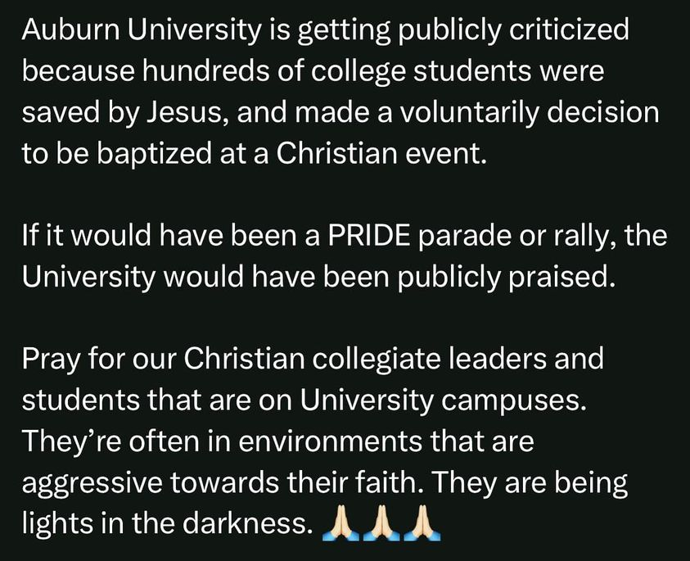

Slide 2
Why Christians Conform
Remembering our call to be different.

Slide 3
Hosea 11.1-12.1 – Forgetting our Identity
Israel had a special and sacred place in God’s heart. He had loved them, cared for them, and called them His own. However, their twisted desire lead them to trust in false gods and devious nations. They would rather eat wind than have the provision of God. They had forgotten whose children they were.
We are “Christians”. A title that means that we have surrendered everything over to God. When we forget the meaning is when we look to the world for meaning and approval. Trust the God who has loved you from the beginning!

Slide 4
Amos 6.1-17 – Forgetting our Mission
Israel’s special place to God has turned into laziness. They abused the blessing and had turned God’s good things into a pit of poison and wormwood. They had forgotten their role to be a light to the nations of the one true God. Instead, they were selfish, prideful, and lazy people.
So much foolishness happens when we stray off mission. When we receive so much from God, forgetting it isn’t ours, and forgetting we are to be sharing the good news and making disciples of all nations. We can’t forget our mission!

Slide 5
Malachi 2.1-9– Forgetting our Role
Israel’s priests didn’t think about the privilege of what it meant to be a priest. They had forgotten they were supposed to listen to God’s words and glorify Him as He rightly deserved. They did not lay it to heart. They treated God with dishonor, disrespect, and they treated his words with partiality.
As priests of God in our day, we have the same resposnibilites: to esteem God, to teach rightly, lead from inquity, listen to God’s words and live them our. When we stop listening to Him, that is when we conform.

Slide 6
How we stop conforming…
Never forget your God.
The importance of prayer, Bible reading, and meditation is that you are mindful of the greatness and wonder of God. You are appreciative of His power, His love, and His grace. When we are reminded of His greatness, He will be the only thing we want to conform to.
II. Being Accountable to the Family
God has given us one another for encouragement and strength. We are to proclaim His excellence to one another. But we can’t forget to hold one another accountable, with gentleness, respectfulness, and love. Uplifting one another will remind us that with God’s family is where we really belong.

