Slide 1
Faith in Difficulty

Slide 2
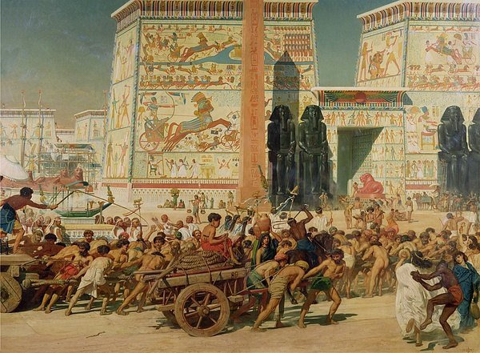
1st Test: The Physical Struggle
Major Struggles:
Slavery, Plagues, and Journey from Egypt
Life in the Wilderness
War Entering Canaan
God provides – with our effort
We must keep our faith throughout the struggles
Physical challenges shouldn’t be linked to truth

Slide 3
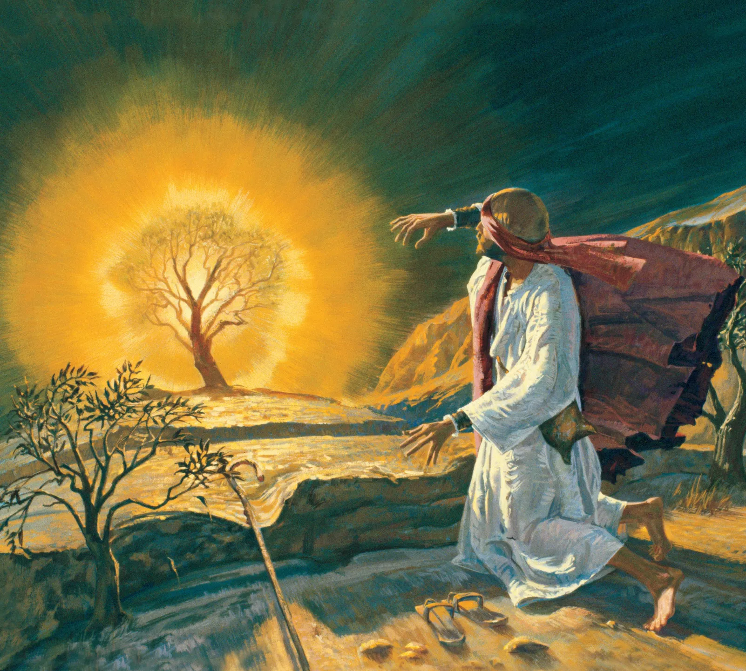
2nd Test: Accepting the Outsider
Moses was unsure if he would be accepted as the leader
His leadership was questioned – partly because he was viewed as an outsider
We need to accept and encourage newcomers
Jealousy, cliques, and personal issues can cause division
To those moving places: Be an encouragement to your new environment and don’t be afraid to step up

Slide 4
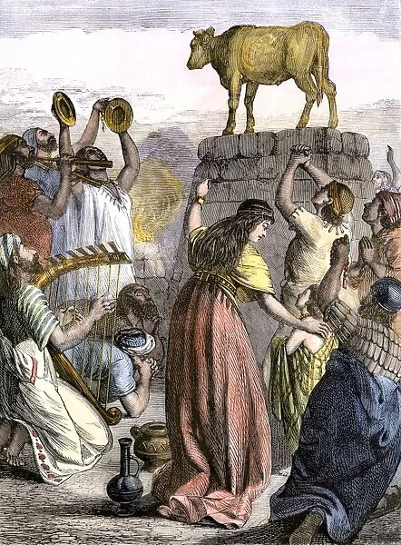
3rd Test: Faith in the Absence of Authority
The Israelites needed constant guidance to stay on the path
When Moses was gone for 40 days, they left God for an idol
As young adults, we have increasing amounts of freedom; we need to make good choices
It is important for our faith to be able to stand on its own

Slide 5
Moving Forward
When physical struggles come, turn toward God
If you’re going to a new place, try to be an encouragement
If not, be an encouragement for newcomers
Don’t allow your faith to depend on someone else

