Slide 1
Psalm 66:1-7

Slide 2
Psalm 66:1-7
Make a loud shout to God, all the earth;
Sing praise for the glory of His name; Establish His praise as glorious.
Say to God, “How fearsome are Your works! Because of the abundance of Your strength Your enemies will cower before You.
“All the earth will worship You, And will sing praises to You; They will sing praises to Your name.”
^{Selah.}

Slide 3
Psalm 66:1-7
Make a loud shout to God, all the earth;
Sing praise for the glory of His name; Establish His praise as glorious.
Say to God, “How fearsome are Your works! Because of the abundance of Your strength Your enemies will cower before You.
“All the earth will worship You, And will sing praises to You; They will sing praises to Your name.”
^{Selah.}
Come and see the works of God, Who is fearsome in His deeds toward the sons of men.
He turned the sea into dry land;
They passed through the river on foot;
^{There let us be glad in Him!}
^{He rules by His might forever;}
His eyes keep watch on the nations;
Let not the rebellious exalt themselves.
^{Selah.}

Slide 4
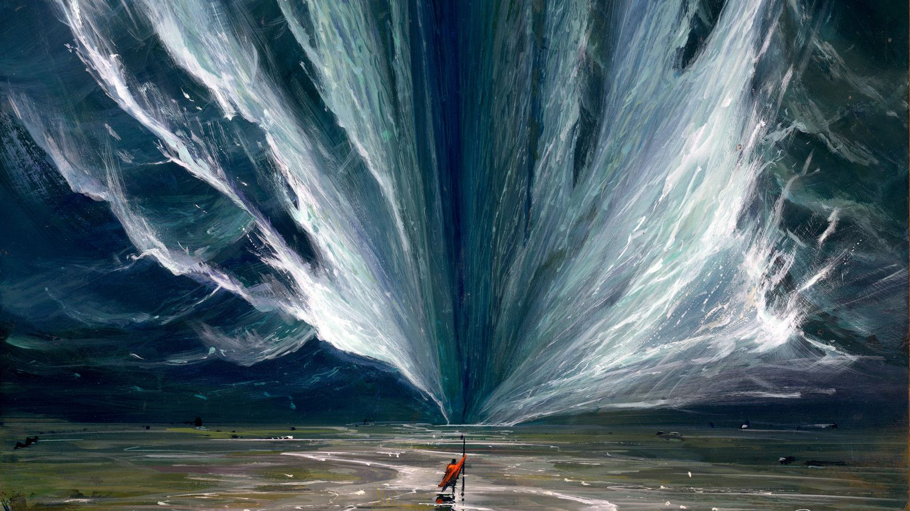
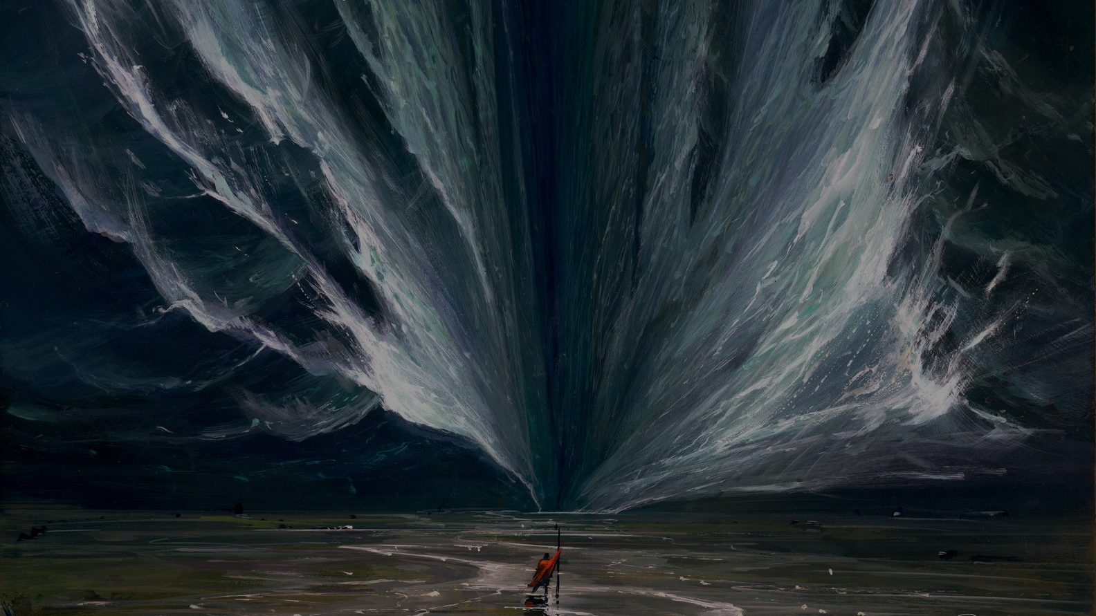

Slide 5
THE POWER OF GOD

Slide 6
THE POWER OF GOD
OUT FROM EGYPT

Slide 7
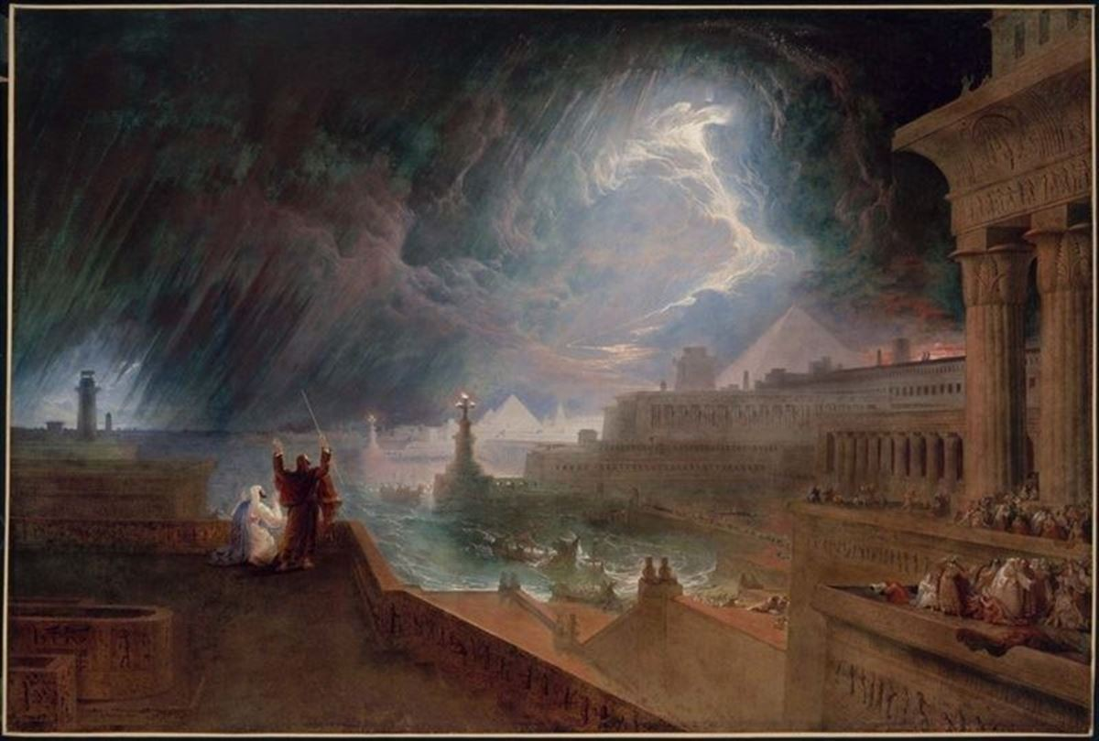

Slide 8
POWER PLAY

Slide 9
POWER PLAY
Imagine the pure horror of the plagues (Ex. 9:13-17)

Slide 10
POWER PLAY
Imagine the pure horror of the plagues (Ex. 9:13-17)
Where are your gods now?
(Ex. 9:18-21, 10:6-7)

Slide 11
POWER PLAY
Imagine the pure horror of the plagues (Ex. 9:13-17)
Where are your gods now?
(Ex. 9:18-21, 10:6-7)
God’s power is demonstrated in terror and restraint

Slide 12
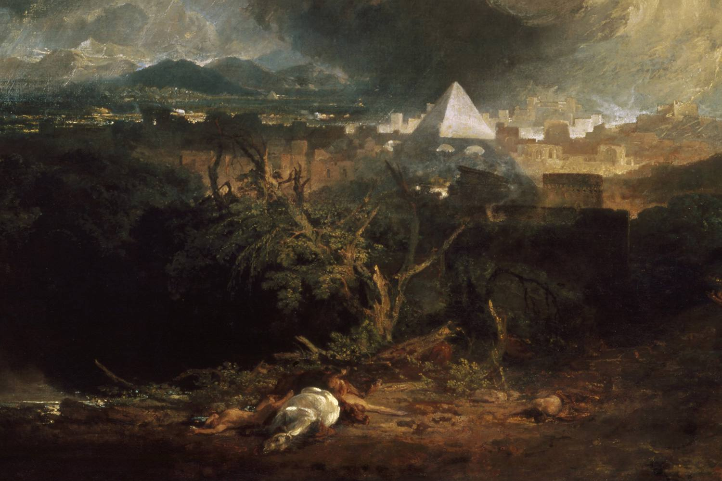

Slide 13
POWER TO SAVE

Slide 14
POWER TO SAVE
Unbridled, power is horror

Slide 15
POWER TO SAVE
Unbridled, power is horror
Why the process?
(Deut. 4:32-40)

Slide 16
POWER TO SAVE
Unbridled, power is horror
Why the process?
(Deut. 4:32-40)
The power of the plagues is also the power to save!
(Isa. 43:1-7)

Slide 17
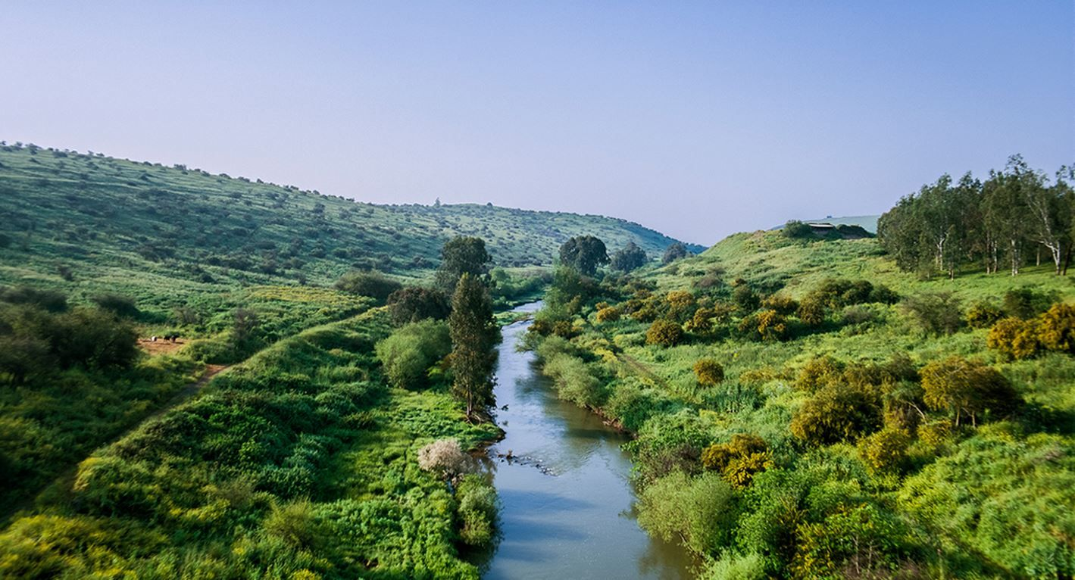

Slide 18
POWER TO CHOOSE

Slide 19
POWER TO CHOOSE
ROMANS 9:6-33

Slide 20
POWER TO CHOOSE
ROMANS 9:6-33
Why not do these signs again?

Slide 21
POWER TO CHOOSE
ROMANS 9:6-33
Why not do these signs again?
Did God give no escape?

Slide 22
POWER TO CHOOSE
ROMANS 9:6-33
Why not do these signs again?
Did God give no escape?
Would we be upset that He offered mercy to all?

Slide 23
POWER TO CHOOSE
ROMANS 9:6-33
Why not do these signs again?
Did God give no escape?
Would we be upset that He offered mercy to all?
You are in the seat of Pharaoh/Israel

Slide 24
POWER TO CHOOSE
ROMANS 9:6-33
Why not do these signs again?
Did God give no escape?
Would we be upset that He offered mercy to all?
You are in the seat of Pharaoh/Israel
“Let not the rebellious exalt himself!”

