Slide 2
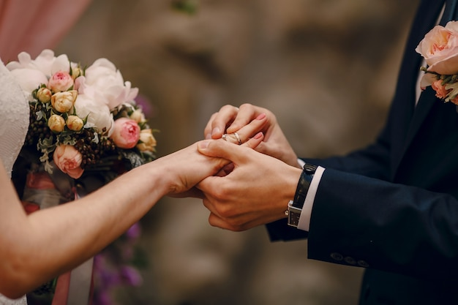
Ephesians 5:22-33

Slide 3
Ephesians 5:22-33
LOVE and RESPECT

Slide 4
Love and Respect
God created MAN and WOMAN.

Slide 5
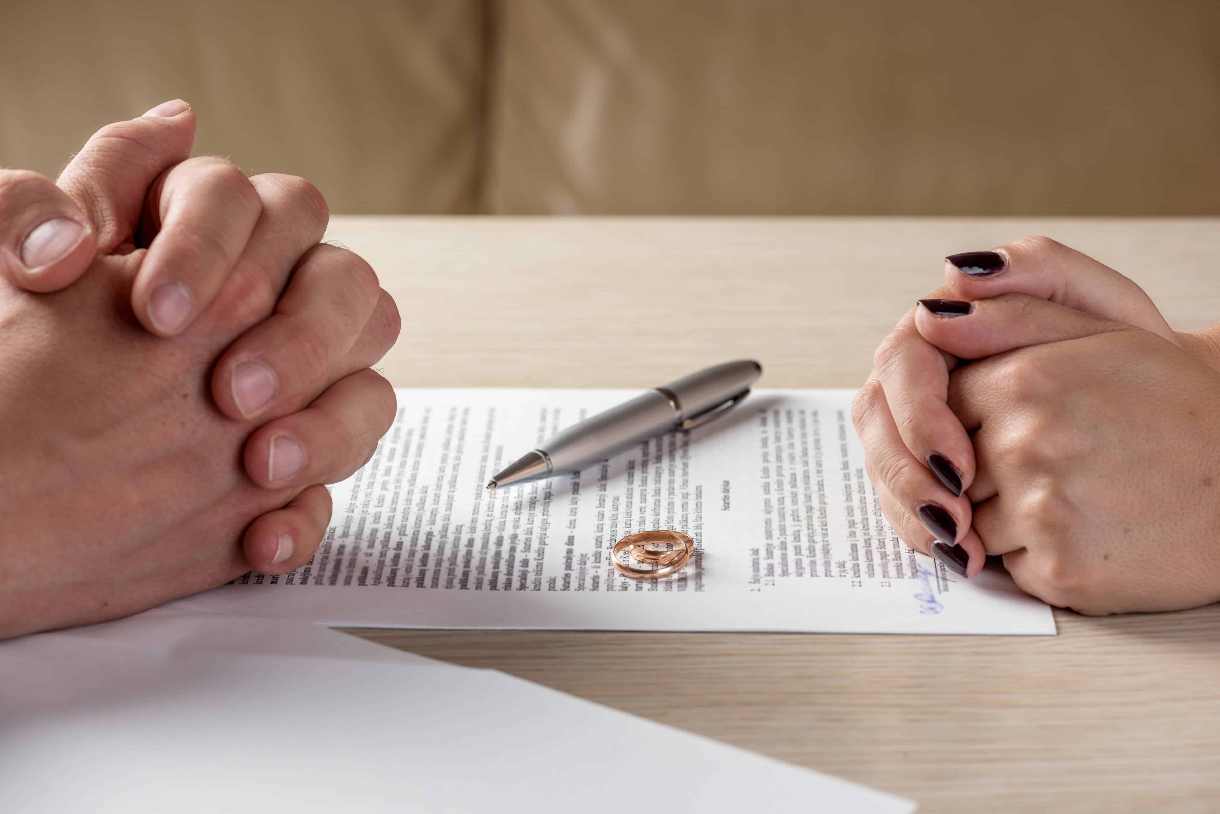

Slide 6
Love and Respect
God created MAN and WOMAN.
Men and women are different.

Slide 7
Love and Respect
God created MAN and WOMAN.
Men and women are different.
Matt 19:4-6-- ⁴ And He answered and said to them, “Have you not read that He who made them at the beginning ‘made them male and female, ⁵ and said, ‘For this reason a man shall leave his father and mother and be joined to his wife, and the two shall become one flesh’? ⁶ So then, they are no longer two but one flesh. Therefore what God has joined together, let not man separate.”

Slide 9
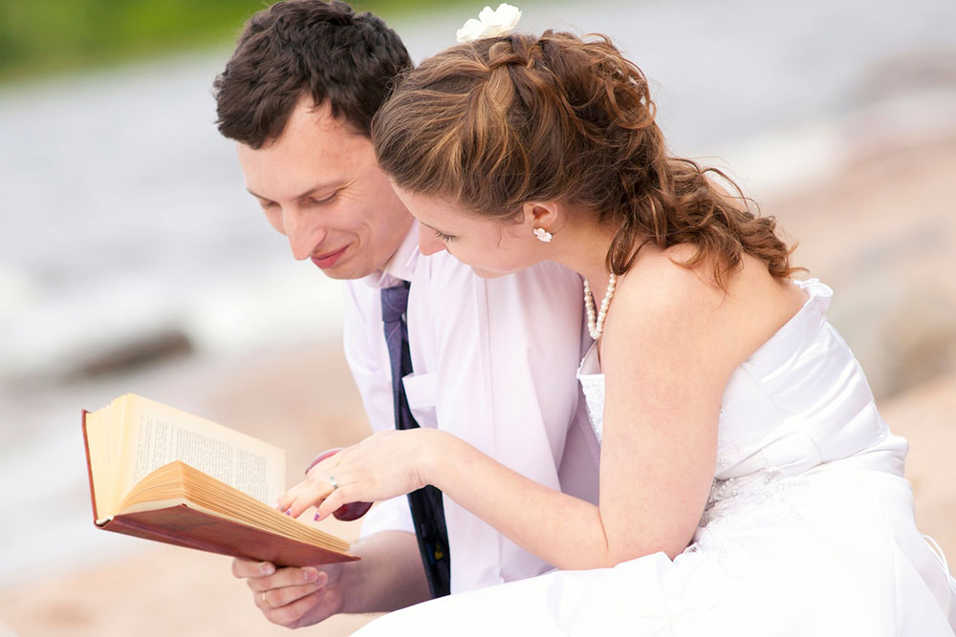
Love and Respect
God created MAN and WOMAN.
Men and women are different.
We all have a job to do– It’s not about you.

Slide 10
Love and Respect
God created MAN and WOMAN.
Men and women are different.
We all have a job to do– It’s not about you.
A man needs to “be a MAN.”

Slide 12
Love and Respect
God created MAN and WOMAN.
Men and women are different.
We all have a job to do– It’s not about you.
A man needs to “be a MAN.”

Slide 13
Love and Respect

Slide 14
Love and Respect

Slide 15
Love and Respect
Wives, respect your husband..
Φοβῆται=phobētai– fear, reverence, venerate.
1 Pet 3:5-6 ⁵ For in this manner, in former times, the holy women who trusted in God also adorned themselves, being submissive to their own husbands, ⁶ as Sarah obeyed Abraham, calling him lord, whose daughters you are if you do good and are not afraid with any terror.

Slide 16
Love and Respect

Slide 17
Love and Respect
Respect the role God gave him.
Tell him you are proud of him.
Make him feel important.
Make him feel like a man.
Understand his physical needs. 1 Cor 7:3-5

Slide 18
Love and Respect
His Needs
Sexual fulfillment.
Recreational companionship.
Attractive spouse.
Domestic support.
Admiration.
RESPECT

Slide 19
Love and Respect
Husbands, love your wives…..
Eph 5:25
25 Husbands, love your wives, just as Christ also loved the church and gave Himself for her, ….

Slide 20
Love and Respect
Husbands, love your wives…
Make her feel secure.
Express your love to her.
Honor her.

Slide 21
Love and Respect
Her Needs
Affection.
Communication
Honesty and openness.
Financial support.
Family Commitment
LOVE

Slide 22
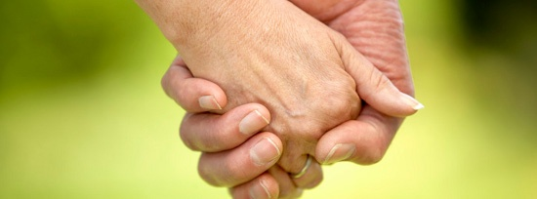
Love and Respect
Communicate.
Be honest about how you feel.
Stay committed.

