Slide 1
Our Heavenly Father
Matthew 5.38-6.18

Slide 2
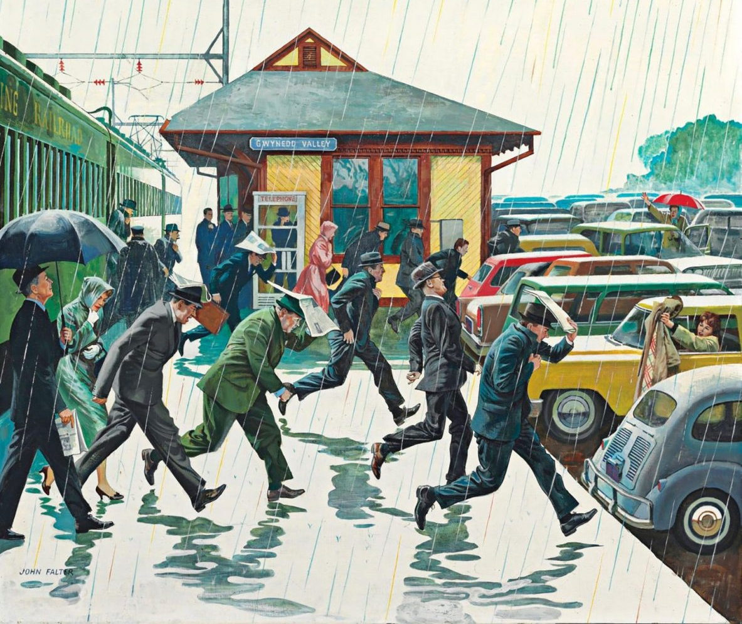
Matthew 5.38-48: Loving Those Who Hate Us
How people treat us usually determines how we treat them. But it isn’t the way that a kingdom citizen operates.
Despite how we are treated, we need to remember to whom we belong – the Father. His response even to His enemies is to bless them with rain.

Slide 3
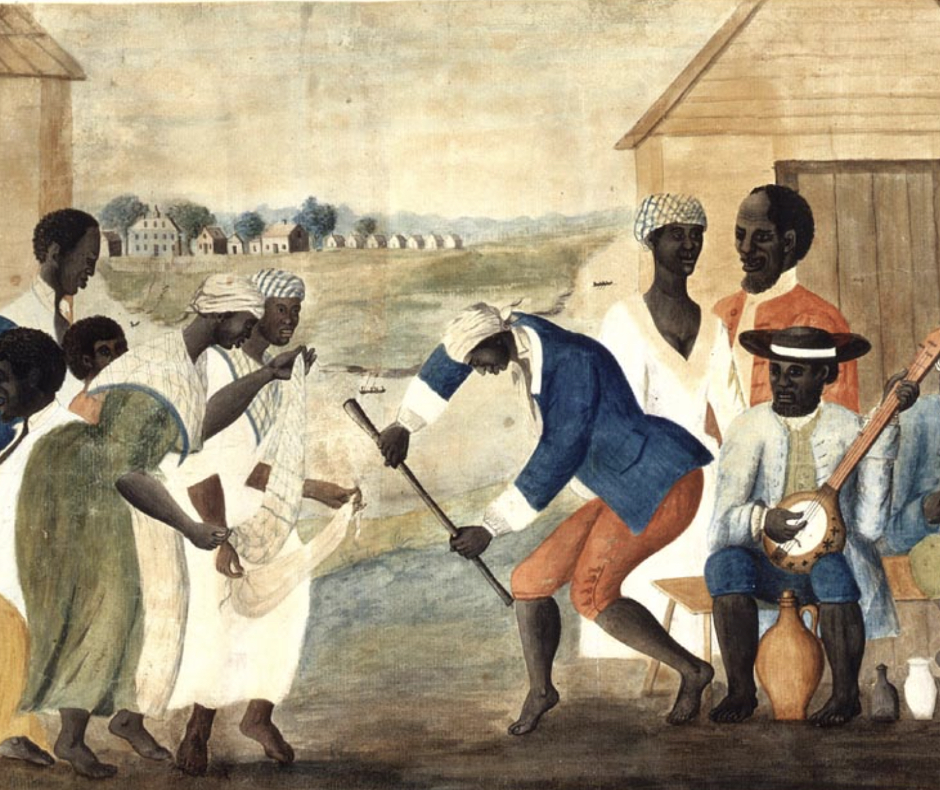
Matthew 6.1-4:
Performative Religion and Giving to the Needy
Hypocrite comes from the Greek word, “actor”. Religion that is a performance receives slight reward – from people. But not the everlasting reward with God.
Generosity should be obvious to the Christian. But what we need is to be motivated merely by pleasing God, not by being seen.

Slide 4
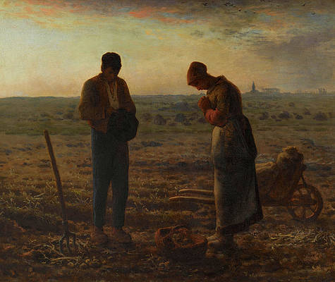
Matthew 6.5-8:
Performative Religion and Prayer
Prayer, as beautiful, but it can be corrupted if the motivation is about being seen.
Prayer is about the connection and intimacy with God – not about personally showing off our righteousness or vocabulary. Speak to the one who knows what you need before you say it.

Slide 5
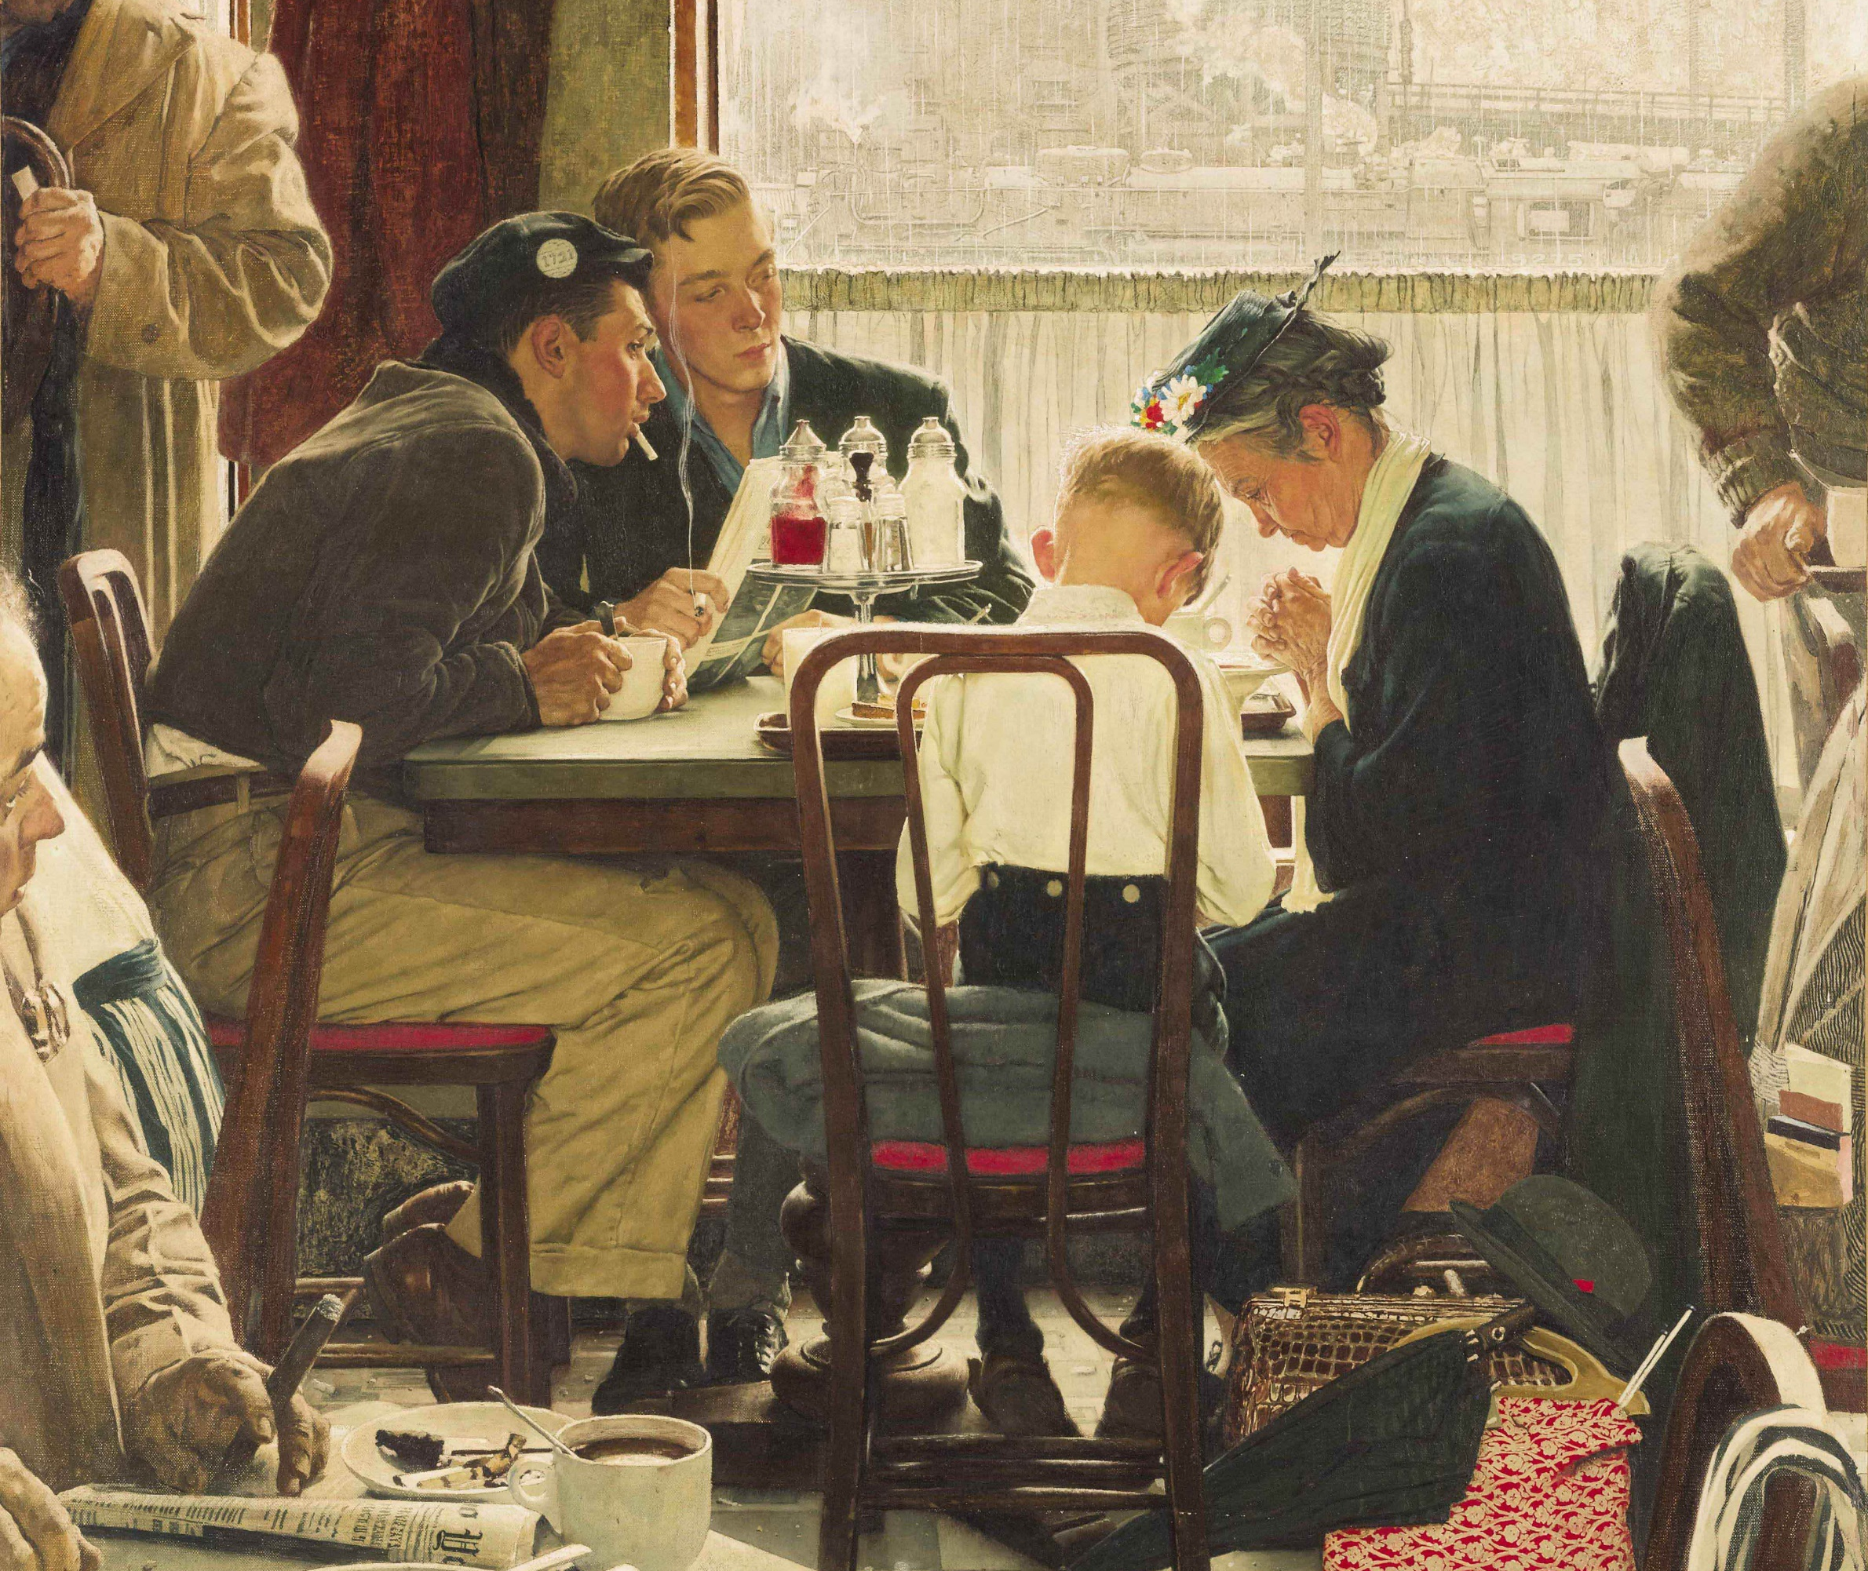
Matthew 6.9-15: The Lord’s Prayer
This prayer is the very center of Matthew’s organization of the Sermon on the Mount – the heartbeat of the believer.
This prayer orients first things first: God the Father, the glory of His name, and a focus on heaven.

Slide 6
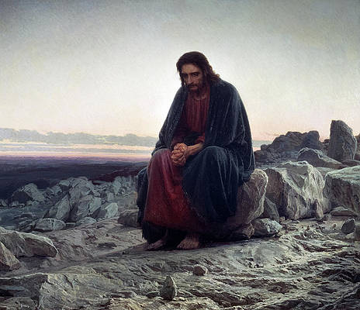
Matthew 6.5-8:
Performative Religion and Fasting
Fasting is a good and necessary for discipline. It becomes corrupted when it becomes a performance.
Fasting, like prayer, is about dependance. It proclaims that I do not live by the physical – I live by the strength that God alone can provide.

Slide 7
Meditation
What we learn about God: He is a being who can’t be fooled and sees right to the heart. What He desires is wholehearted worship, not self-serving performance.
What we learn about kingdom citizenship: We are to treat each person, friend and enemy alike, by how our loving Father has treated us, not how we have been treated by others.
What we learn about our lives in the world: Let them see our good works, our patience and zeal, but always remind them – it’s not so they’re impressed with us, but that God is honored. Invite them to experience what it means to love and serve the Lord.

