Slide 1
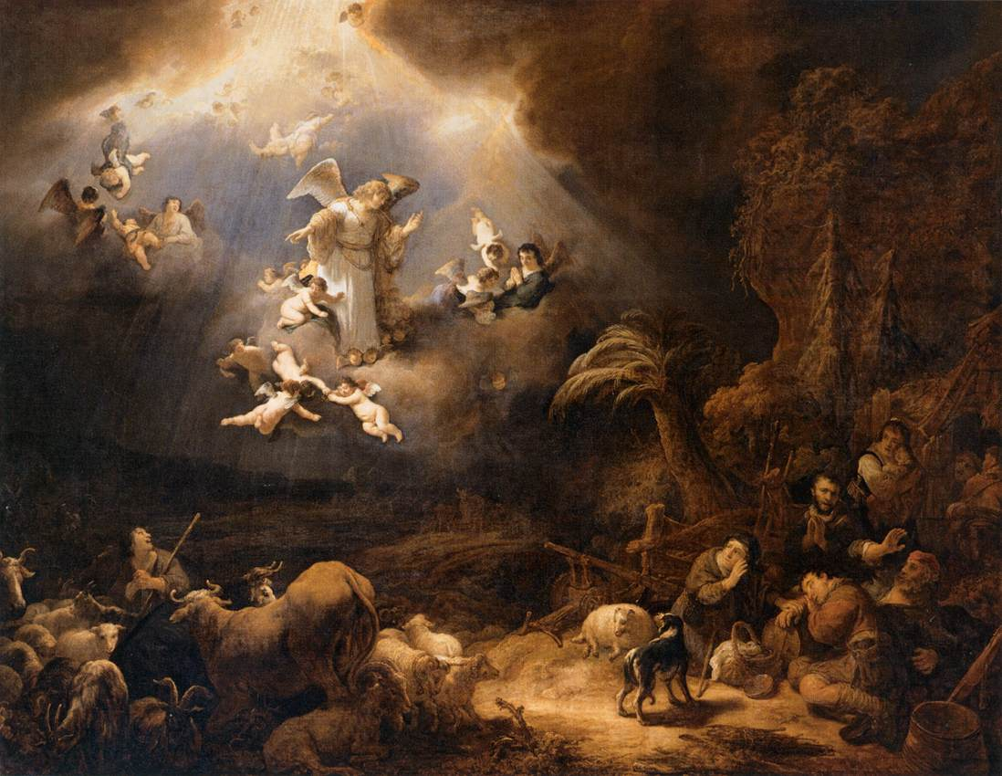
The Humble King

Slide 2
A King Who Needs to Be Humbled Daniel 4.28-37
Nebuchadnezzar was a king of the most powerful nation in the world at that time. But he had been warned about the consequences of his pride.
In God’s humiliation of Nebuchadnezzar, we also see his mercy – God will restore Him. But a lesson must be learned: “…the Most High rules the kingdom of men and gives it to whom he will.” (vs. 32)
Nebuchadnezzar does learn that lesson, but the question remains – who is the proper, humble king? Who will have the right to rule?

Slide 3
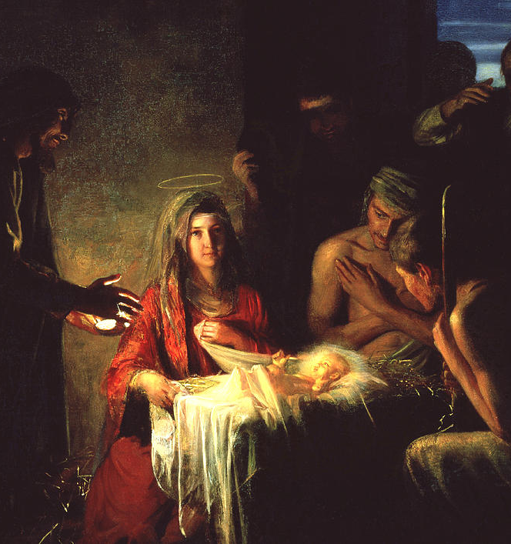
The Throne is a Manger Luke 2.1-7
The redemptive plan of God has God entering the world. But not in an impressive or royal way. But one of absolute humility.
He would be born to parents who would likely be despised by their community. They would be in the backwoods of the Roman empire. To the rest of the world, they were insignificant.
The God of all Creation, the King of Kings, comes into the world through humble means – His first bed being a feeding trough for animals.

Slide 4
“…he was called Jesus…” Luke 2.8-21
The great king has landed on the earth. Who would God announce this good news to?
God has chosen the humble to welcome to king.
Mary, the “servant girl of the Lord”
Joseph, the faithful betrothed from Nazareth
Shepherds, the humble occupation.
“Glory to God in the highest, and on earth peace among those with whom he is pleased!”

Slide 5
The Servant to the King Philippians 2.1-11
Knowing about Jesus, the humble king, should transform us as we follow Him.
We see that God has given us blessings and our response should be to have the same mind, the same love, and to put on humility.
Christ lived His live as a slave to His father and to humanity. Knowing of His humility, we need to, “Have this mind among yourselves, which is yours in Christ Jesus”…
Just as Christ emptied Himself and served, so also must we all.

