Slide 1
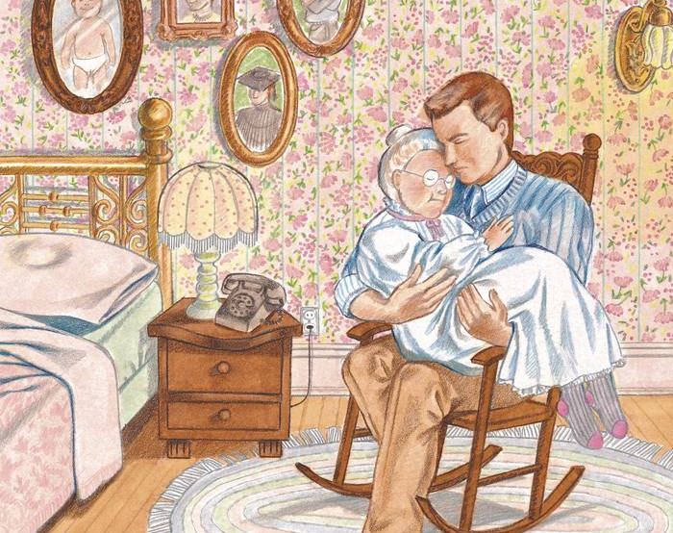
The Teknon and the Patria

Slide 2
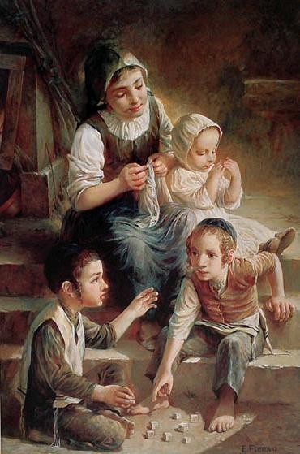
Children: Young and Growing
The first responsibility of young children is to learn obedience to God through obeying the instruction of their parents.

Slide 3
Children: Young and Growing
The first responsibility of young children is to learn obedience to God through obeying the instruction of their parents.
These responsibilities become more difficult but are just as important when children begin to become young adults.

Slide 4
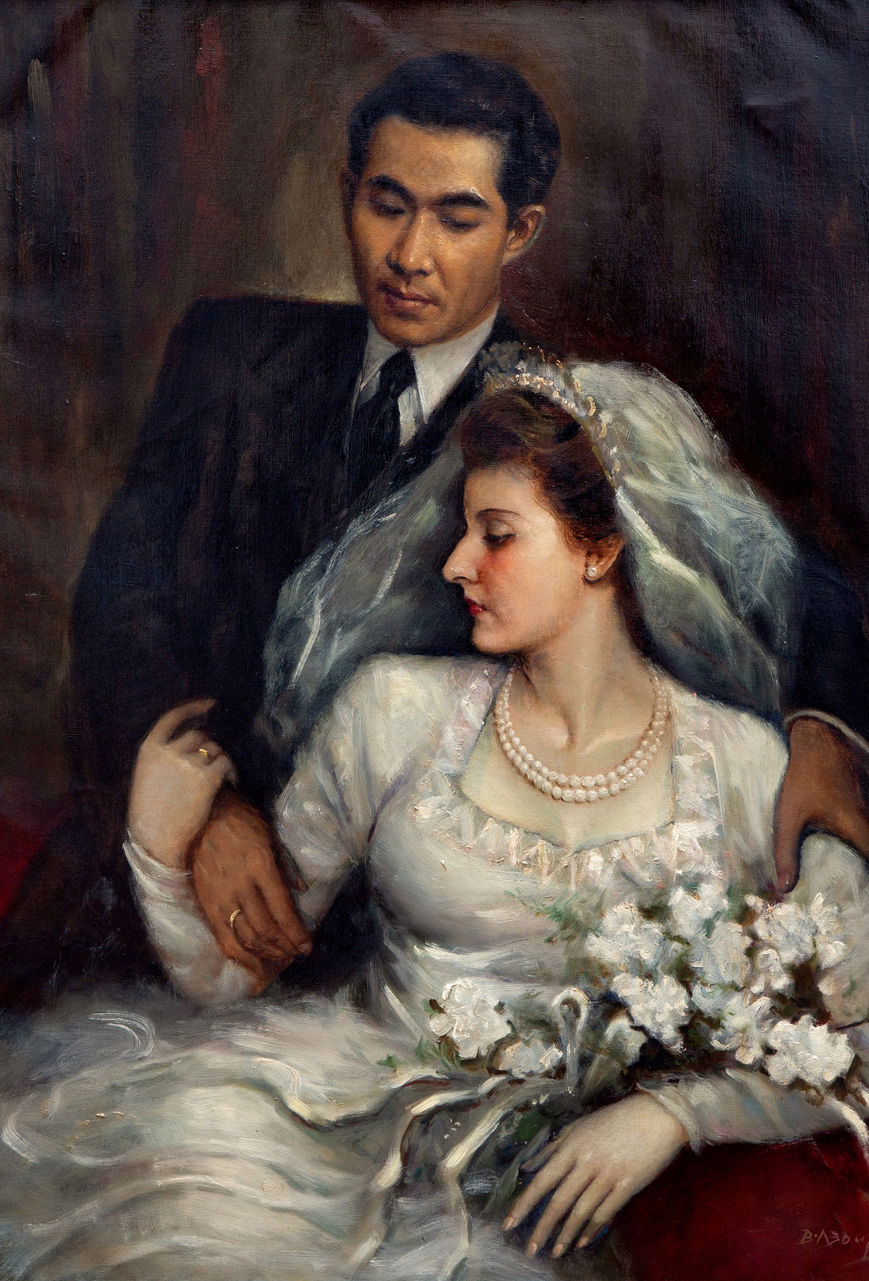
Children: Forming Their Own Families
The concept of “adulthood” is a little difficult to pin down—where exactly do we mark that this transition takes place?

Slide 5
Children: Forming Their Own Families
The concept of “adulthood” is a little difficult to pin down—where exactly do we mark that this transition takes place?
We should note that there are at least Biblical principles of those who are clearly not adolescents still deferring to their parents wishes.

Slide 6
Children: Forming Their Own Families
Even young married couples stand to benefit from at least seeking input from their parents on important decisions.

Slide 7
Children: Forming Their Own Families
Even young married couples stand to benefit from at least seeking input from their parents on important decisions.
Regardless of relationship, parents should still be respected.

Slide 8
Children: Forming Their Own Families
Even young married couples stand to benefit from at least seeking input from their parents on important decisions.
Regardless of relationship, parents should still be respected.

Slide 9
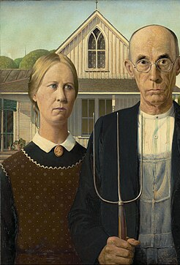
Children: Honoring Ageing Parents w/Piety
Children are charged with the care of their parents in their final years.

Slide 10
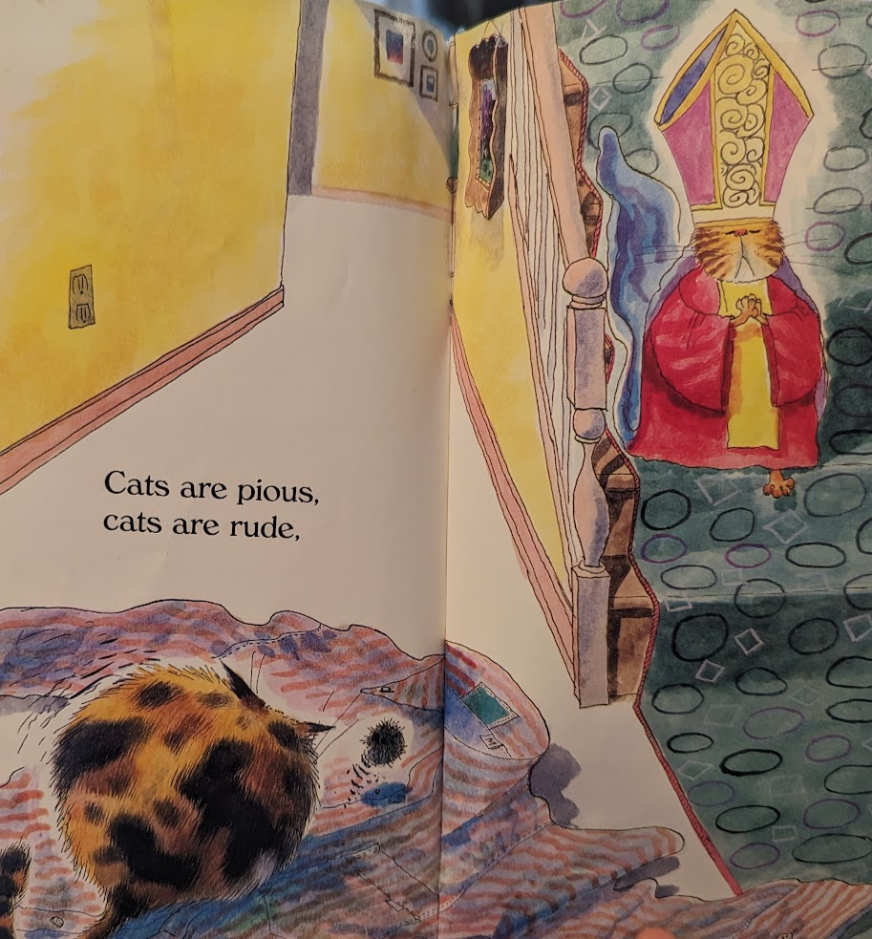

Slide 11
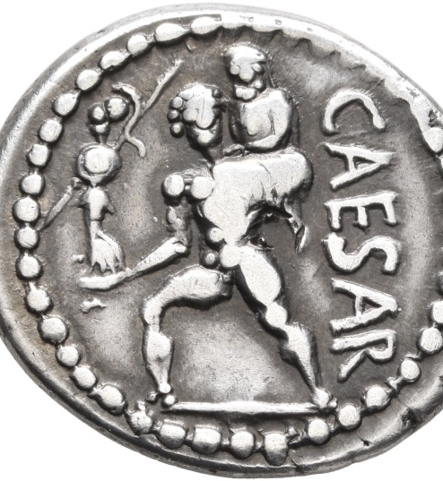
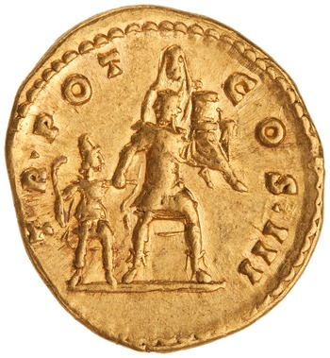

Slide 12
Children: Honoring Ageing Parents w/Piety
Children are charged with the care of their parents in their final years.
Piety, translated in various ways, calls on us to show devotion, honor, and a sense of duty or obligation.

Slide 13
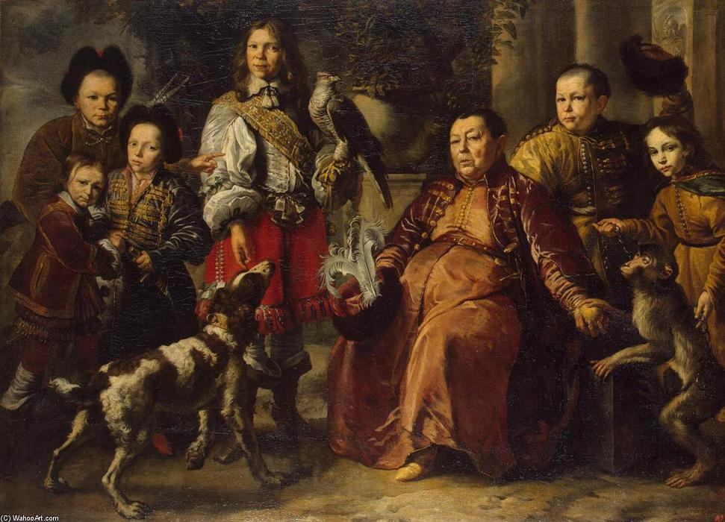
Thinking Ahead
Obey
Respect
Care

