Slide 1
Introduction and Context of Philippians

Slide 2
The Macedonian Call – Acts 16.6-10
Paul’s intentions to go and teach in Bithynia were stopped by God. When God stops our plans, we should still be seeking serve Him where we are.
Paul does not hesitate when He has his vision. He is ready to go wherever to bring the good news.

Slide 3
Entering Philippi and Lydia – Acts 16.11-15
Philippi is a “leading city”: a place of rich history but it was a Roman colony – a “little Rome”. Could the gospel thrive here?
Lydia and her household accept the good news and immediately offers her kindness to her new family. The church at Philippi’s founding member was filled with compassion.

Slide 4
Freeing and Imprisoning – Acts 16.16-24
Paul frees a woman with dual – oppression: by demon and by man. The power of Christ frees the exploited.
The men’s dishonesty is clear: stirring up the crowd based on ethnicity, disturbance, and foreign customs.
The leaders of the city buy into the mob and beat Paul and Silas unjustly without doing their due diligence.

Slide 5
Believe in the Lord Jesus– Acts 16.25-34
How do we react to when we’re done wrong? Paul and Silas show us the way – praising God.
Even when God frees them and they could escape free, the love of God compels them to stay for the sake of their imprisoner. The gospel demands our love.
The jailer understands his need and receives salvation that very night.

Slide 6
Defending the Young Church – Acts 16.35-40
Paul and Silas could have insisted on their rights yesterday – why did they do it today?
It’s to protect the reputation of the young church they were going to have to leave behind.
They encouraged the group and left. This would be one of the very few times Paul would ever visit. It adds to the importance of the letter.

Slide 7
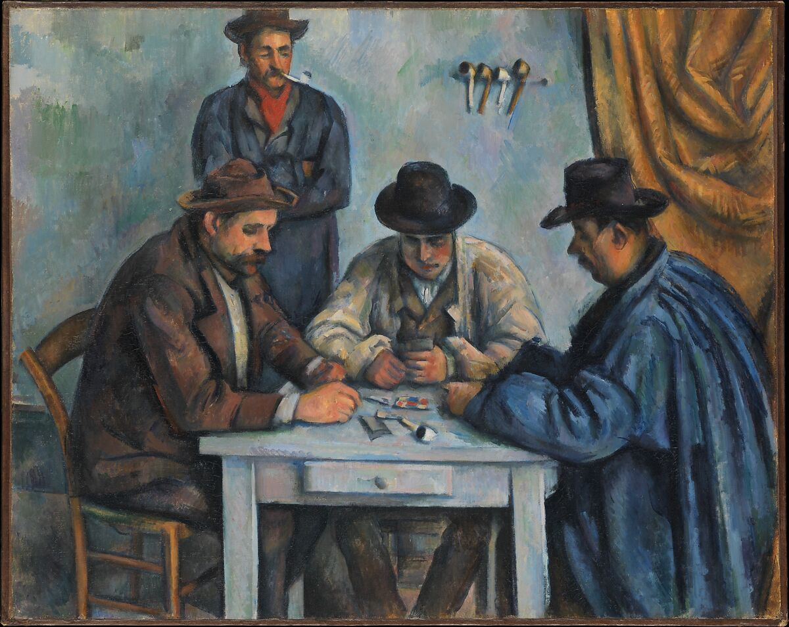
Unity Found in Christ
Other main themes:
Service
Joy
Peace

