Slide 1
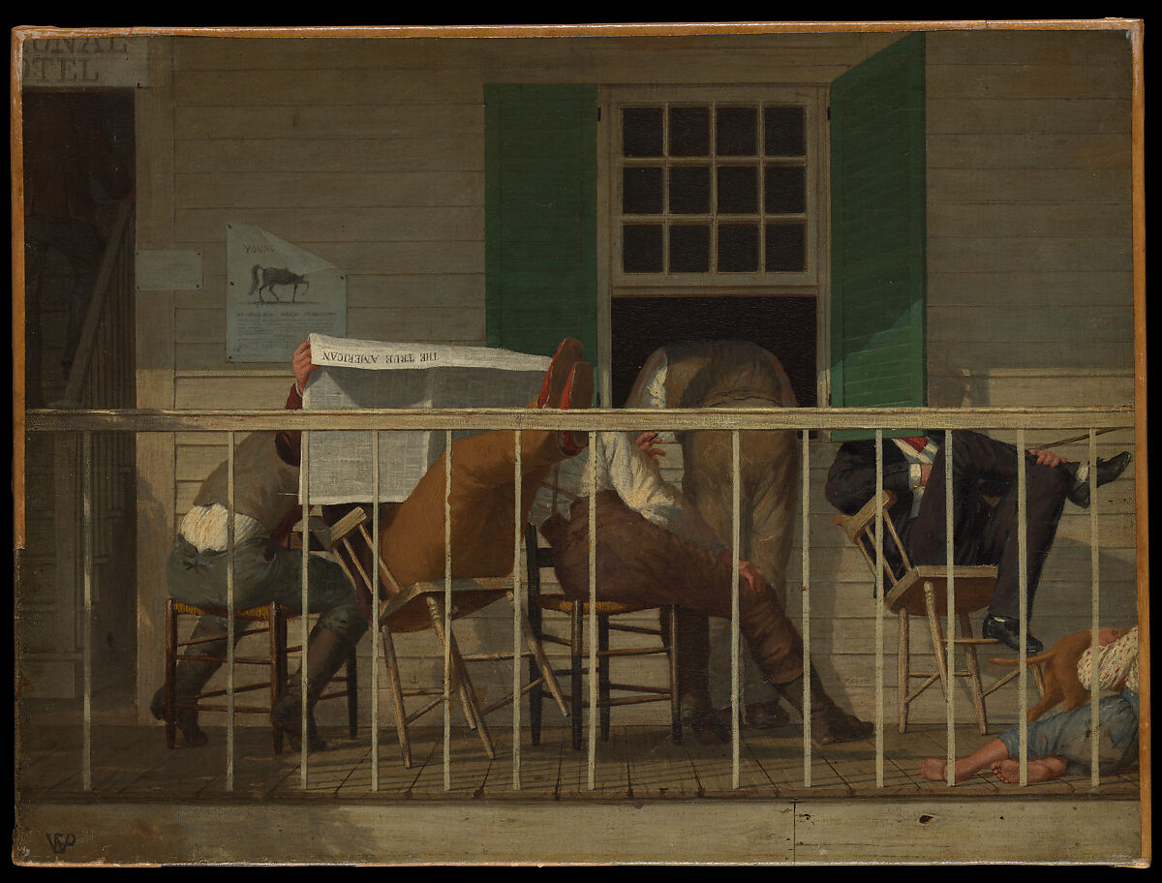
Unity in Christ
Philippians 2.1-30:
Have this Mind

Slide 2
Philippians 2.1-4 – Count Others More Significant
We’re called on to be thoughtful about how we have been loved and served both by God and by others.
To best honor Christ, we must reject conceit and pursue humility.
We need to consider the needs of others above ourselves.

Slide 3
Philippians 2.5-11 – Emptied
The ultimate display of humility that we’re called to reflect on is Christ.
He was humbled in multiple ways: God taking human flesh, a human enslaved to other humans, and He submits to a cruel death.
But Jesus’ humility leads to glory. Even Caesar will bow the knee to Jesus, as all will.

Slide 4
Philippians 2.12-18 - Children of God
Christianity is not a faith for the lazy. It demands our full effort. But the comfort is that God is with us, ultimately making it work – and what He’s creating in us gives Him joy.
Children of God are to be lights. Grumbling and complaining demonstrates selfishness and ingratitude. How are we different than the world?
Paul demonstrates this mind like Christ – pouring himself out sacrificially for the sake of the Philippians. We ought to be the same.

Slide 5
Philippians 2.19-30 Ministers to the Needs
Paul doesn’t abruptly change the subject: instead he reflects on two men who demonstrate humility.
From Timothy, we learn of genuine concern. He is a servant who desires to help where he’s needed.
From Epaphroditus, we learn of sacrifice. For the sake of Paul and the Philippians, he almost died seeking to serve. He is a joy bringer.

Slide 6
For Meditation
Service: Who have you thought you’re better than? How can you serve that person?
Joy: To serve unites us in joy. Put other people first and enter joy together.
Peace: Especially in an election year, make sure someone you disagree with knows you love them.

