Slide 1
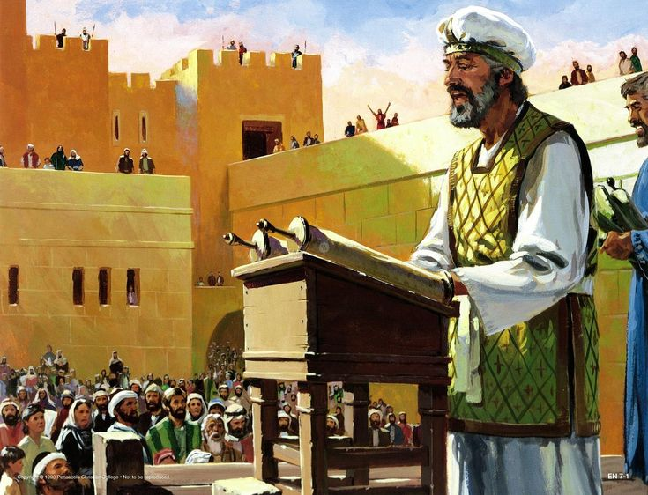
A Royal Priesthood:
Christians as Priestly Messengers and Teachers

Slide 2
We Are a Royal Priesthood

Slide 3
We Are a Royal Priesthood
Deuteronomy 7:6 -Chosen People.

Slide 4
We Are a Royal Priesthood
Deuteronomy 7:6 -Chosen People.
Exodus 19:6 -Kingdom of Priests, Holy Nation.

Slide 5
We Are a Royal Priesthood
Deuteronomy 7:6 -Chosen People.
Exodus 19:6 -Kingdom of Priests, Holy Nation.
Deuteronomy 26:18 -His Special People.

Slide 6
We Have Priestly Responsibilities
Every christian now takes on the responsibilities of the priests.

Slide 7
We Have Priestly Responsibilities
Every christian now takes on the responsibilities of the priests.
One of their biggest responsibilities was to teach the law.

Slide 8
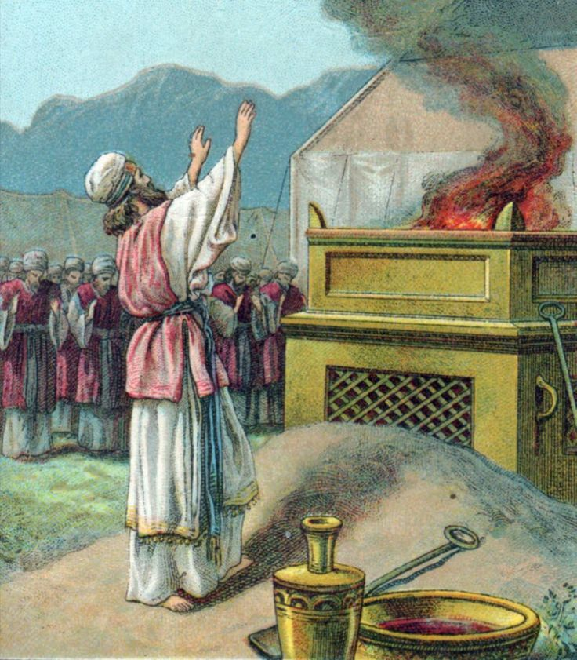
The Priests were the Teachers:
Sacrificing and the rituals of worship were only a small part of the priestly duties. 1 Chronicles 24:1-19.

Slide 9
The Priests were the Teachers:
Sacrificing and the rituals of worship were only a small part of the priestly duties. 1 Chronicles 24:1-19.
What did they do for the rest of the year?

Slide 10
The Priests were the Teachers:
Sacrificing and the rituals of worship were only a small part of the priestly duties. 1 Chronicles 24:1-19.
What did they do the rest of the year? They taught the word.

Slide 11
The Priests were the Teachers:
Leviticus 10:11 “and that you may teach the children of Israel all the statutes which the LORD has spoken to them by the hand of Moses.”

Slide 12
The Priests were the Teachers:
Leviticus 10:11 “and that you may teach the children of Israel all the statutes which the LORD has spoken to them by the hand of Moses.”
Deuteronomy 24:8 “Take heed in an outbreak of leprosy, that you carefully observe and do according to all that the priests, the Levites, shall teach you; just as I commanded them, so you shall be careful to do.”

Slide 13
The Priests were the Teachers:
What happened if they fail to teach?

Slide 14
The Priests were the Teachers:
What happened if they fail to teach?
When the priests failed to teach, the people almost always fell away. Malachi 2:7-8.

Slide 15
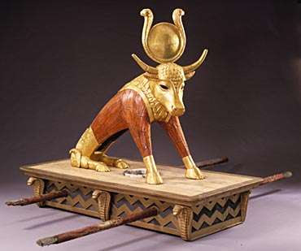
The Priests were the Teachers:
What happened if they fail to teach?
When the priests failed to teach, the people almost always fell away. Malachi 2:7-8.

Slide 16
The Priests were the Teachers:
What happened if they fail to teach?
When the priests failed to teach, the people almost always fell away. Malachi 2:7-8.
2 Chronicles 15:3-6:

Slide 17
The Priests were the Teachers:
What happened if they fail to teach?
When the priests failed to teach, the people almost always fell away. Malachi 2:7-8.
2 Chronicles 15:3-6:
Lamentations 4:13-14:

Slide 18
The Priests were the Teachers:
What happened when they taught the word?

Slide 19
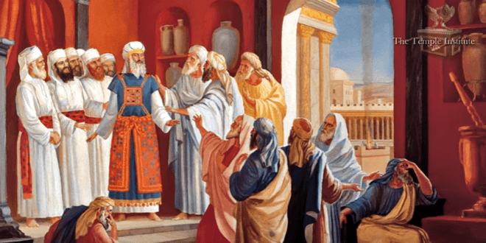
The Priests were the Teachers:
What happened when they taught the word?
The nation prospered and God was glorified. 2 Chronicles 17:8-9.

Slide 20
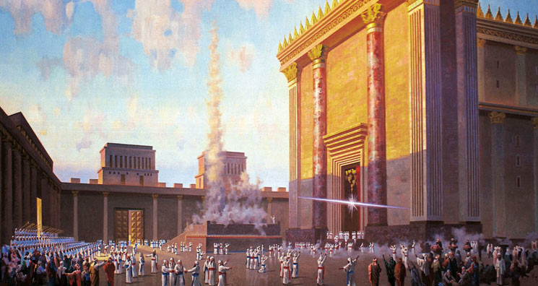

Slide 21
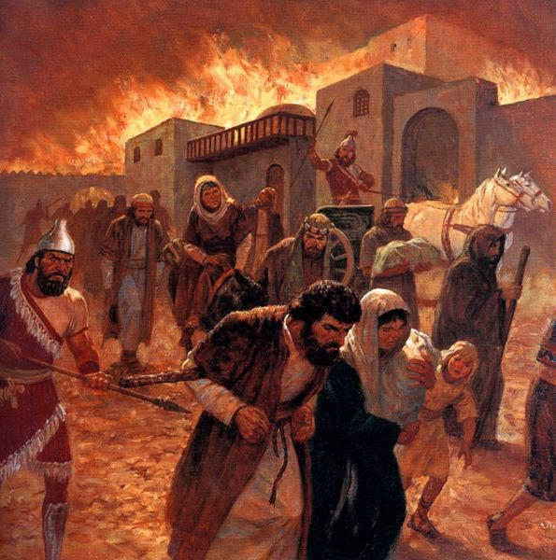
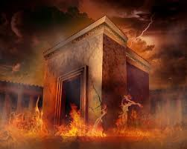

Slide 22
As Priests, We are now the Teachers

Slide 23
As Priests, We are now the Teachers
We are divinely obligated to know and teach God’s word. Matthew 28:19-20.

Slide 24
As Priests, We are now the Teachers
We are divinely obligated to know and teach God’s word. Matthew 28:19-20.
Keepers of His knowledge,

Slide 25
As Priests, We are now the Teachers
We are divinely obligated to know and teach God’s word. Matthew 28:19-20.
Keepers of His knowledge, Those who can be sought for answers,

Slide 26
As Priests, We are now the Teachers
We are divinely obligated to know and teach God’s word. Matthew 28:19-20.
Keepers of His knowledge, Those who can be sought for answers, Messengers of God. Malachi 2:7.

Slide 27
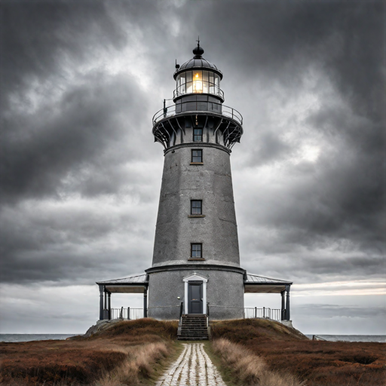
As Priests, We are now the Teachers
Ezekiel 33:7-9. Watchman of Israel.

Slide 28
As Priests, We are now the Teachers
Ezekiel 33:7-9. Watchman of Israel.
Why would Ezekiel be responsible if he did not warn the people?

Slide 29
As Priests, We are now the Teachers
Ezekiel 33:7-9. Watchman of Israel.
Why would Ezekiel be responsible if he did not warn the people? He was given the word of God.

Slide 30
As Priests, We are now the Teachers
The principle in Ezekiel 33 applies to us as God’s priestly messengers.

Slide 31
As Priests, We are now the Teachers
The principle in Ezekiel 33 applies to us as God’s priestly messengers.
We were given the word of God. 1 Peter 1:25.

Slide 32
As Priests, We are now the Teachers
The principle in Ezekiel 33 applies to us as God’s priestly messengers.
We were given the word of God. 1 Peter 1:25.
All who were given the word have a responsibility to teach it. Mark 16:15.

Slide 33
As Priests, We are now the Teachers
Many who should be teachers who are not. Hebrews 5:12.

Slide 34
As Priests, We are now the Teachers
Many who should be teachers who are not. Hebrews 5:12.
No one can be blamed but you.

Slide 35
How can we be Priestly Teachers?

Slide 36
How can we be Priestly Teachers?
Teach from house to house. Acts 20:20.

Slide 37
How can we be Priestly Teachers?
Teach from house to house. Acts 20:20.
Teach by inviting to your own house. Luke 5:27-29.

Slide 38
How can we be Priestly Teachers?
Teach from house to house. Acts 20:20.
Teach by inviting to your own house. Luke 5:27-29.
Teach one another privately when one is in error. Acts 18:24-26.

Slide 39
How can we be Priestly Teachers?
Teach from house to house. Acts 20:20.
Teach by inviting to your own house. Luke 5:27-29.
Teach one another privately when one is in error. Acts 18:24-26.
Teach while you’re out working. Colossians 3:17.

Slide 40
How can we be Priestly Teachers?
Teach from house to house. Acts 20:20.
Teach by inviting to your own house. Luke 5:27-29.
Teach one another privately when one is in error. Acts 18:24-26.
Teach while you’re out working. Colossians 3:17.
Teach by example in difficult situations. Philippians 1:12-13, Acts 28:30-31.

Slide 41
How can we be Priestly Teachers?
There is a way for everyone to teach.

Slide 42
How can we be Priestly Teachers?
The main point is that we are Christ’s priests,

Slide 43
How can we be Priestly Teachers?
The main point is that we are Christ’s priests, we have been entrusted with God’s word,

Slide 44
How can we be Priestly Teachers?
The main point is that we are Christ’s priests, we have been entrusted with God’s word, and it is our duty to know and spread that word.

Slide 45
We Must Teach
When we fail to teach, others will fall away.

Slide 46
We Must Teach
We have been honored by God because He gave us the title of “royal Priests”

Slide 47
We Must Teach
We have been honored by God because He gave us the title of “royal Priests”
The title comes with responsibilities.

